Slide 1





BATNA in Negotiations Template
Video Tutorial Link: https://youtu.be/u7Kv7Y7SgEk?si=RAaNRYW2f6qXLghx

Slide 2

Let me introduce myself

Slide 3
BATNA may be a central aspect of negotiations but MLATNA and WATNA should also be considered to have a good idea of your negotiation position.

Slide 4
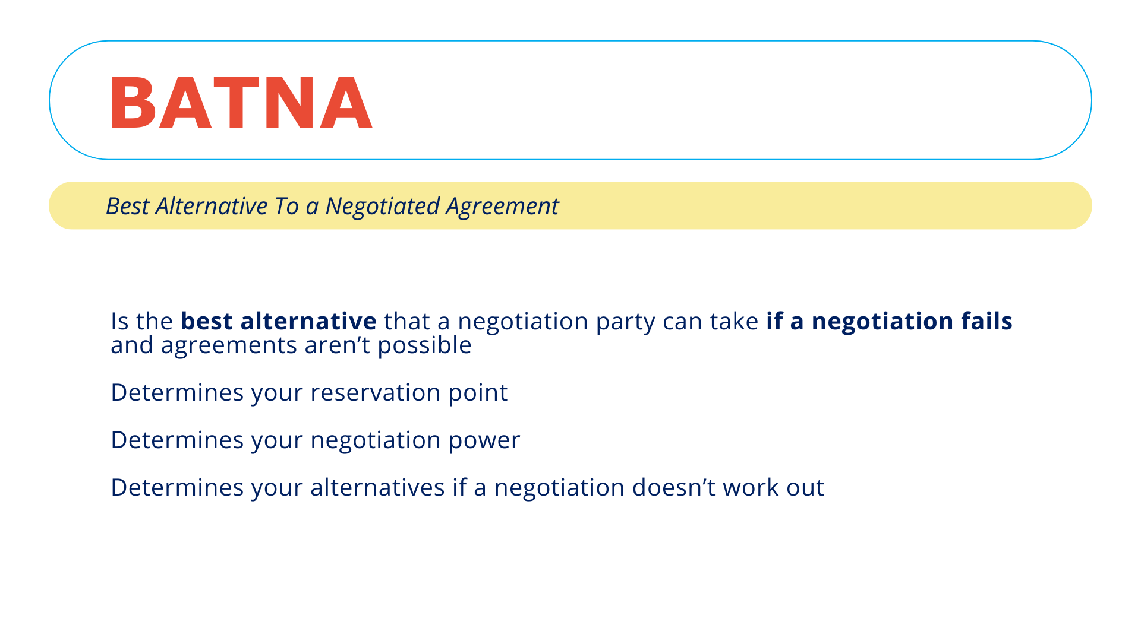

Slide 5
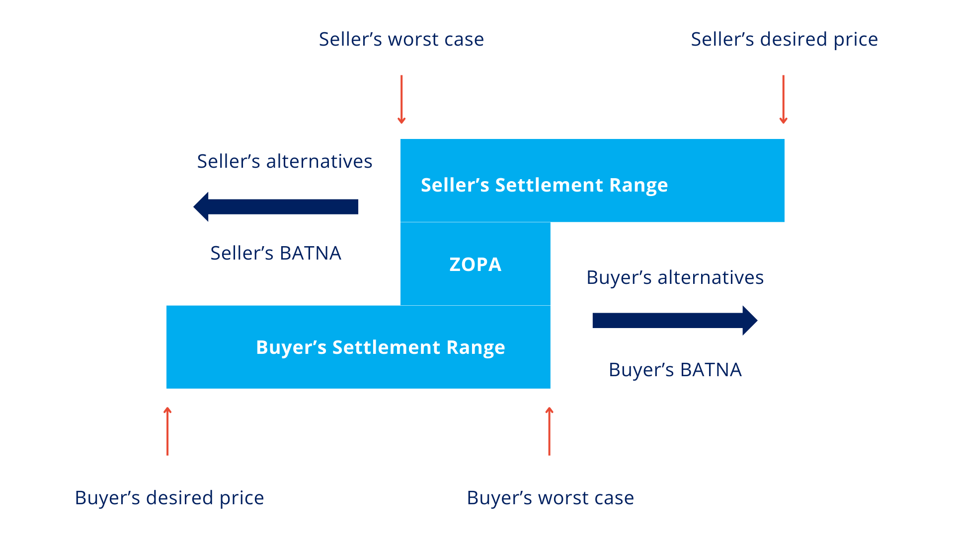
BATNA Illustration

Slide 6
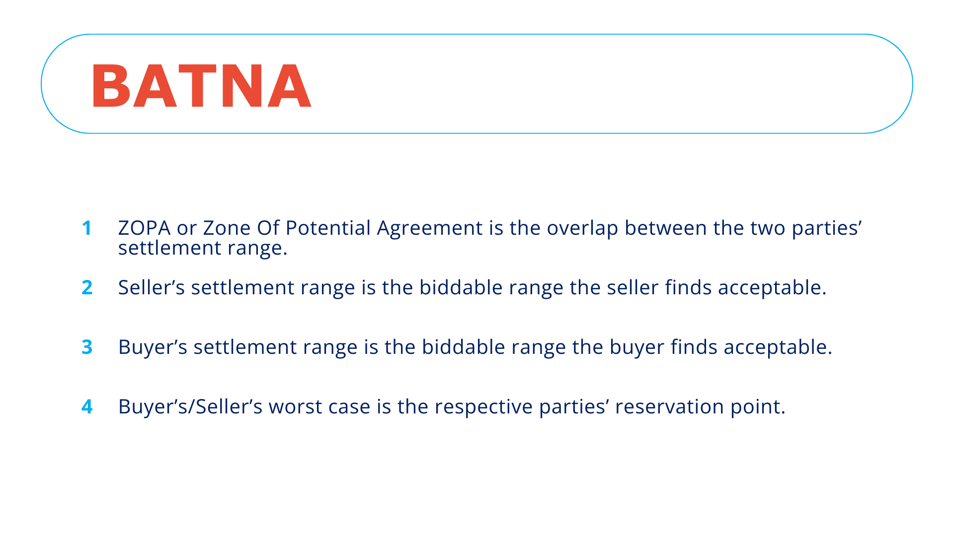

Slide 7
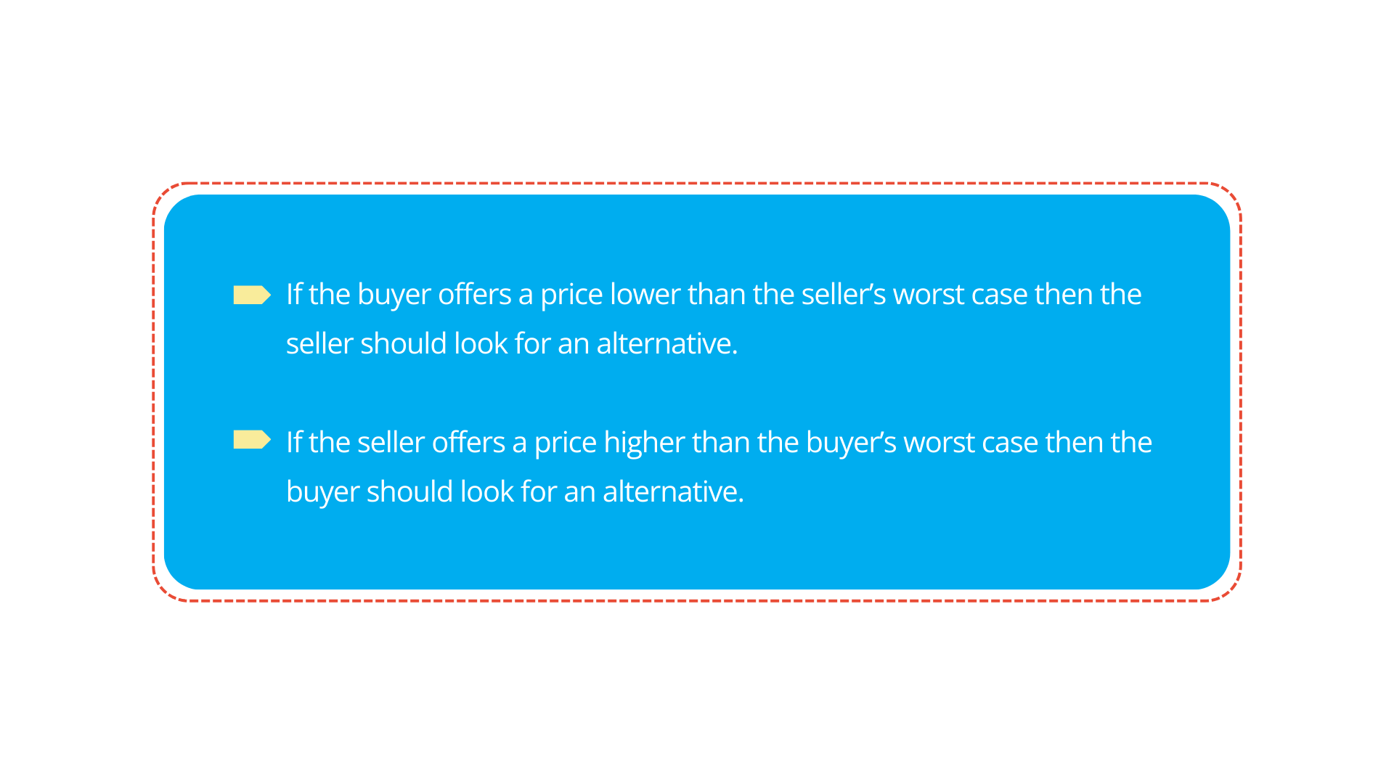
How it operates

Slide 8
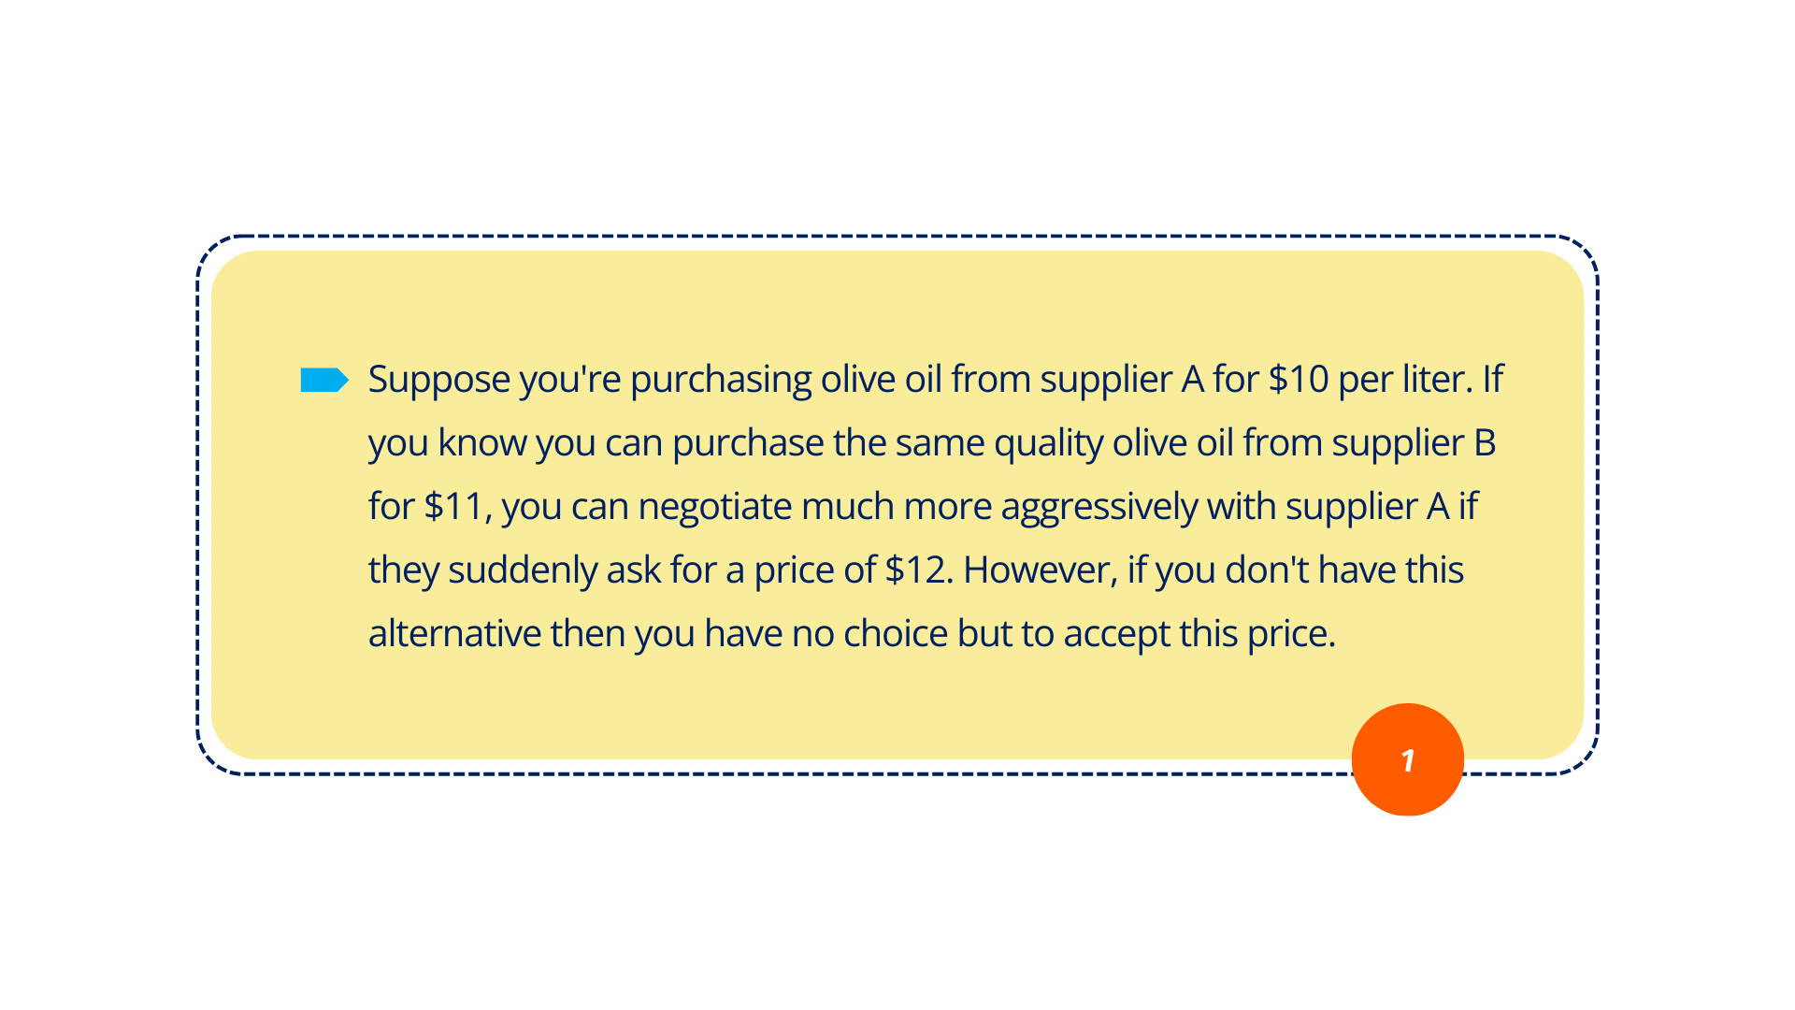
BATNA Illustration Example

Slide 9

BATNA Illustration Example

Slide 10
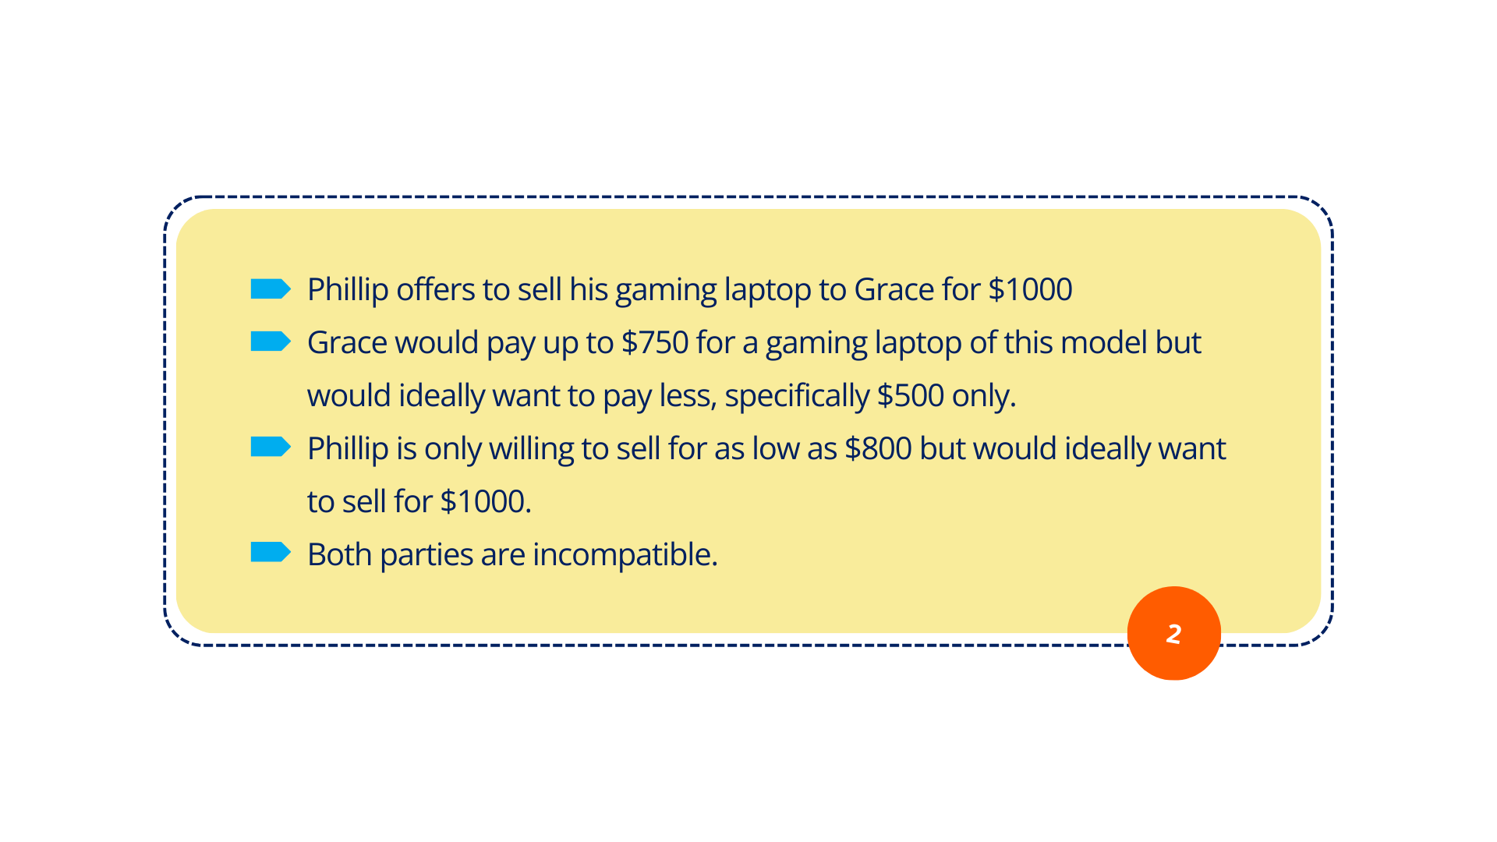
BATNA Illustration Example

Slide 11

BATNA Illustration Example

Slide 12
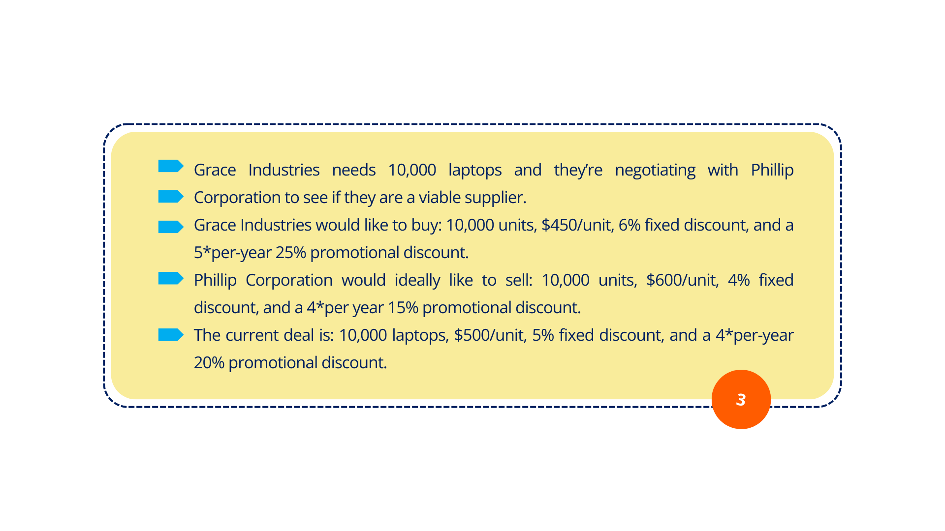
Table Example

Slide 13
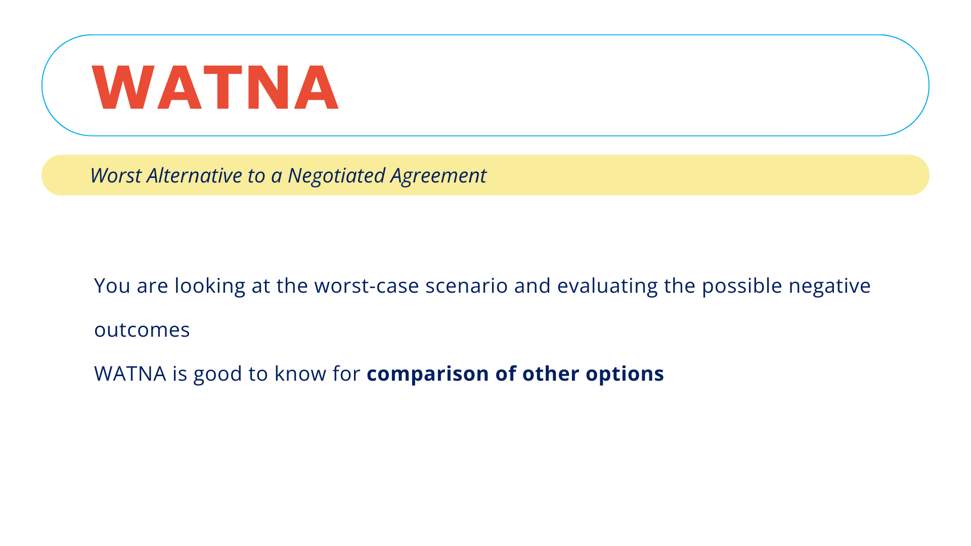

Slide 14
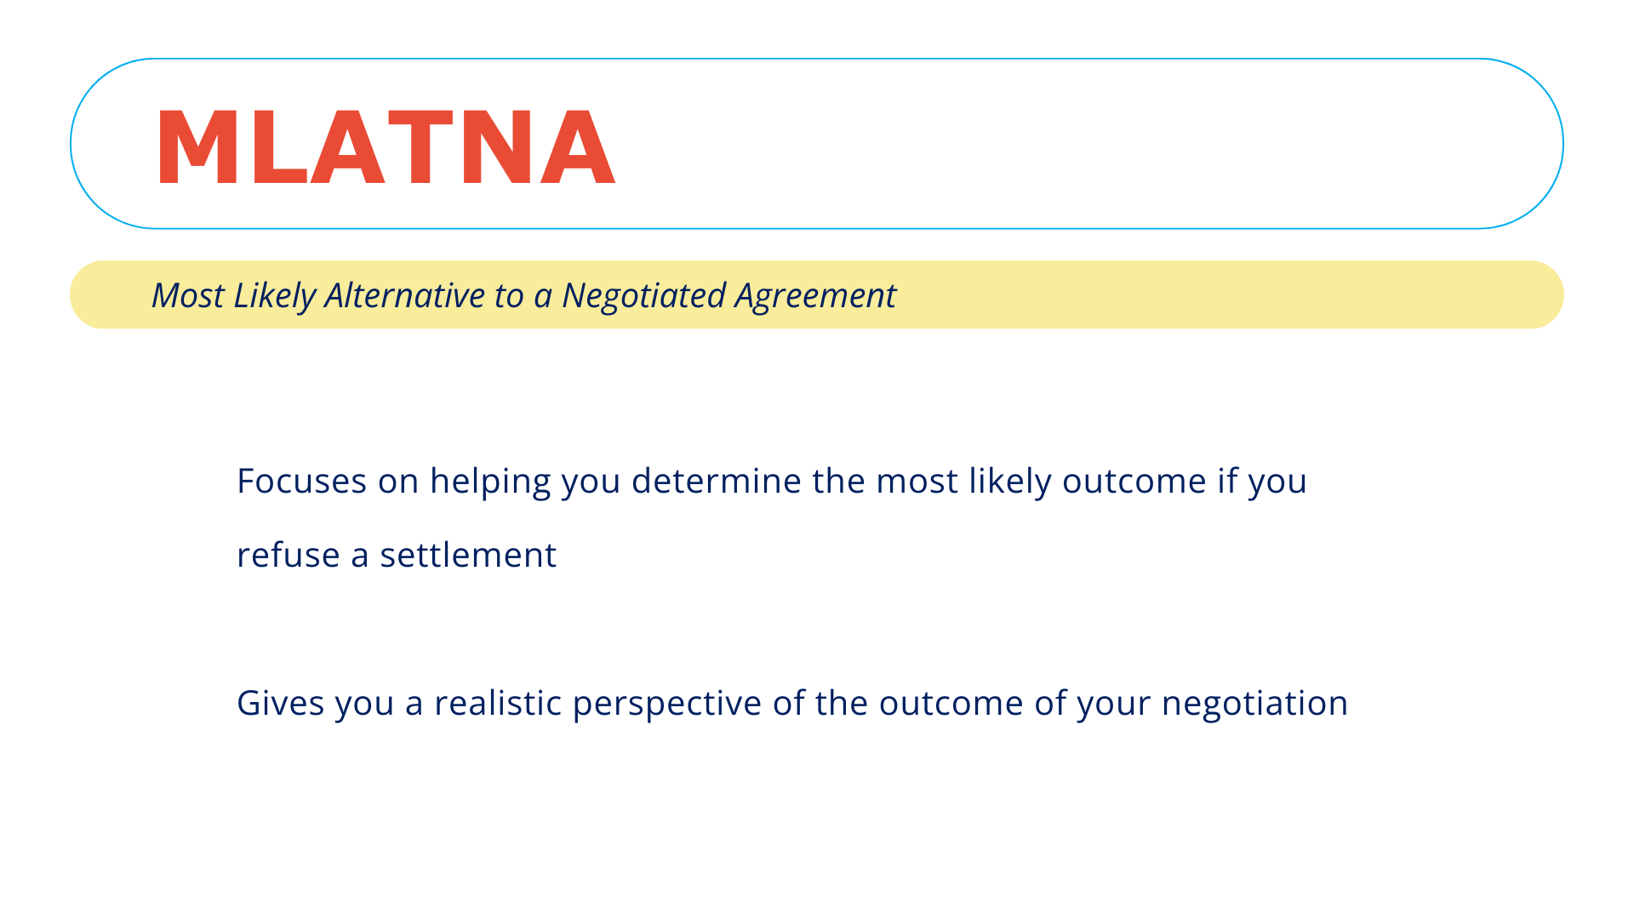

Slide 15
BATNA, WATNA, and MLATNA
BATNA | WATNA | MLATNA
Best option without an agreement | The worst-case scenario if the agreement falls through | Helps you determine the most likely outcome after settlement refusal

Slide 16
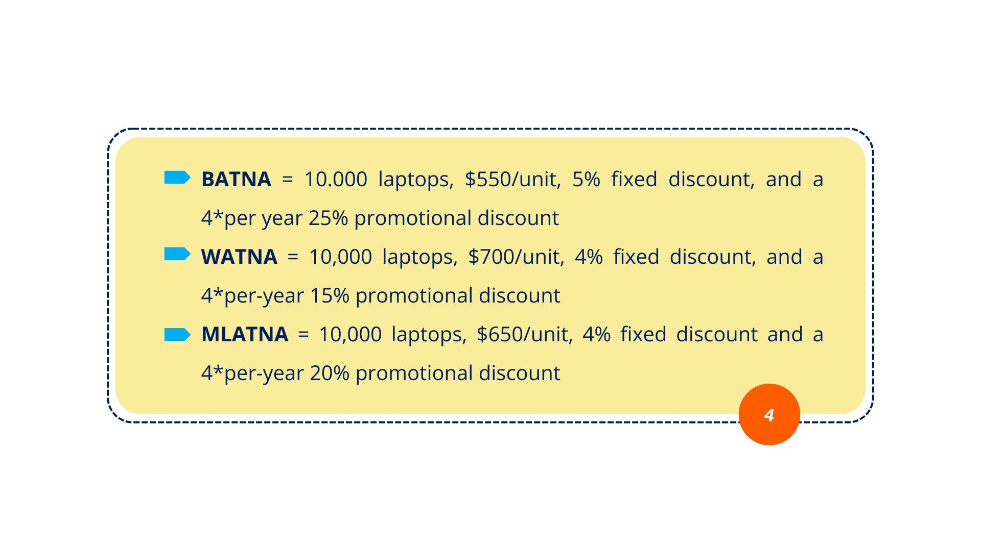
Table Example

Slide 17
Table Example
 | Current Deal | Buyer Desired Outcome (Ask) | Supplier Desired Outcome (Proposal) | BATNA | WATNA | MLATNA
Item | 10,000 laptops invoice price $500 | 10,000 laptops invoice price $450 | 10,000 laptops invoice price $600 | 10,000 laptops invoice price $550 | 10,000 laptops invoice price $700 | 10,000 laptops invoice price $650
Fixed Discount | 5% | 6% | 4% | 5% | 4% | 4%
Promotional Discount | 4*per year 20% discount | 4*per year 25% discount | 4*per year 15% discount | 4*per year 25% discount | 4*per year 15% discount | 4*per year 20% discount

Slide 18
It’s a wrap!
Thank you!

