Slide 1




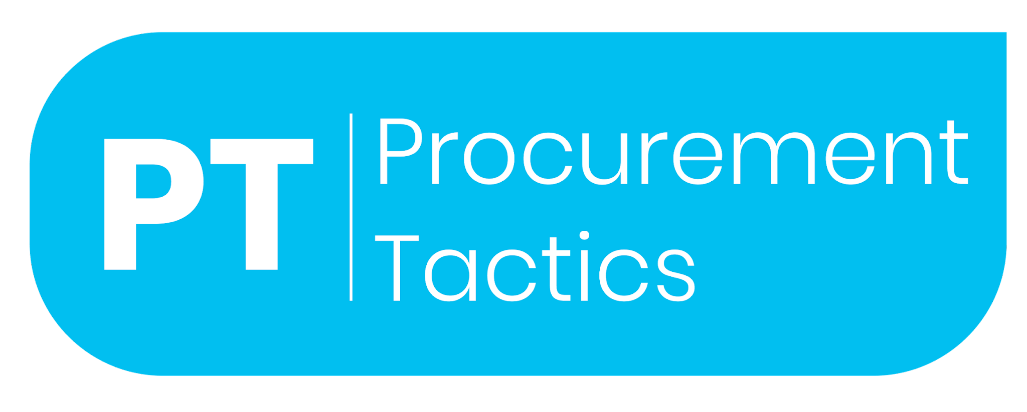
E-Auction
Video Tutorial Link: https://youtu.be/wlFD4VRVfM0?si=OQ5BkskHY_D1evX3

Slide 2

Let me introduce myself

Slide 3
What are E-Auctions?
E-auctions give procurement professionals competitive prices for products, with suppliers competing against each other to offer their best prices, online.

Slide 4
When should they be used?
Whenever possible
Adding e-auctions to the negotiation process has often resulted in better savings than negotiating solely face-to-face

Slide 5
The 6 Types of E-Auctions

Slide 6
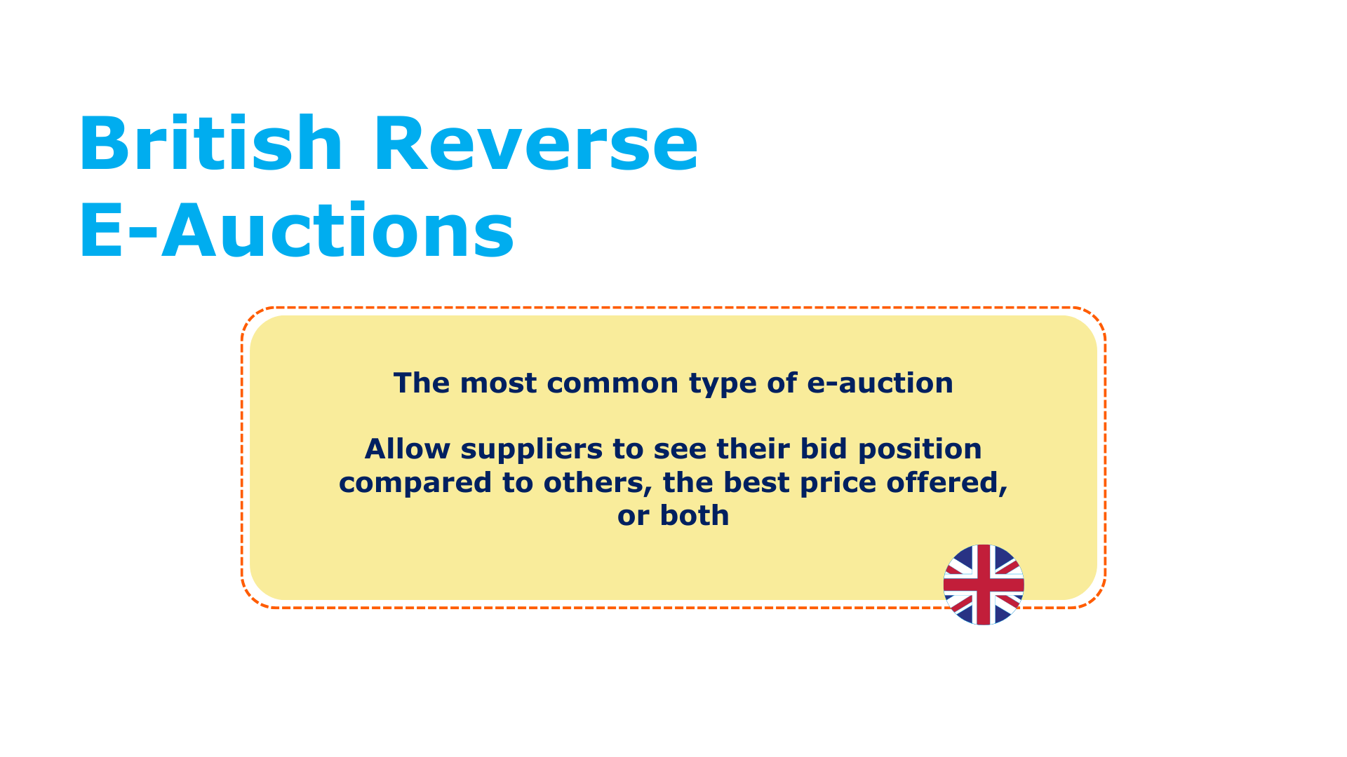

Slide 7
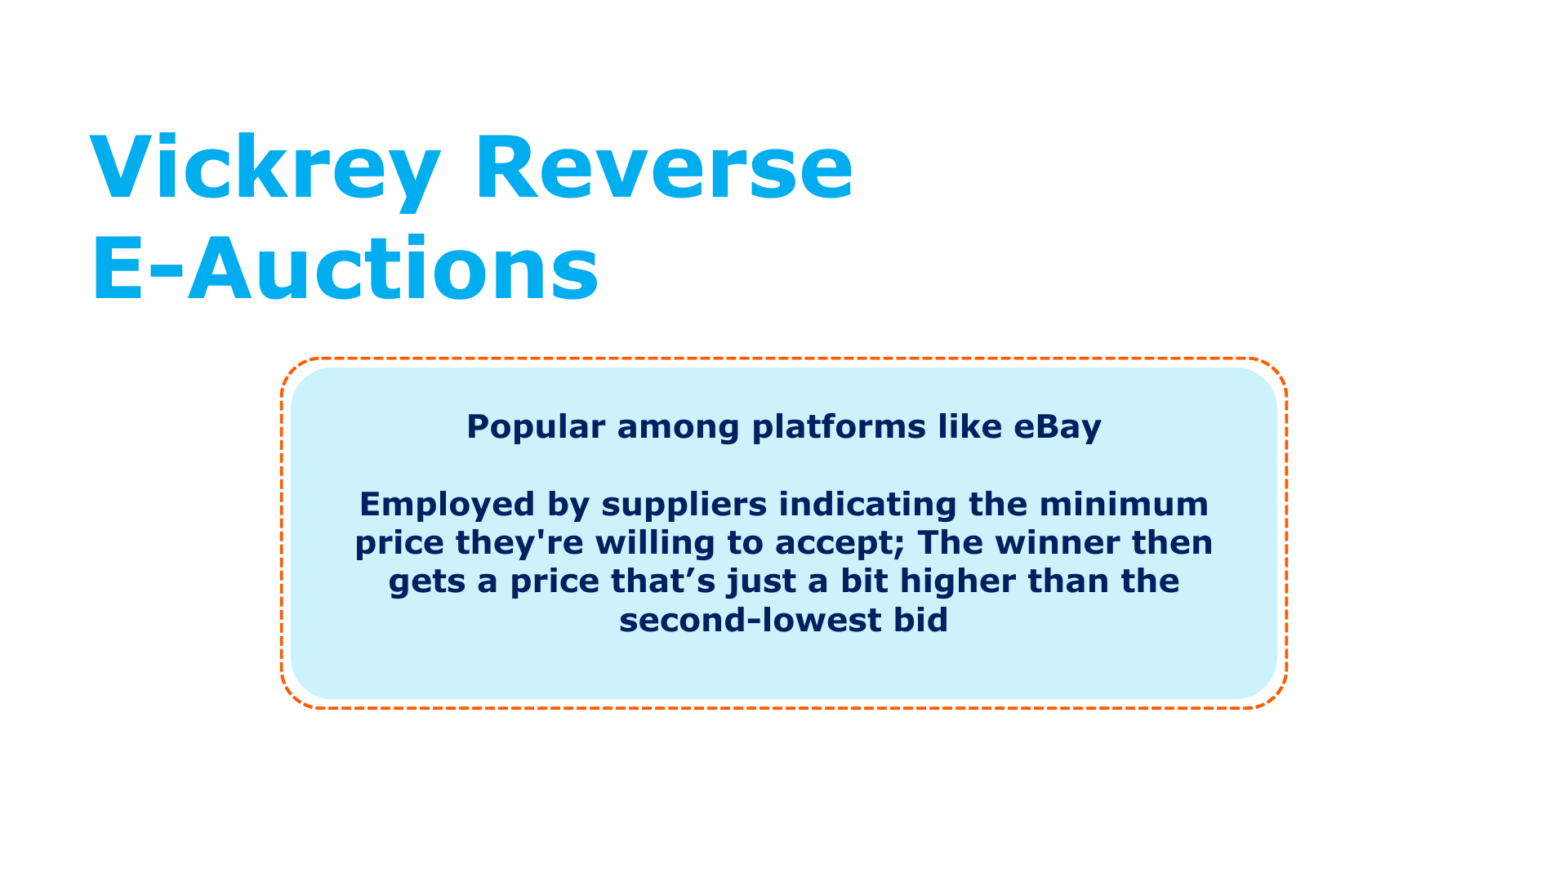

Slide 8
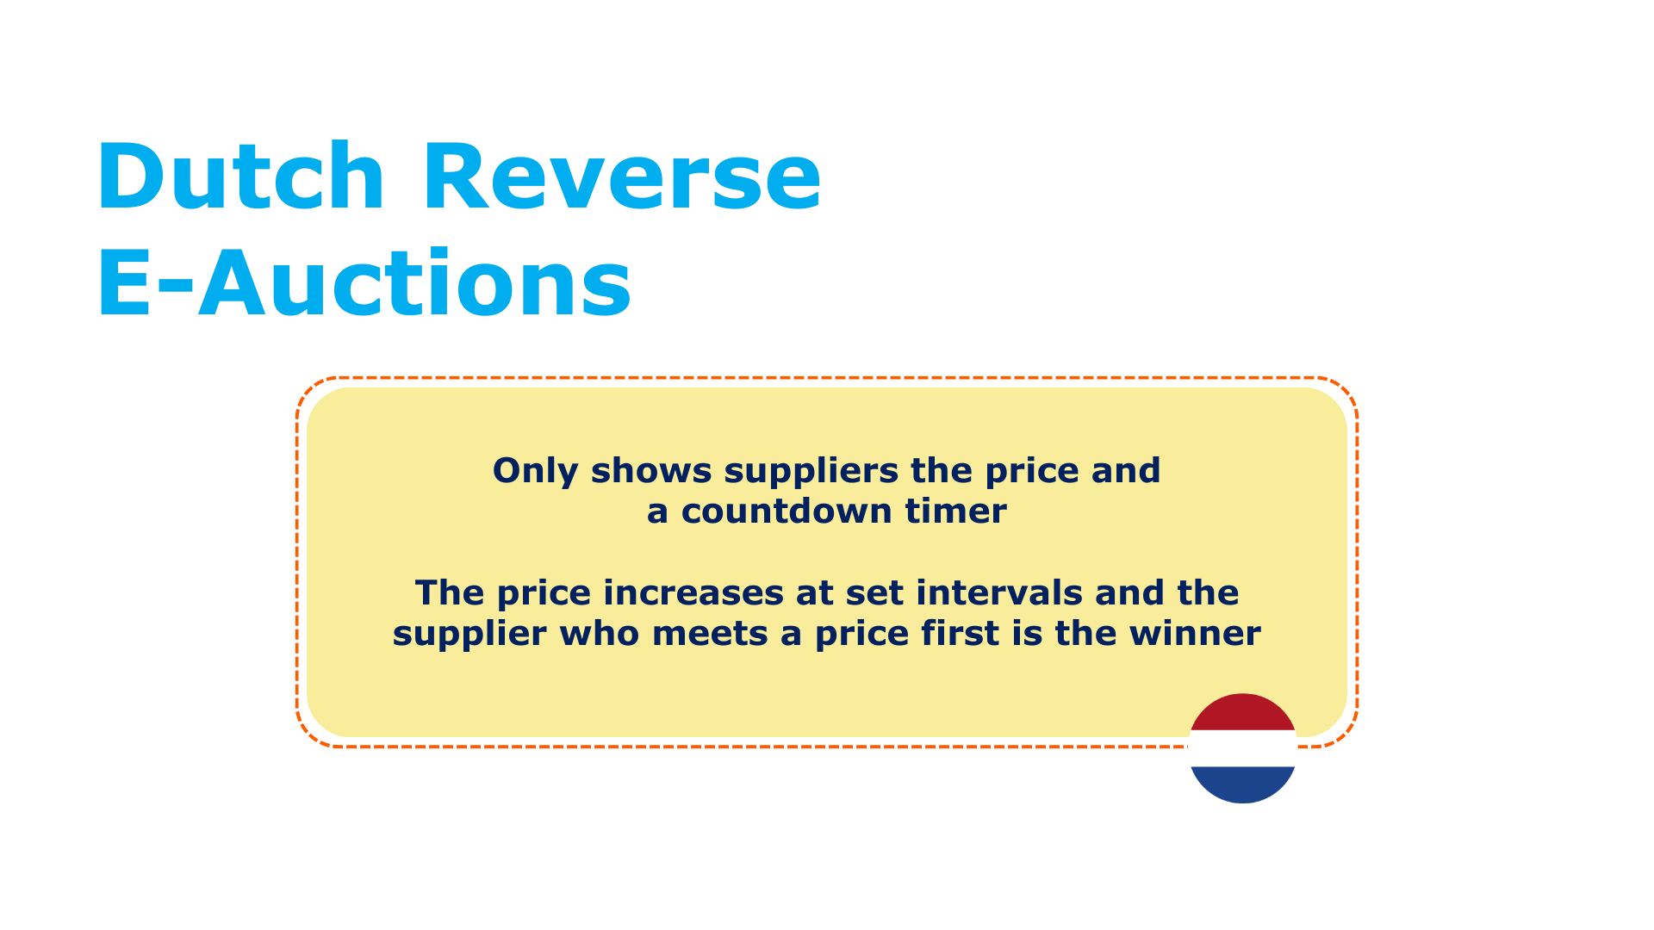

Slide 9
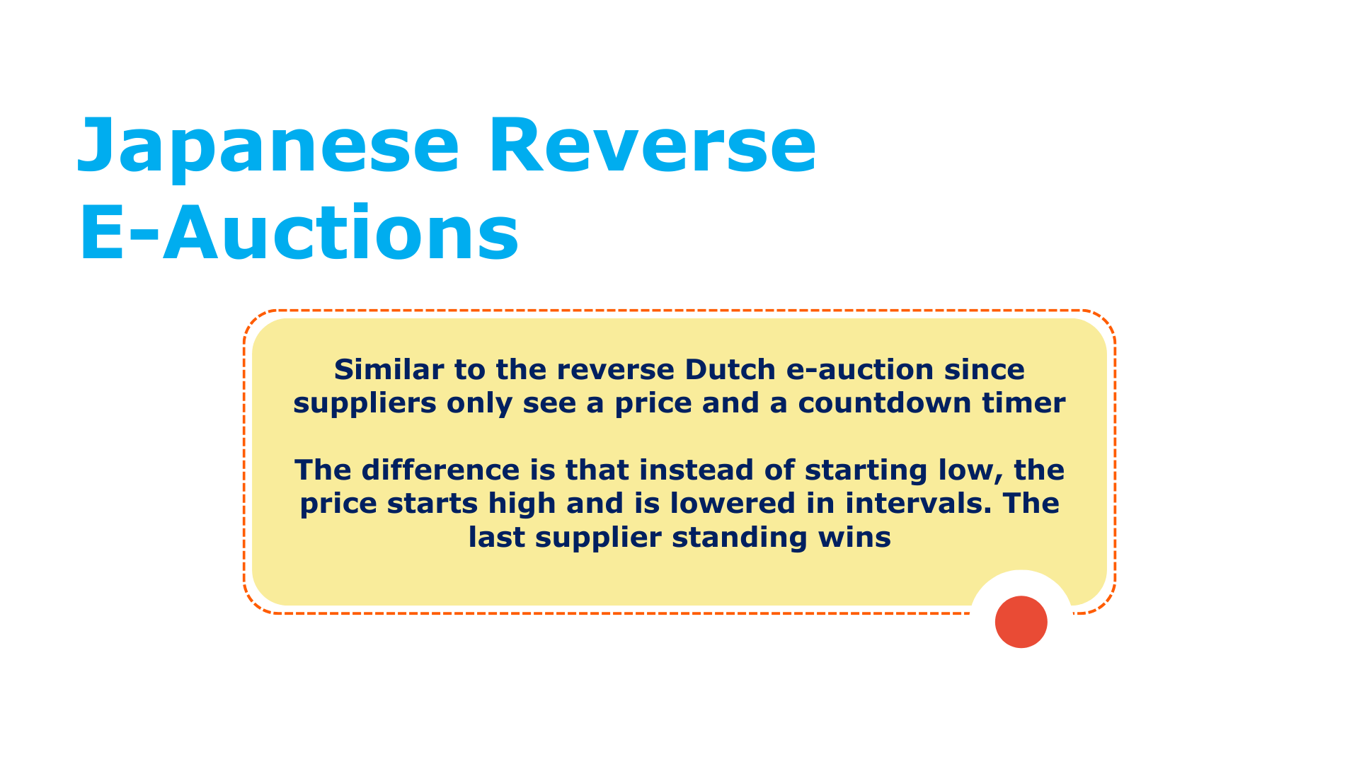

Slide 10
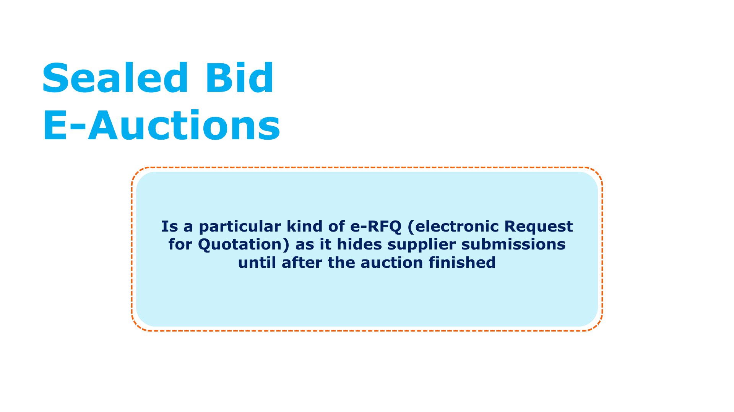

Slide 11
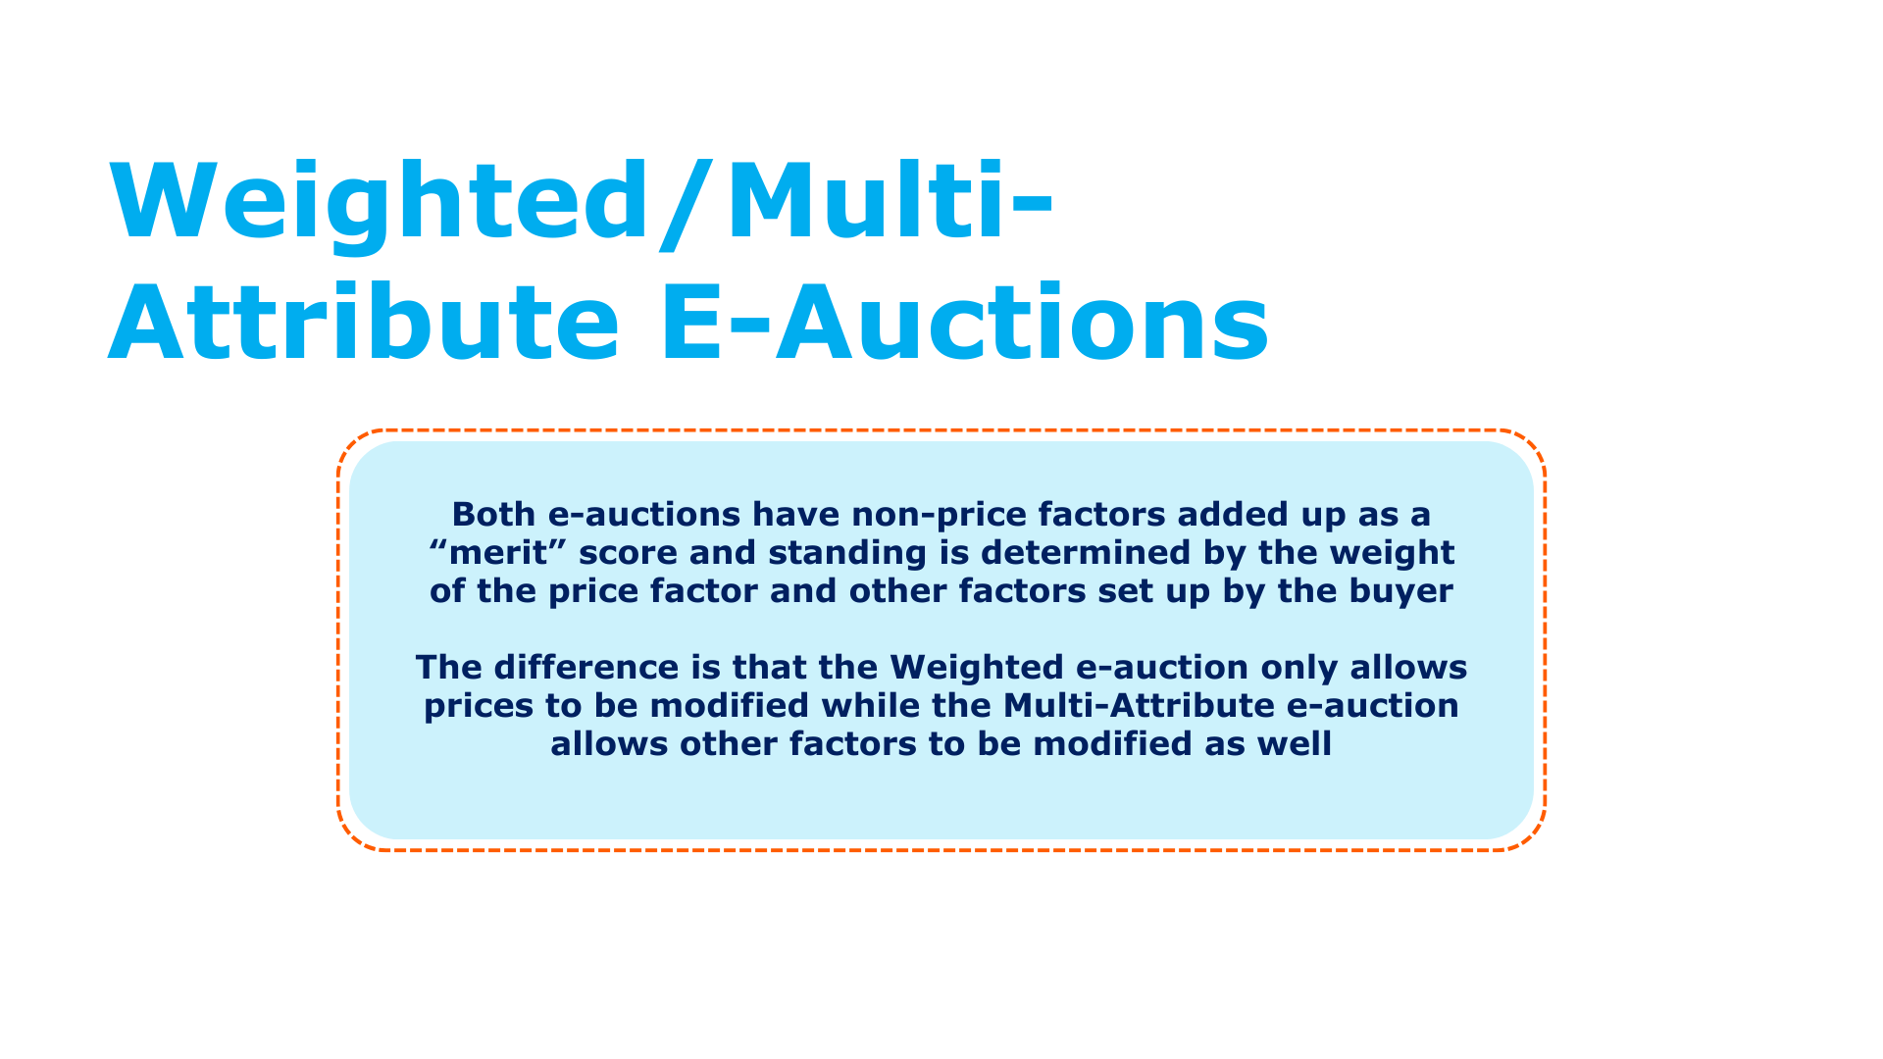

Slide 12
Pros and Cons for Each E-Auction Type

Slide 13
Pros and Cons for Each E-Auction Type
Type of E-Auction | Pros | Cons | When to Use
British Reverse E-Auctions | Competitive bidding You decide what information suppliers see & the auction step | Low-ranking suppliers lose confidence | Anytime
Vickrey Reverse E-Auctions | Encourages best prices on first bid Useful for products or services with a limited quantity available Transparency Usually a one-step process | May not be suitable for complex products or services where price is not the only determining factor | When there are a small number of suppliers When the product or service being auctioned has price as the primary factor For a quick and transparent negotiation process

Slide 14
Pros and Cons for Each E-Auction Type
Type of E-Auction | Pros | Cons | When to Use
Dutch Reverse E-Auctions | Encourages competition for lower prices Transparent process with clear rules | May not work well with many suppliers Requires careful setup of starting price and increments | When there are few suppliers When quick price determination is needed When transparency and competitiveness are priorities
Japanese Reverse E-Auctions | Encourages supplier participation Can lead to lower costs | May discourage suppliers with a high starting price Requires careful management with changing price intervals | Small number of suppliers Simple products/services where price is key

Slide 15
Pros and Cons for Each E-Auction Type
Type of E-Auction | Pros | Cons | When to Use
Sealed Bid E-Auctions | Ensures fair competition Encourages best prices upfront | Suppliers can't adjust offers based on competitors May not result in the lowest prices | When fairness and transparency is important When you want best prices upfront
Weighted/ Multi-Attribute E-Auctions | Includes non-price factors in evaluation Suppliers can adjust prices and/or other factors to improve ranking | Complexity in determining and weighting non-price factors Subjectivity in evaluating non-price factors Risk of suppliers focusing on gaming non-price factors | Anytime

Slide 16
It’s a wrap!
Thank you!

