Slide 1





Empathy and Compassion in Procurement

Slide 2
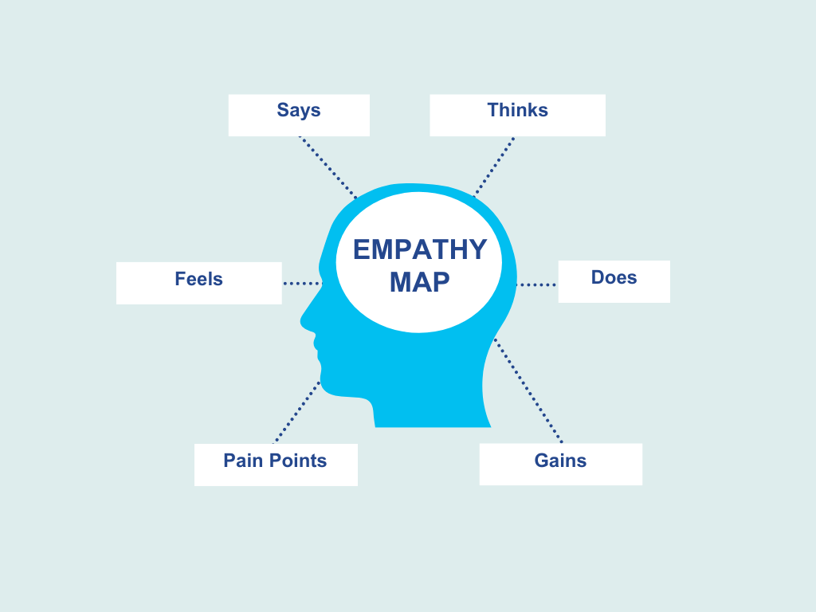
Empathy Map
Type Here
Type Here
Type Here
Type Here
Type Here
Type Here

Slide 3
It’s a wrap!
Thank you!

