Slide 1





Excel for Procurement Professionals
Template
Video Tutorial Link: https://youtu.be/RdSpvcNY9n8?si=SNjtf37iky-5SLgr

Slide 2

Let me introduce myself

Slide 3
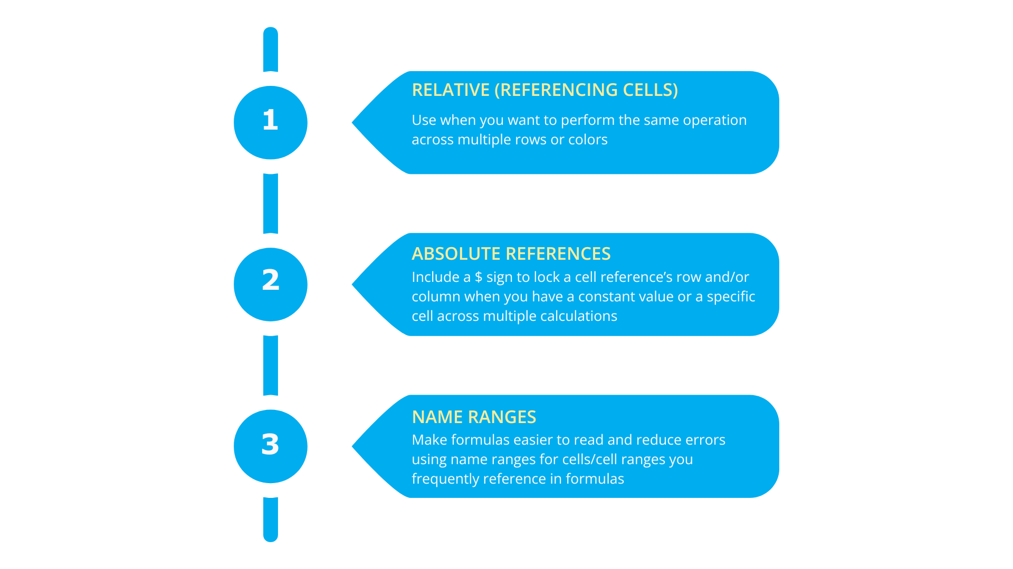

Excel Functions to Create Formulas

Slide 4
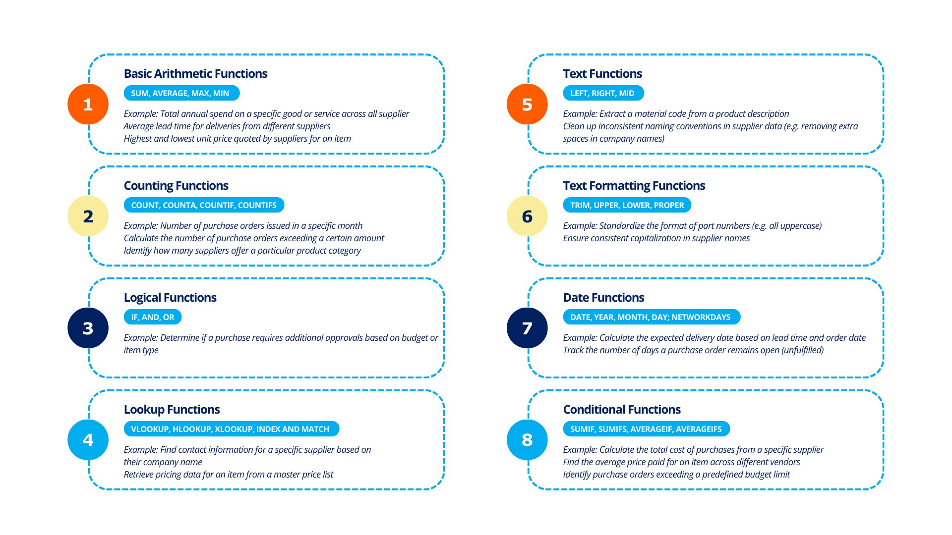
8 Types of Excel Functions Procurement Needs

Slide 5
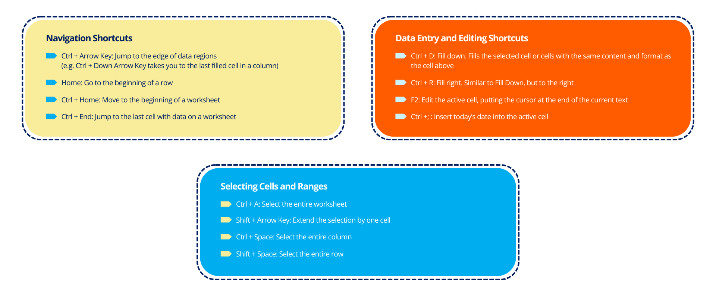
3 Essential Excel Shortcuts

Slide 6
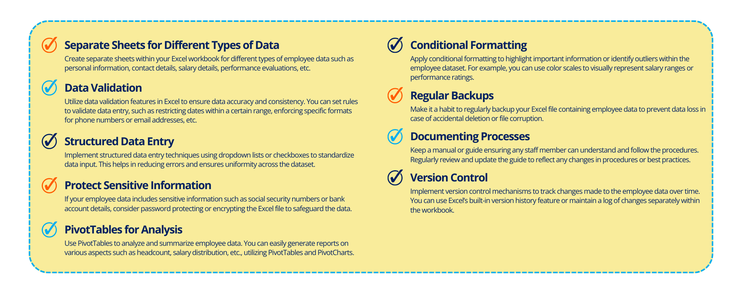
Tips to Manage Procurement Data in Excel

Slide 7
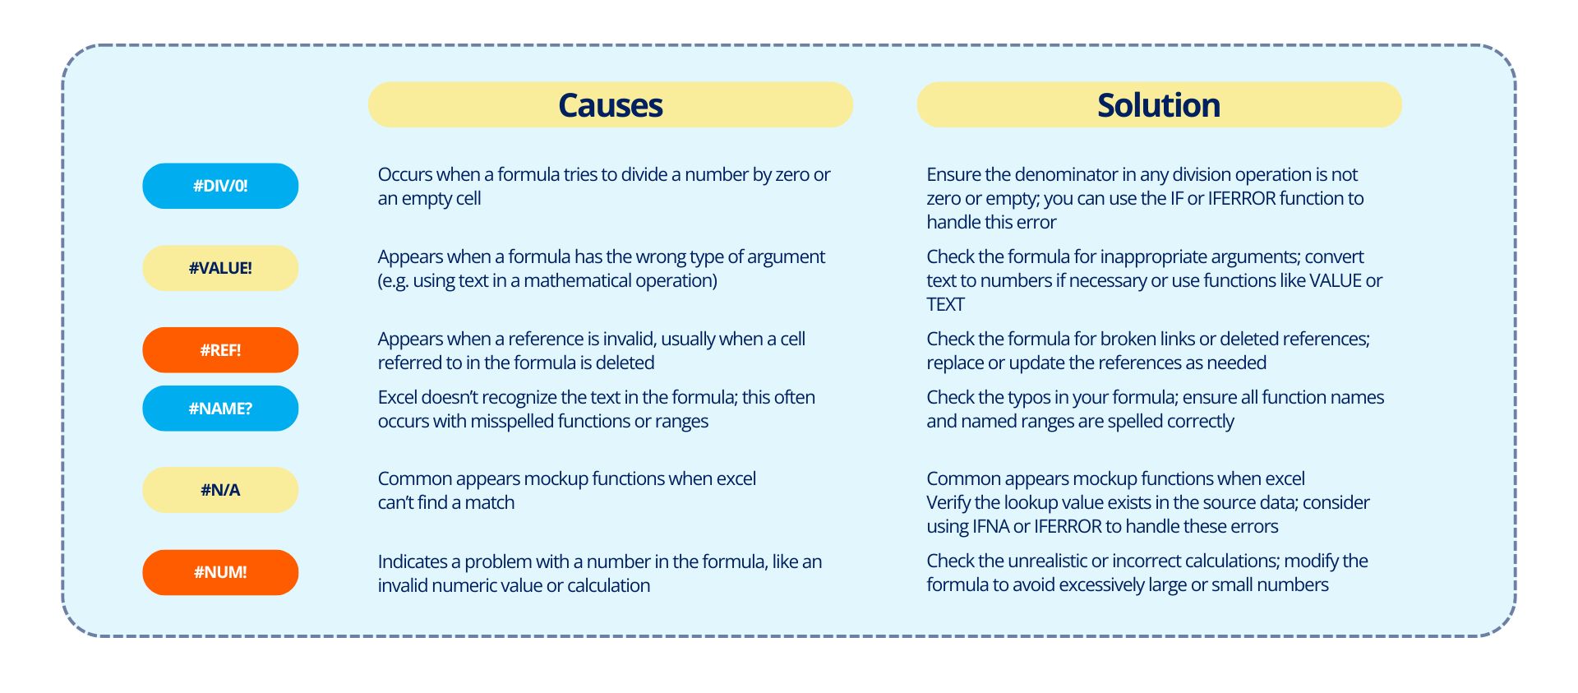
Common Excel Errors

Slide 8
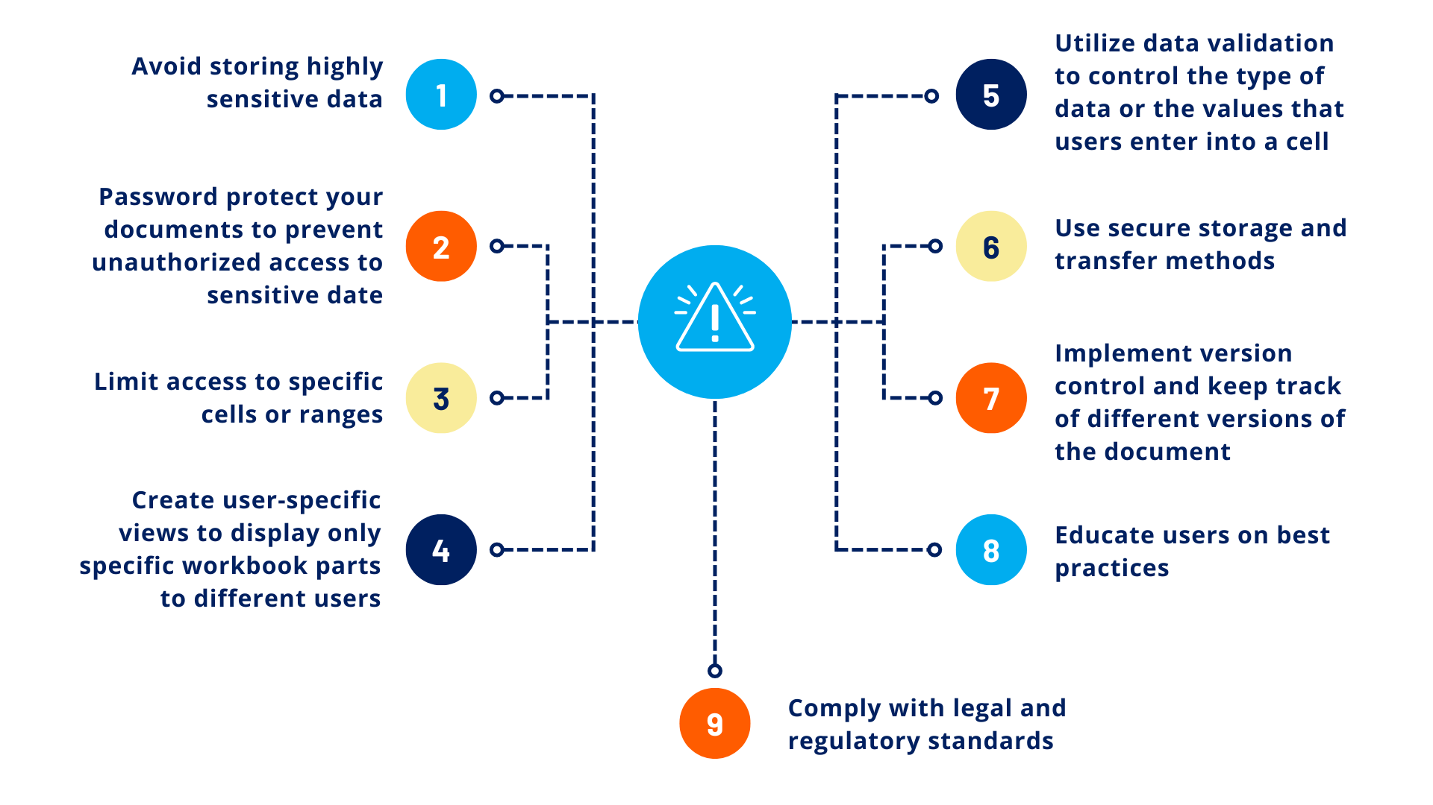
Tips to Protect Data Privacy in Excel

Slide 9
It’s a wrap!
Thank you!

