Slide 1


In-Negotiation
Toolkit
Templates
Video Tutorial Link: https://youtu.be/EctsF8TM1gs?si=Vc3NCmH7w088329x

Slide 2
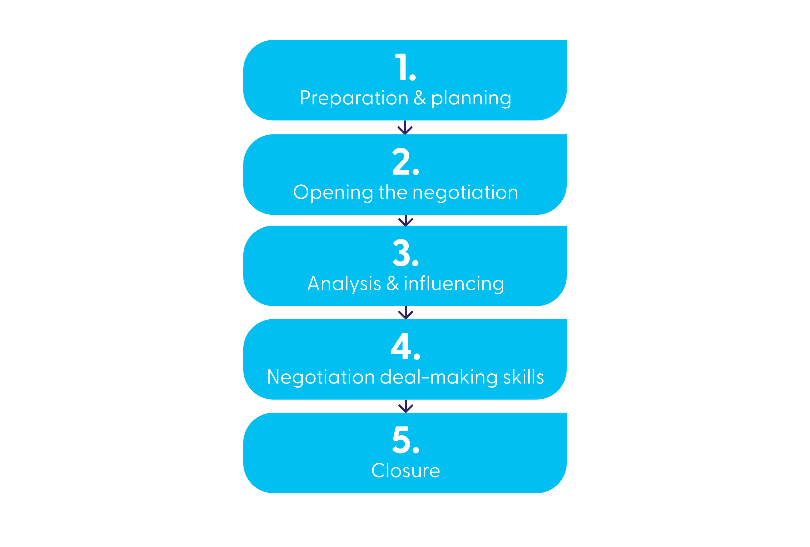
Negotiation process

Slide 3
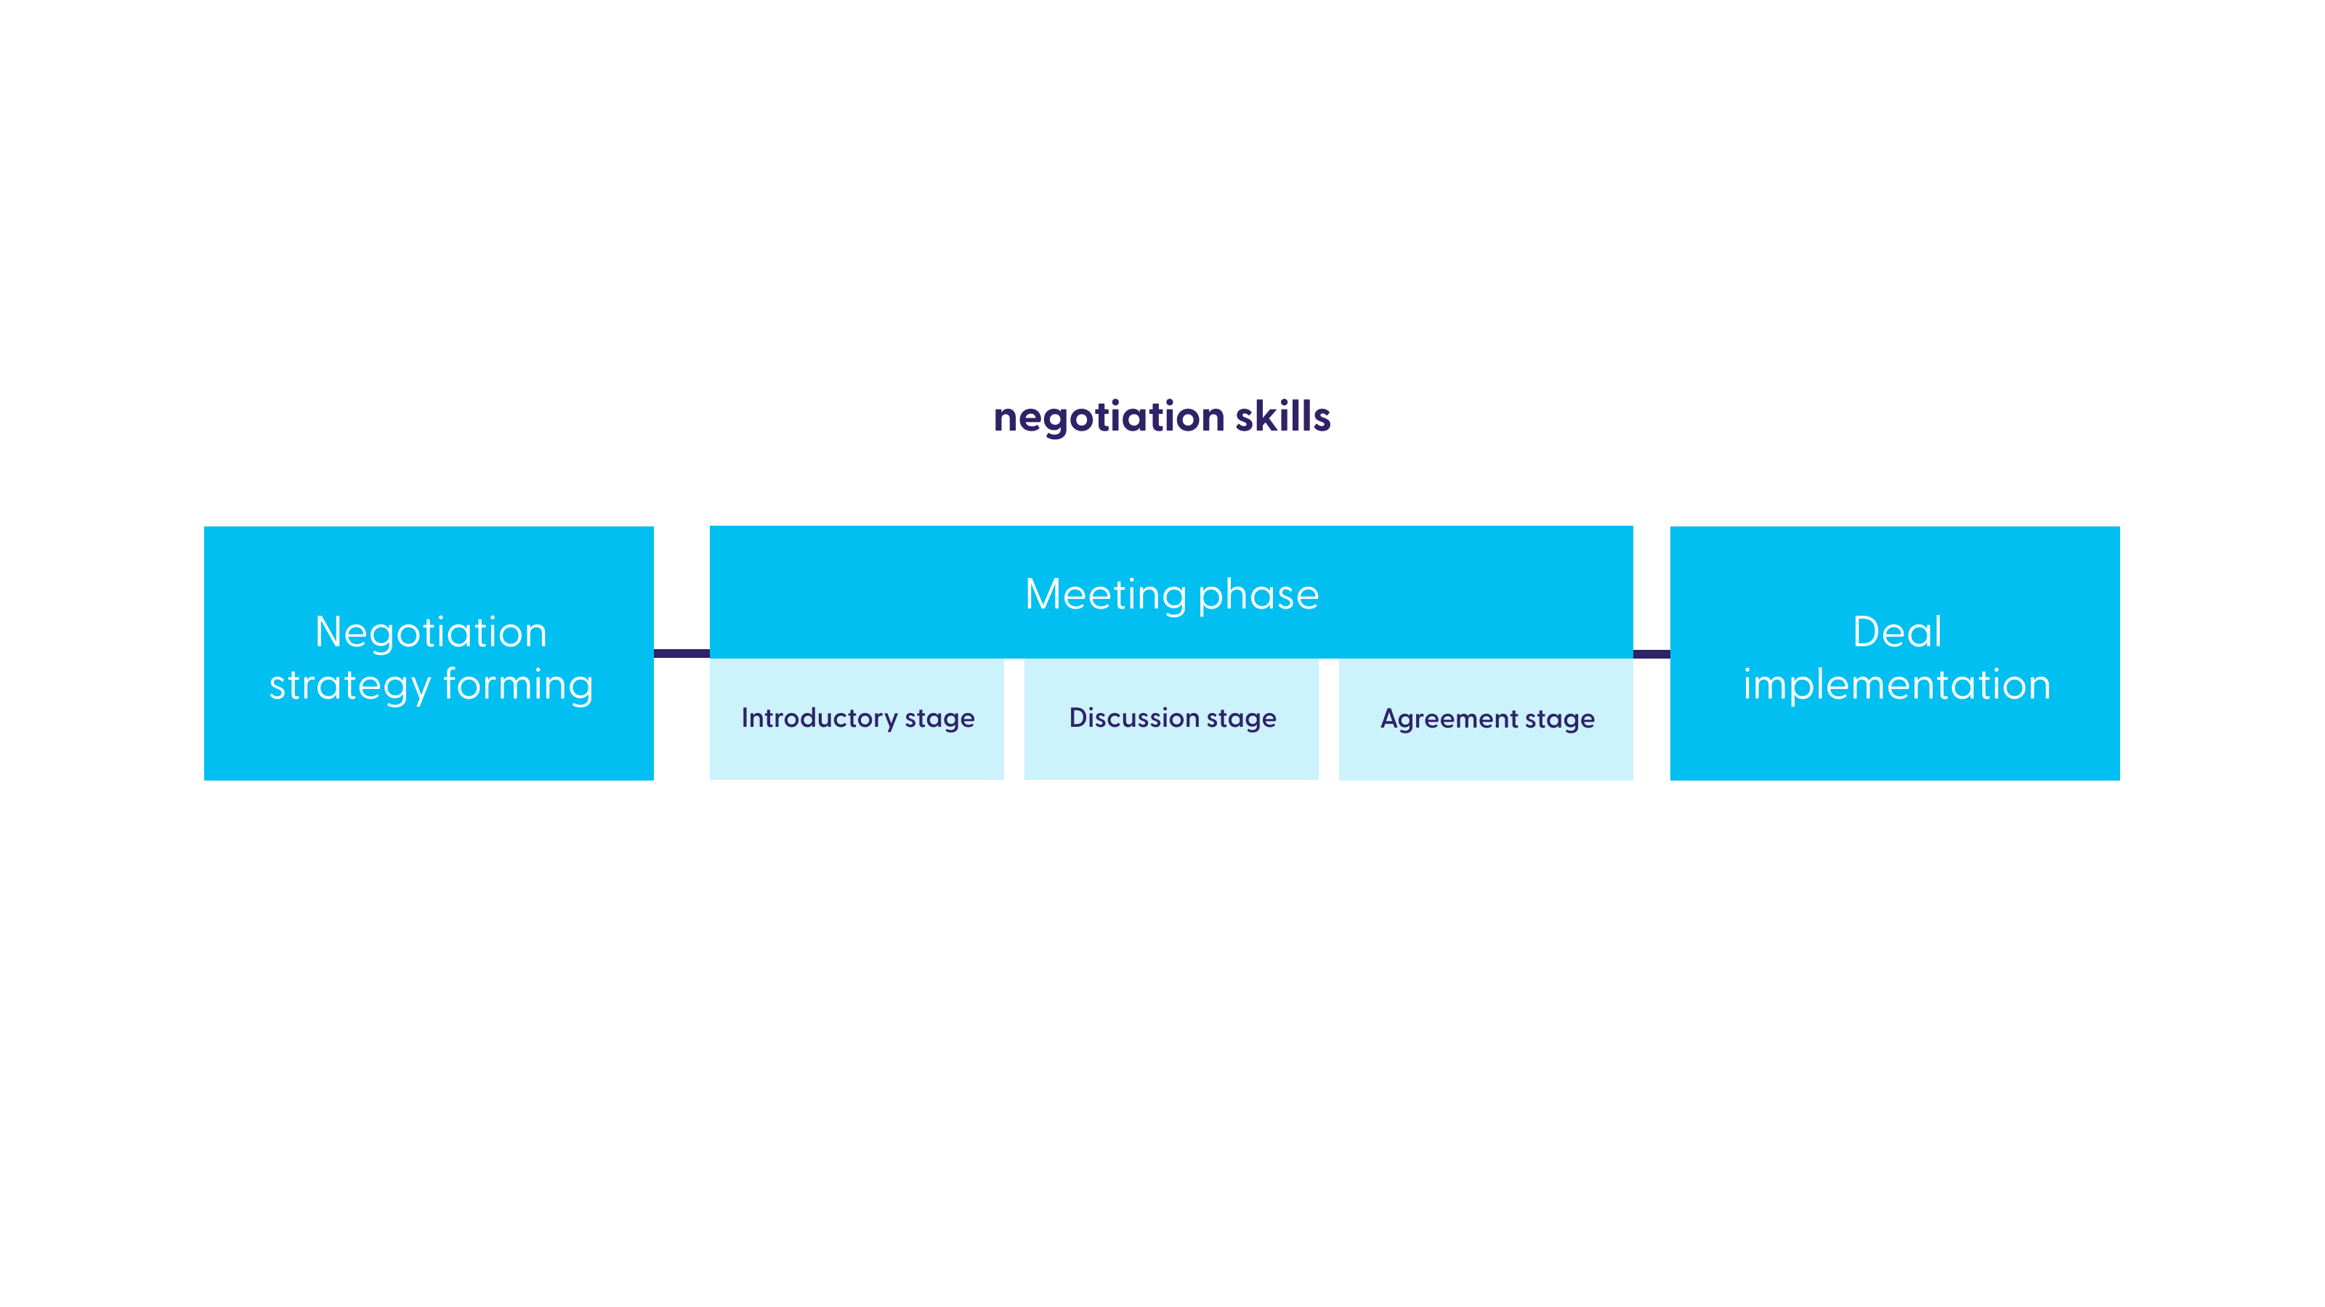
Phases of negotiation template

Slide 4
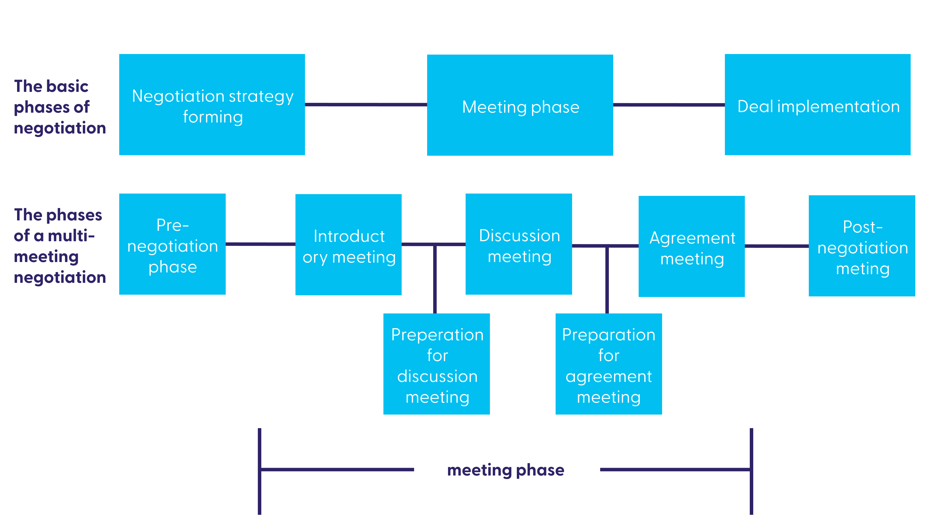
Negotiation phase deepdive template

Slide 5
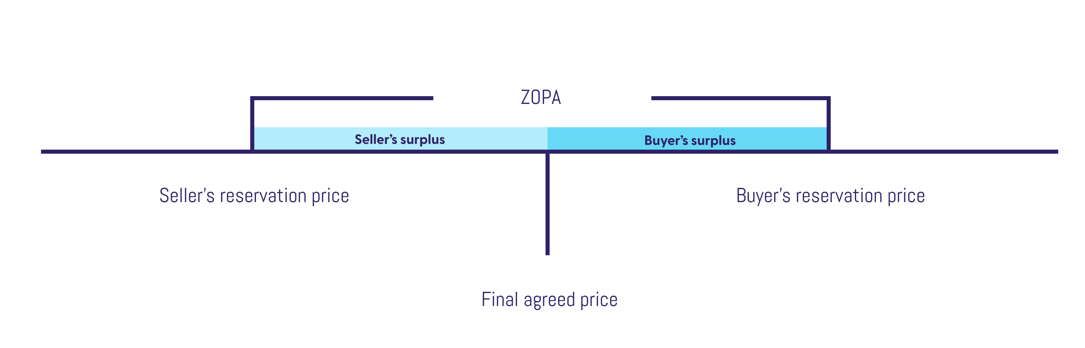
Zone of Potential Agreement template
Intend
Break point

Slide 6
Negotiation template
Supplier xxx
Opening
Like
Intend
Break point
Price
$145.000
Investments
$100.000
Payment term
Other variable 1
Delta vs deal last
year
$377.640

Slide 7
Conditional Move planner template
If I give my supplier this…
I want this in return…
Distribution 500
Price $14.50
Volume 1M
Volume discount 1.5%
Volume 1.3M, Promotions 5
Making investment $80.000

Slide 8
Record of proposals template
Yours
Theirs
Yours
Theirs
Record of proposals
Price
14.90
12.20
14.00
13.00
Volume discount
1.5%
2.0%
1.75%
2.0%
Marketing
investment
80.000
150.000
100.000
Payment terms
30
60
60
Distribution
500
400
Medium
500
Volumes / pa
1.000.000
1.000.000
1.300.000
1.500.000
Promotions
6
8
10
10
Exclusivity

