Slide 1





Kraljic Matrix
Video Tutorial Link: https://youtu.be/btewog04OOk?si=YsohueQltOiCKmcp

Slide 2

Let me introduce myself

Slide 3
Kraljic Matrix
Developed by Peter Kraljic in 1983 to calculate supplier risk and profitability
Notes:
Now, a short disclaimer. In our pursuit to teach you about culture, we acknowledge that although it is a significant factor, we cannot attribute everything solely on cultural differences.
The template I’m guiding you through today is Culture and Negotiations: Asian Style!
Let’s dive into it!

Slide 4
The Four Quadrants

Slide 5
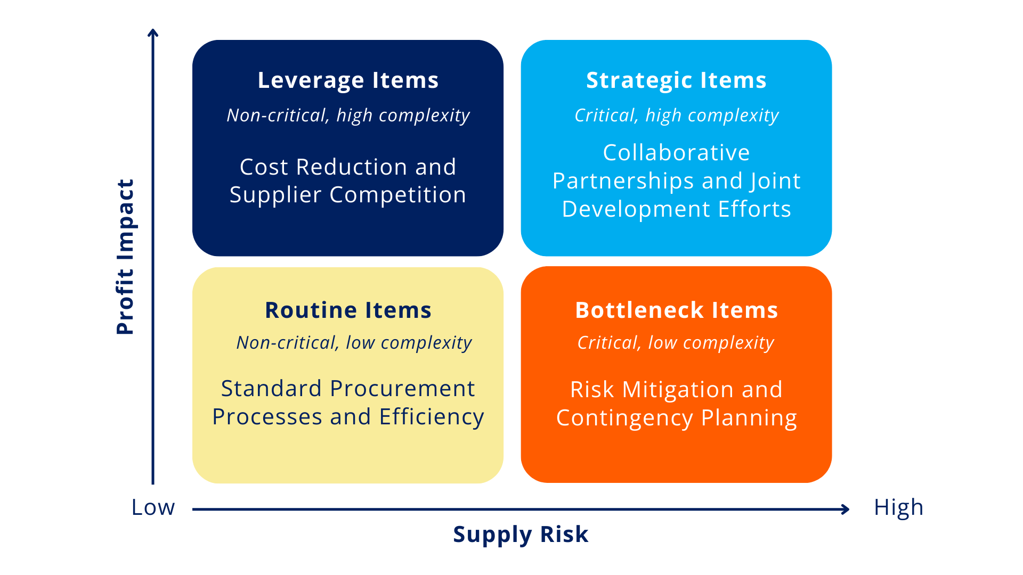

The Four Quadrants of the Kraljic Matrix

Slide 6
How to Use the Kraljic Matrix

Slide 7
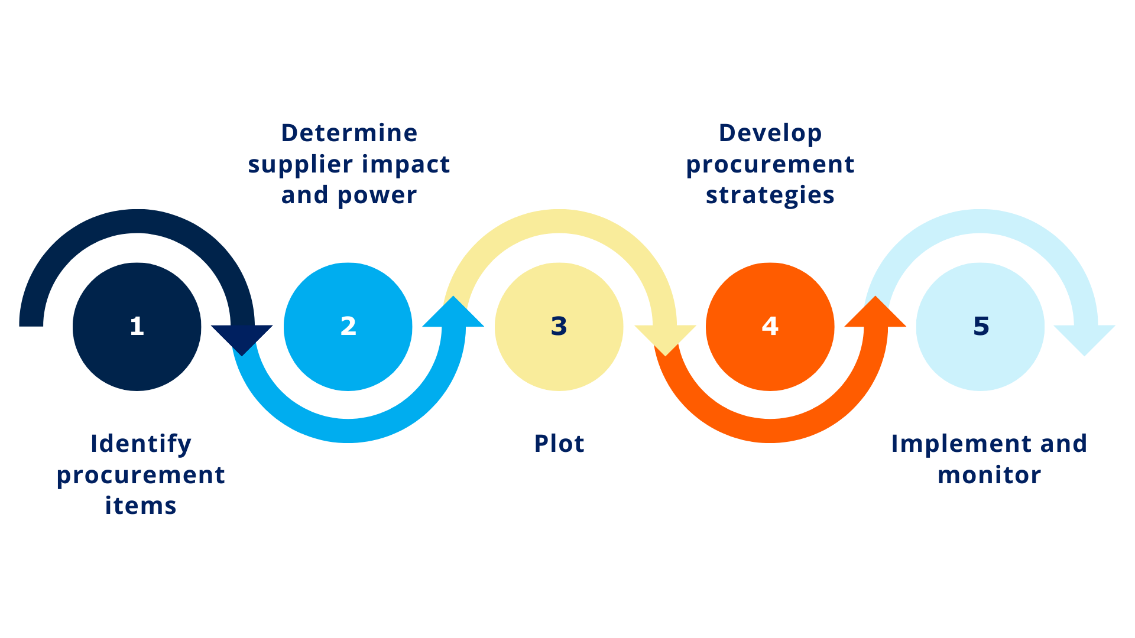
How to Use the Kraljix Matrix

Slide 8
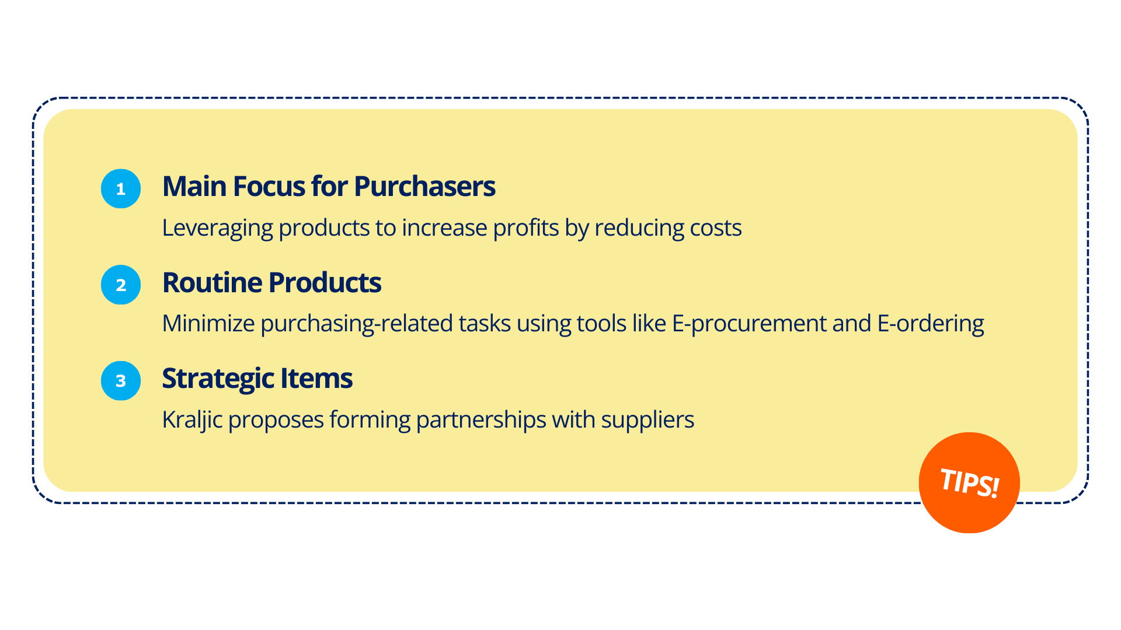
Suggestions of Cees J. Gelderman and Arjan J. van Weele

Slide 9
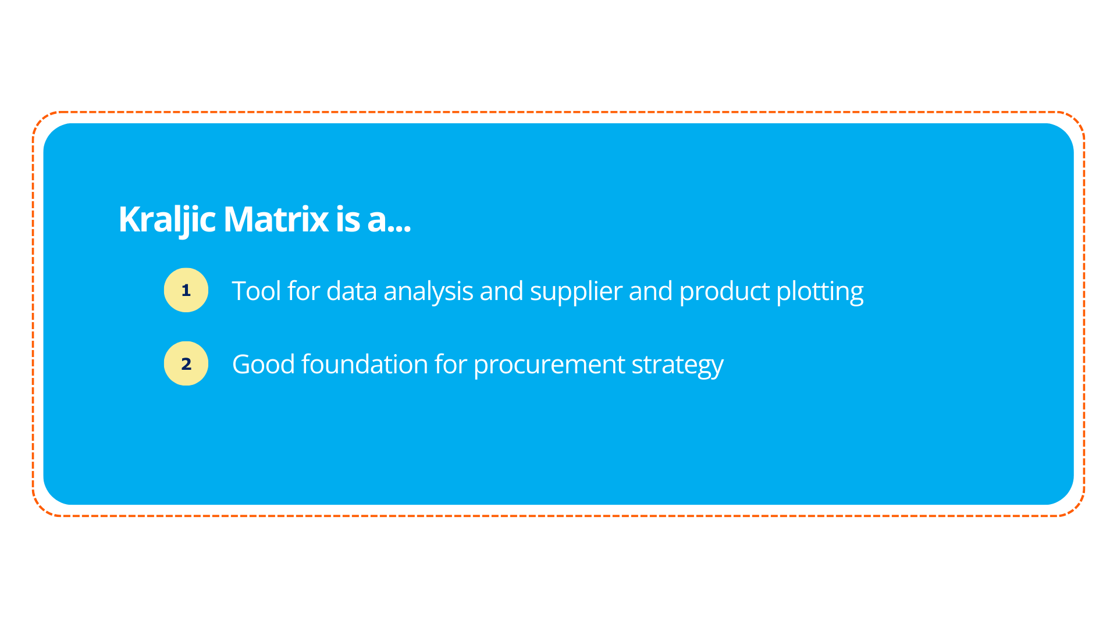
Wrap-up

Slide 10
It’s a wrap!
Thank you!

