Slide 1





Margin Calculations
Download Template Here
Video Explanation

Slide 2

Let me introduce myself

Slide 3
Explanation of the Terms

Slide 4
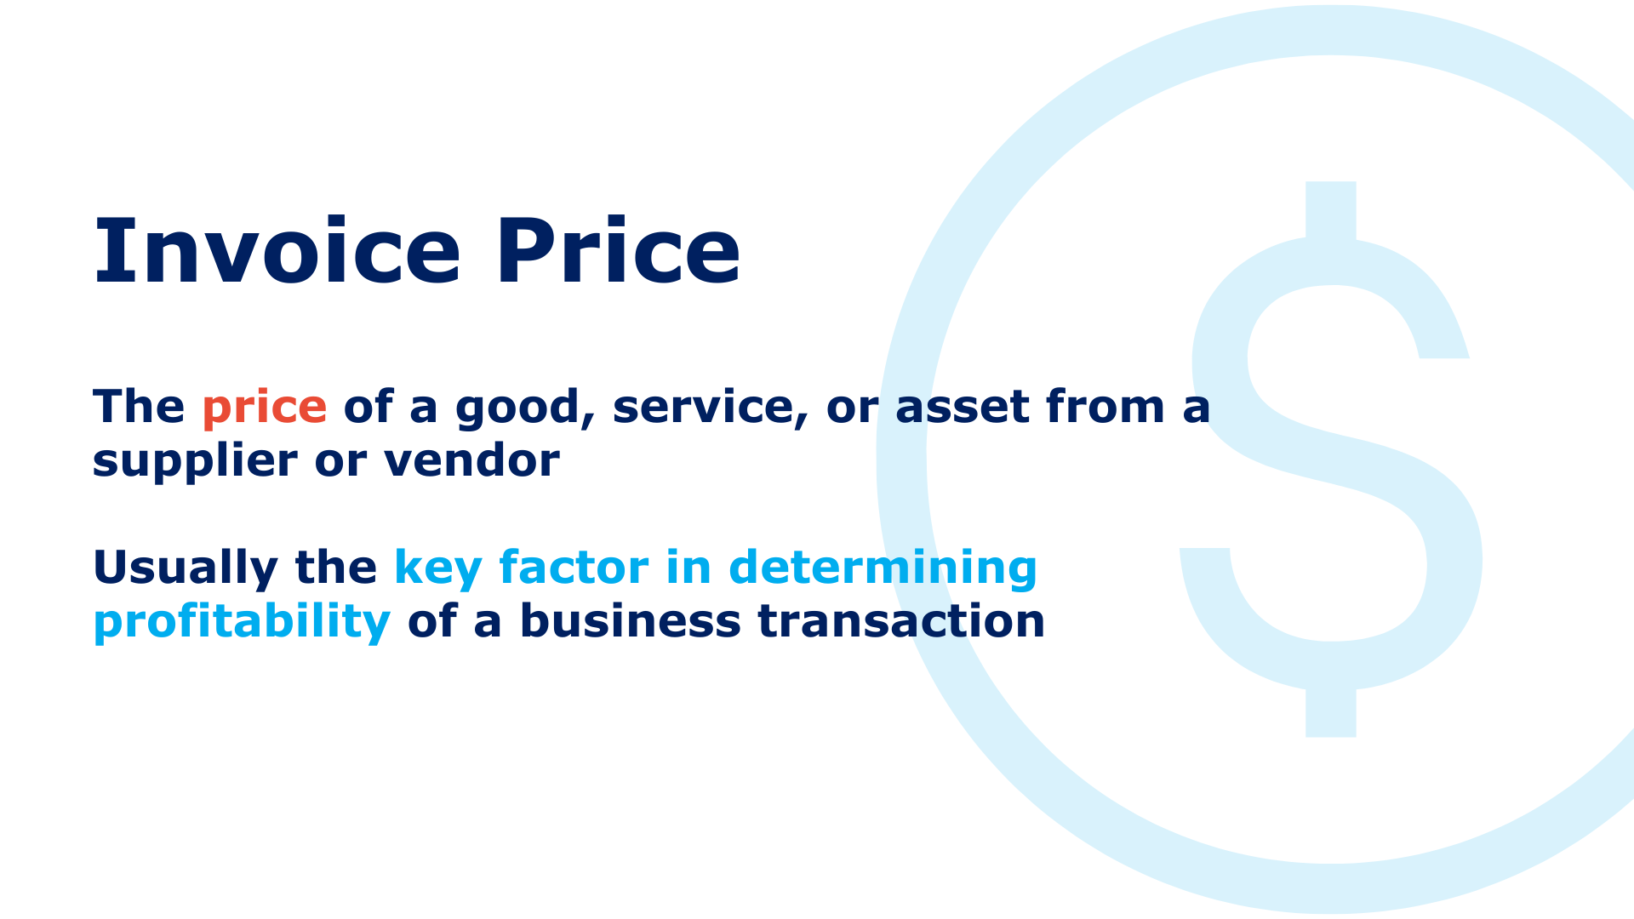

Slide 5


Slide 6


Slide 7
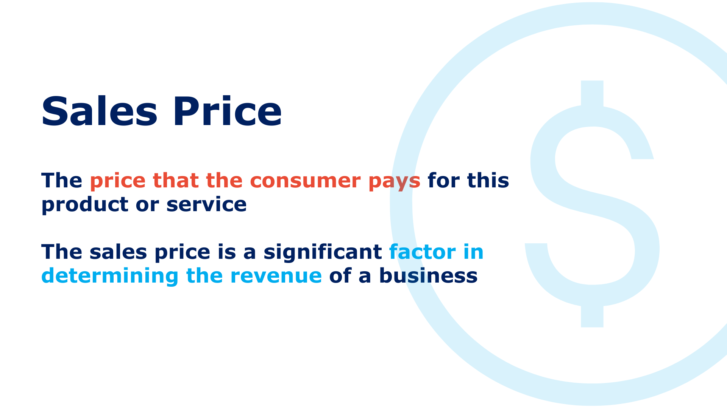

Slide 8
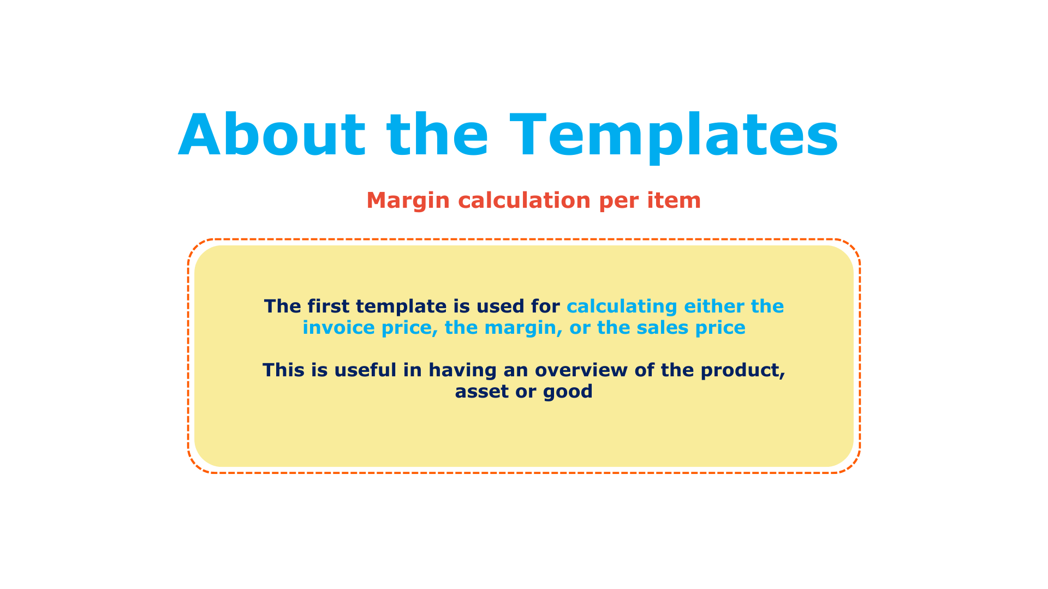

Slide 9
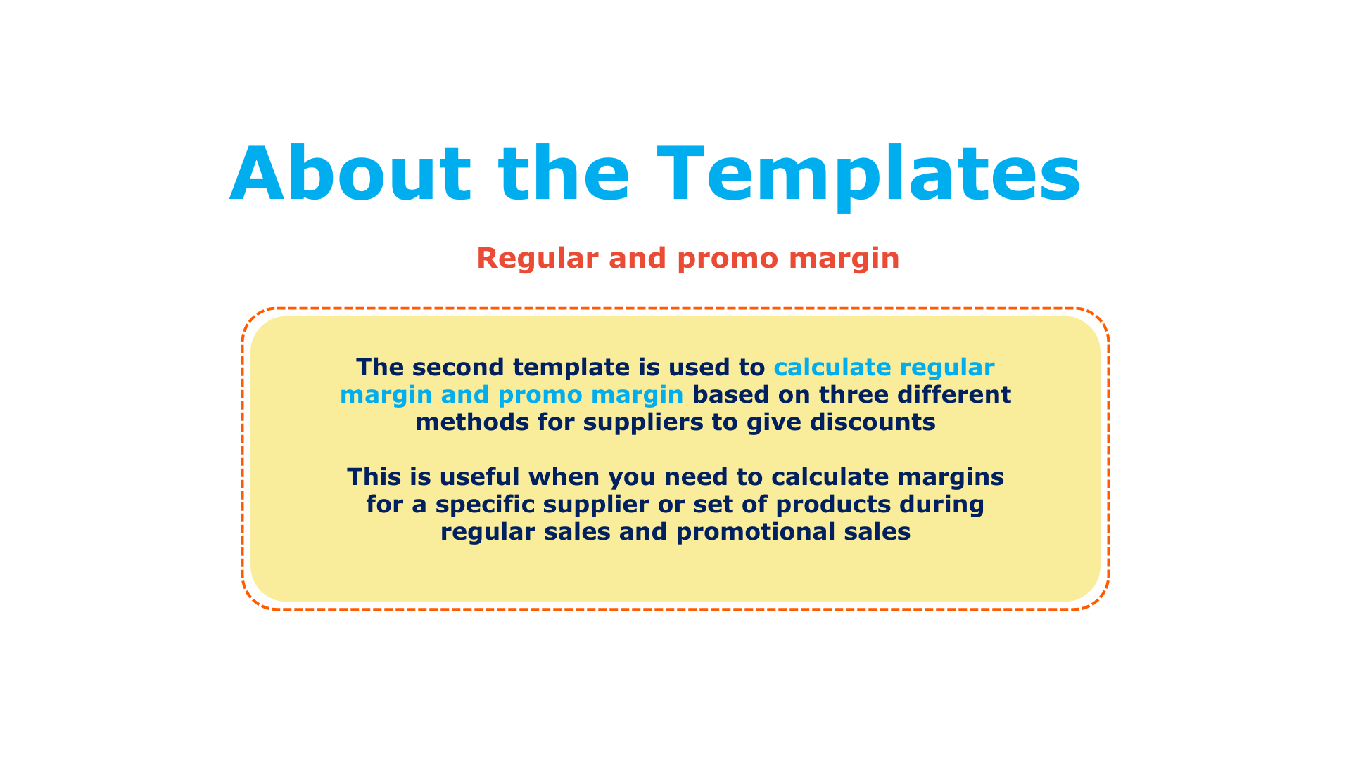

Slide 10
It’s a wrap!
Thank you!

