Slide 1


Negotiation Preparation Toolkit Template
Video Tutorial Link: https://youtu.be/y7fO8T2LuDs?si=mcIoBGqCjoZBEPd6

Slide 2
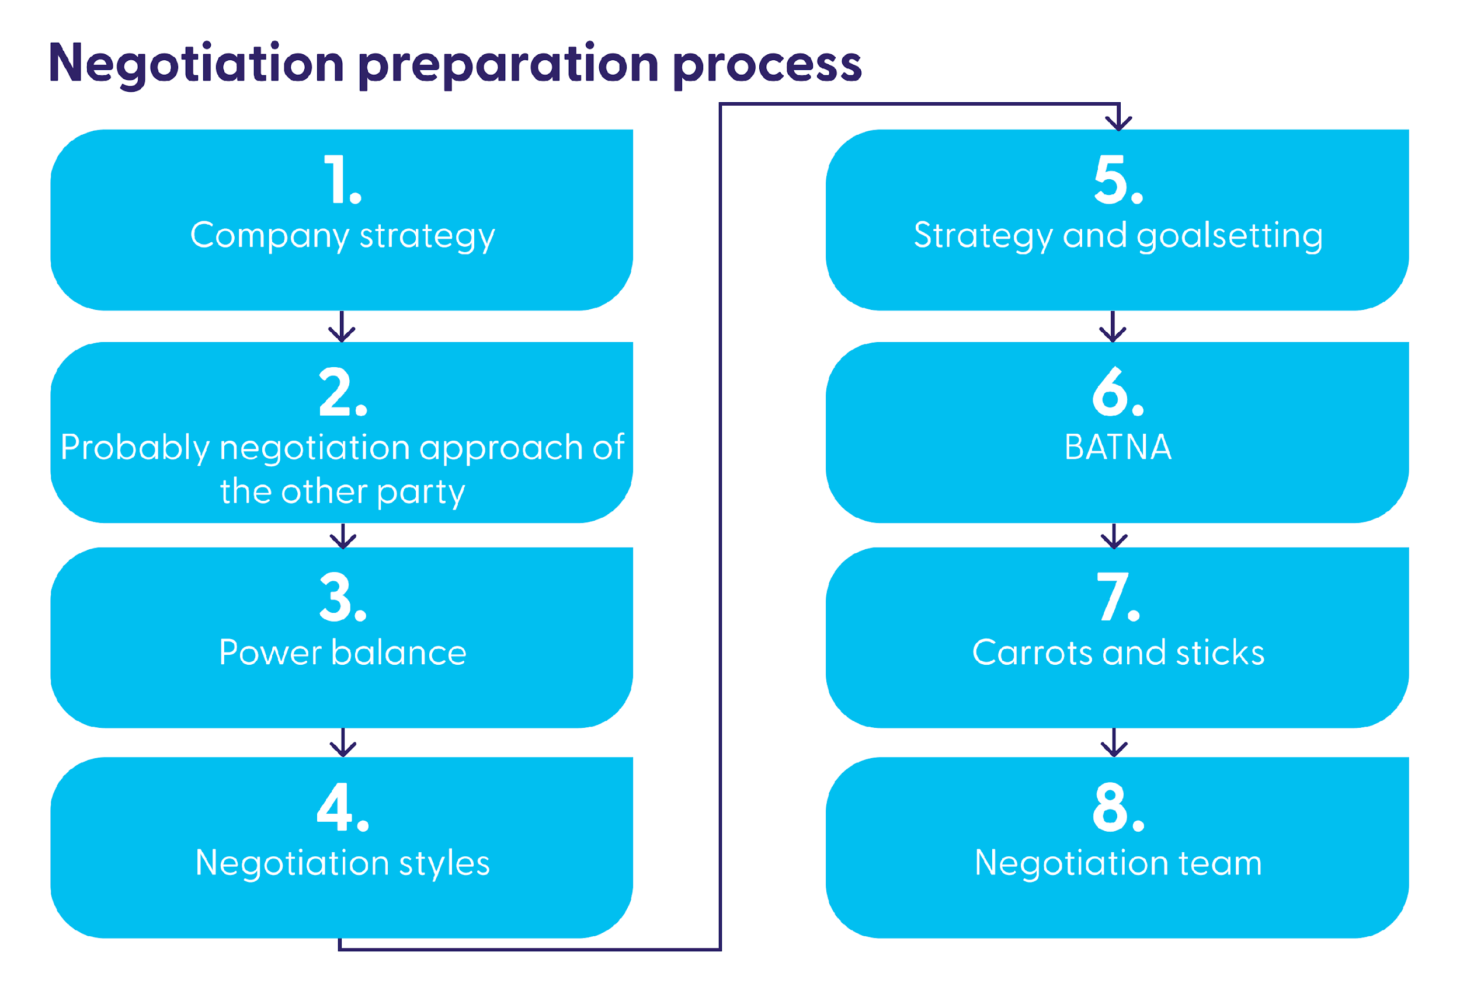

Slide 3
Excepted supplier arguments
Negotiation variable theme
Expected argument suppliers
Counter argument

Slide 4
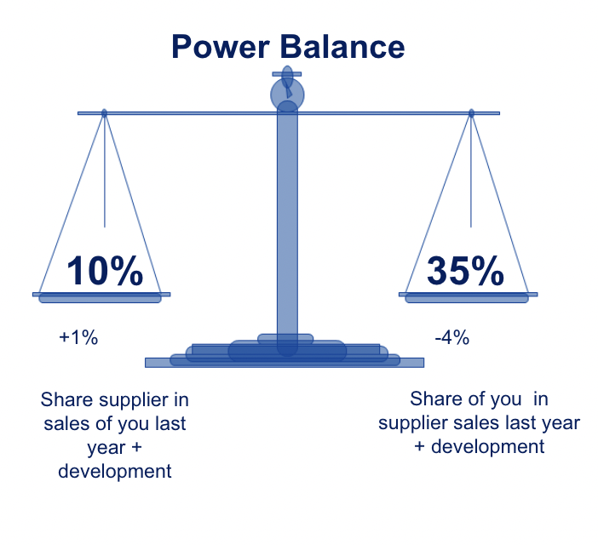
Power Balance template
Supplier A
Supplier B
Supplier C
Supplier D
Supplier E
Your share in total
sales of supplier
xx%
xx%
xx%
xx%
xx%
Supplier share in total
sales of your company
xx%
xx%
xx%
xx%
xx%

Slide 5
Comparing proposals template
Supplier 1
Supplier 2
Supplier 3
Winner
Price
Best
Medium
Worst
Supplier 1
Quality
Medium
Best
Worst
Supplier 2
Speed
Best
Medium
Worst
Supplier 1
X
Medium
Worst
Best
Supplier 3
Y
Worst
Best
Medium
Supplier 2
Z
Best
Medium
Worst
Supplier 1

Slide 6
Comparing suppliers template
Supplier A
Supplier B
Supplier C
Supplier D
Supplier E
Supplier share in
total tales with you
xx%
xx%
xx%
xx%
xx%
Total sales in dollars
Growth vs LY
% margin
Growth vs LY
Margin in dollars
Media investments
Purchase volume
rebate
Growth bonus

Slide 7
Negotiation variable ranking template
Variable
Important to me
Important to them

Slide 8
Qualitative deal movement template
Qualitative movement
Cost price
Logistics
Investments
Investments
Growth bonus
Payment terms
Variable xxx

Slide 9
Like, intent, breakpoint template
Negotiation Variables
Like to achieve
Intent to achieve
Breakpoint to achieve

Slide 10
Negotiation Trade-off template
Importance to
supplier (select one)
Takes
Gives
When
Variable 1
High / Medium / Low
Variable 2
High / Medium / Low
Variable 3
High / Medium / Low
Variable 4
High / Medium / Low
Variable 5
High / Medium / Low
Variable 6
High / Medium / Low
Variable 7

Slide 11
Negotiation opening template
Supplier X
Supplier Y
Supplier Z
Price
$xxx
Investments
$xxx
Payment term
Other variable 1
Delta vs deal last year
$xxx

Slide 12
Carrots/Gives & Sticks/Takes template
Carrots / gives
Sticks / takes
Supplier A
Supplier B
Supplier C
Supplier D

Slide 13
Escalation plan template
Cooperative scenario
Do now
When
Impact to them in $
Impact to us in $
Consumption /
assumptions
Escalation 1
Total impact
Uncooperative scenario
Do now
When
Impact to them in $
Impact to us in $
Consumption /
assumptions
Escalation 1
Total impact

