Slide 1





Culture and Negotiation Styles
Video Tutorial Link: https://youtu.be/qm3cCD_Y5ew?si=Ygzur94NC9lE2t3m
Notes:
Hello, and welcome to the Negotiating in Asia Template.

Slide 2

Let me introduce myself
Notes:
Before we dive into the details of this template, let me introduce myself first:
My name is Aleksandra Panic and I am the head of product at Procurement Tactics.
I’m thrilled that you’re here!
The team at Procurement Tactics has over 20 years of experience in procurement and negotiations. Let’s delay no further!
We have been working on providing you with a template to navigate negotiations when dealing with individuals from diverse cultural backgrounds. Today, we'll focus on negotiating in Asia, and I'll assist you through the process.

Slide 3
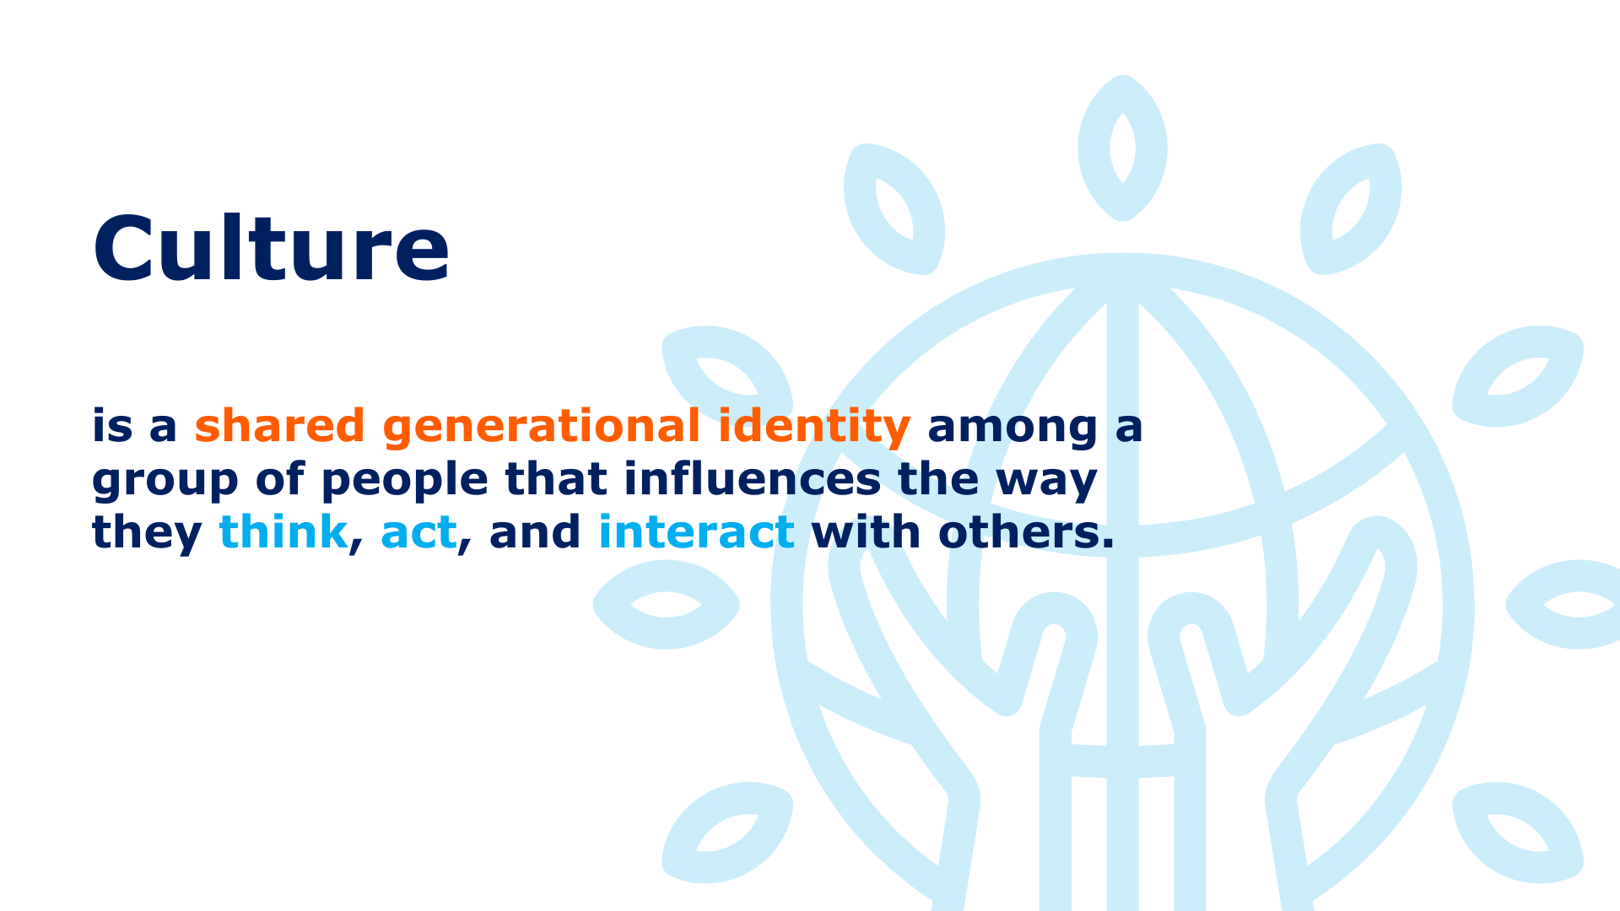

Notes:
Culture is a shared generational identity among a group of people that influences the way they think, act, and interact with others. Since culture plays a big role in shaping a person, their decisions, and behavior, it also significantly shapes how they handle their business matters and negotiations. A person’s culture informs us of their negotiation goals and how they may manage their negotiations along with various other aspects of their behavior.

Slide 4
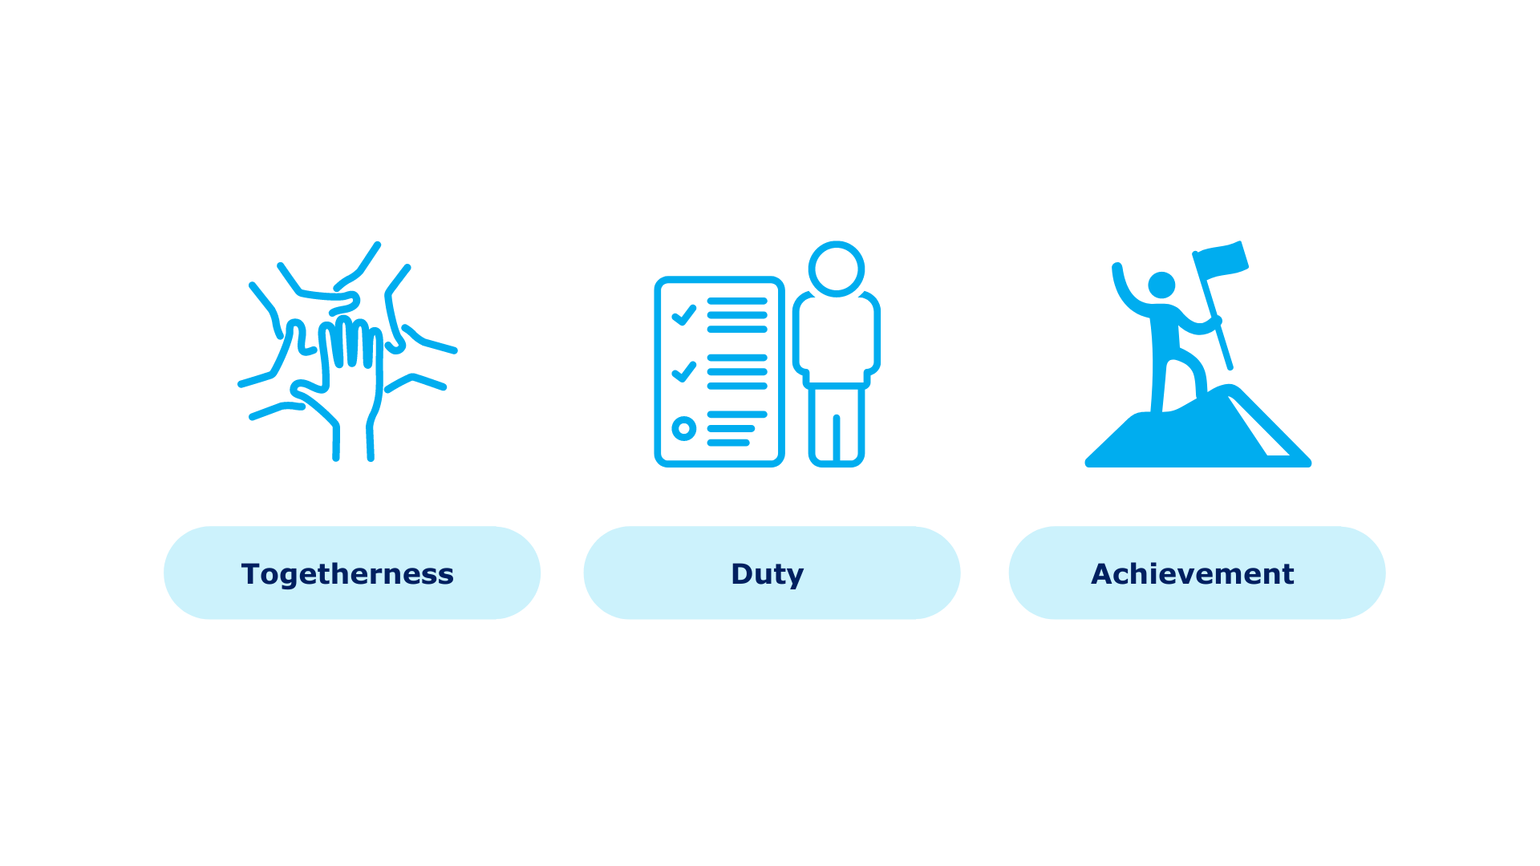
Asian Culture
Notes:
Today, we will be talking about Asian cultures specifically.
Many Asian cultures like China, South Korea, and Japan are known to be collectivistic cultures, prioritizing the collective good over individual goals and emphasizing the rights of the community above personal rights. This means that they lean towards togetherness, duty, and achievement of group goals while tending to avoid conflict and achieve compromise. This is important to note when exploring Asian culture.

Slide 5
Disclaimer!
In our pursuit to teach you about culture, we acknowledge that although it is a significant factor, we cannot attribute everything solely on cultural differences.
Notes:
Now, a short disclaimer. In our pursuit to teach you about culture, we acknowledge that although it is a significant factor, we cannot attribute everything solely on cultural differences.
The template I’m guiding you through today is Culture and Negotiations: Asian Style!
Let’s dive into it!

Slide 6
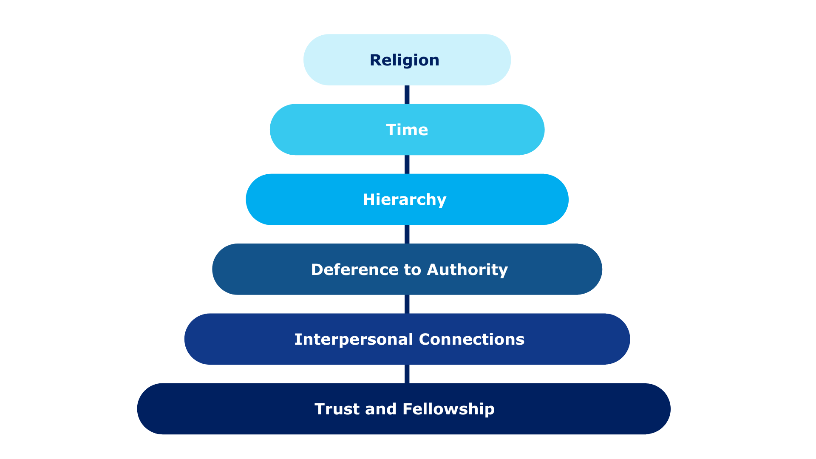
Cultural Patterns in Asian Negotiation
Notes:
Have you ever wondered about Asia’s cultural patterns and negotiation styles? Well if you have then it’s your lucky day because we’ll discuss all this and beyond.
Asia hosts various cultural identities that shape the region’s uniqueness. These cultural identities can overlap in some aspects but the many cultures remain distinct from each other.
An important thing to establish beforehand is that Asian culture is heavily influenced by religion and so is their negotiation style. This shows certain concepts also present in their business culture like "Guangxi" in Chinese culture and "senpai-kohai" in Japanese culture.
Generally, Asian business practices prioritize time, hierarchy, deference to authority, and the cultivation of strong interpersonal connections. Maintaining face, or preserving reputation is also prominent in Asian business cultures.
Moreover, business dealings in many Asian societies unfold gradually, emphasizing on establishing trust and fellowship before engaging in substantive discussions.
The cultural patterns of Asia are also another thing.

Slide 7
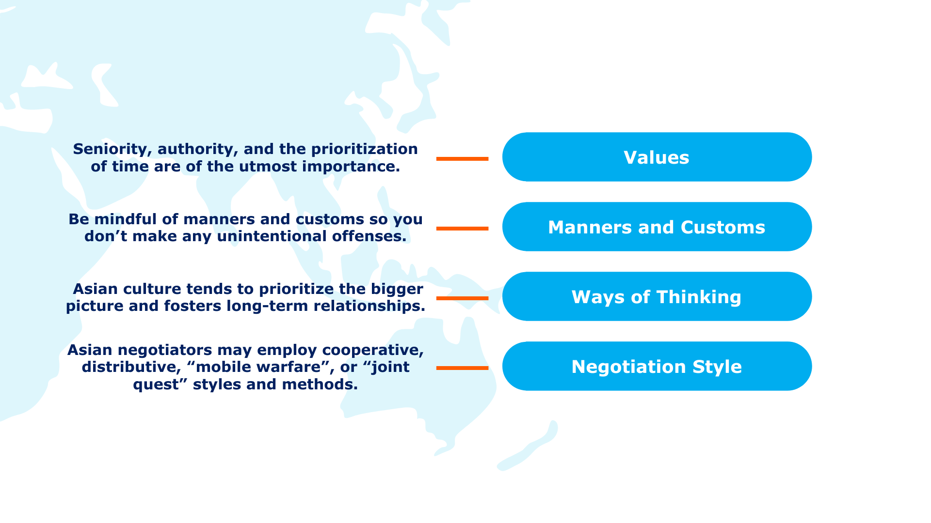
Influence and Priorities in Asian Business Culture
Notes:
Let’s start with their values.
Seniority, authority, and the prioritization of time are of the utmost importance. Asian culture tends to give more value to those with more seniority or authority, to the point where objectivity in making decisions may be obscured. They also see their time as personal and valuable which makes punctuality a common practice.
This applies to both their business culture and their culture in general.
Let’s turn to their manners and customs.
As much as possible, when you’re holding negotiations in Asia, it’s better to be mindful of their manners and customs so you don’t make any unintentional offenses.
An example is the importance of greetings in Asian cultures, such as the traditional “Namaste” in India or bowing in Japan and South Korea, which serve as gestures of respect.
What about their ways of thinking?
Erin Meyer, who wrote a book about the Culture Map, says that the key feature in Asian thinking is focusing on the overall situation. Due to this emphasis, Asian culture tends to prioritize the bigger picture and fosters long-term relationships. This approach is seen as beneficial for both parties in the long run.
This leads us to their relationship-building style. Negotiations and businesses are slow-paced because they are selective of partnerships and look for long-term relationships.
Now with those finished, let’s focus on their negotiation style.
Asian negotiators usually employ a cooperative negotiation style but they may also use a distributive negotiation style. Some strategies Asian negotiators tend to use may employ a “mobile warfare” approach, which use deception and manipulation to weaken you. Or use a collaborative "joint quest" method, seeking mutual value through subtle exchanges.

Slide 8
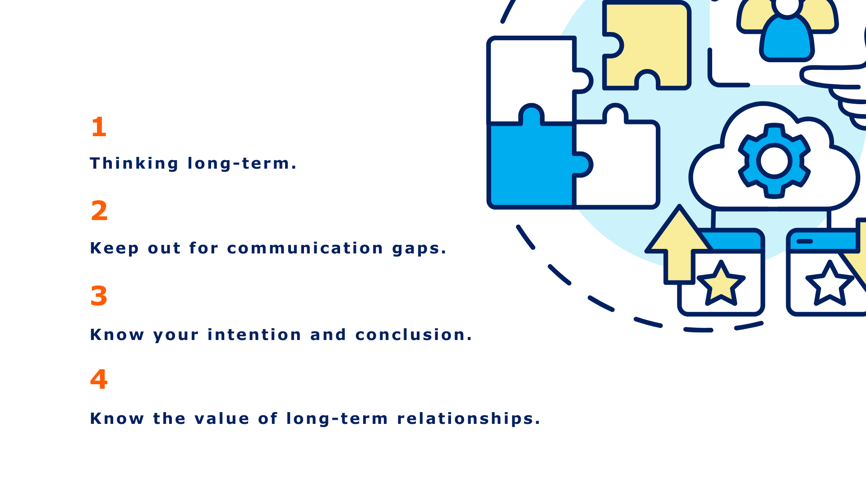
Ta Wei Chaos’ Advice
Notes:
For the preparation of Asian negotiations keep in mind these four things, which were inspired by Ta Wei Chao’s advice from the ESSEC Business School:
First, think long-term. Second, keep out for communication gaps. Third, know your intention and conclusion. And fourth, know the value of long-term relationships.
These are significant for your negotiation needs, especially when dealing with Negotiations in Asia.

Slide 9
Exploring Negotiation Styles of Asian Countries
Notes:
After a general overview of Asian culture and negotiation, let's introduce the three chosen countries we’ve focused on: Japan, South Korea, and China. Asia is a big continent and we couldn’t include every country in the region but here are three country’s negotiation styles that may be significant to you.

Slide 10
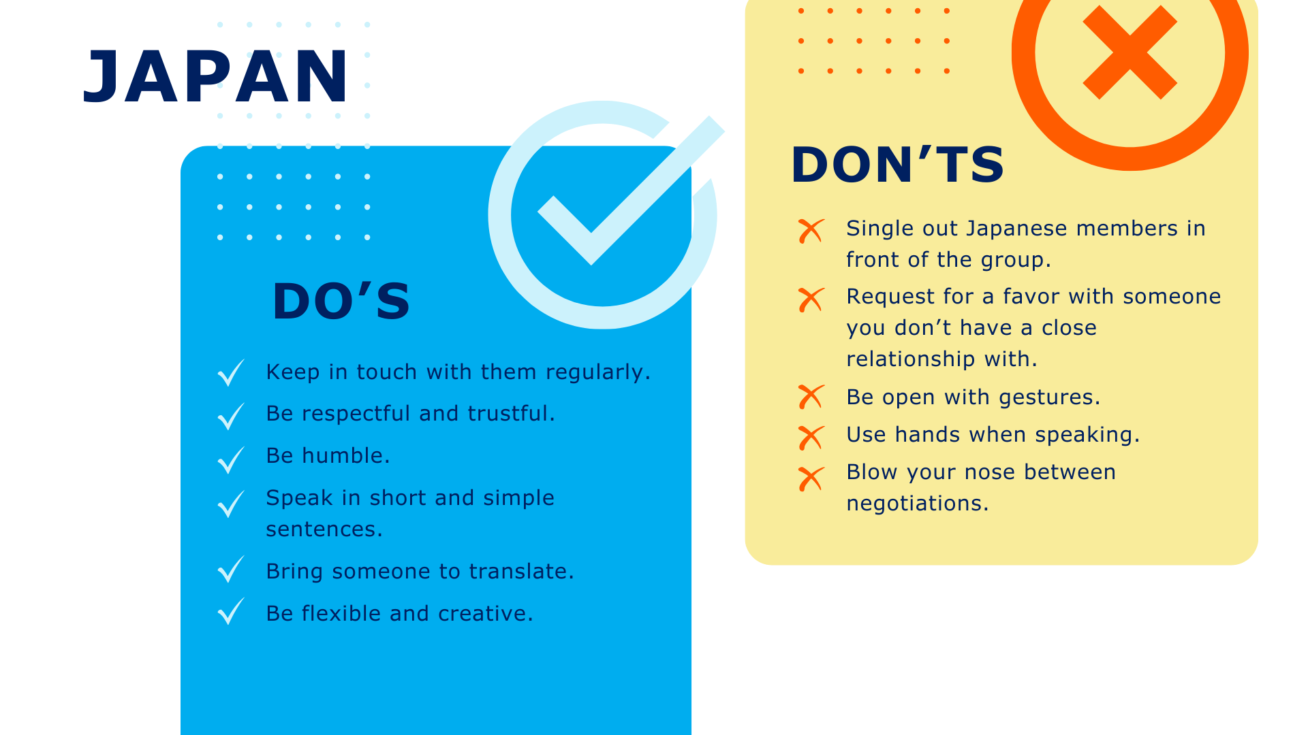
Notes:
First, Japan.
Japanese negotiators put a high value on relationships, and are group-oriented. Before closing any deals with you, there must already be an existing relationship. This is a bit difficult to do since Japanese negotiators prefer to take their time in relationship building.
Negotiations tend to be slow with them and they expect relationships to be mutually beneficial.
When having negotiations with them, do:
Regularly keep in touch.
Be respectful, trustworthy, and humble.
Speak in short and simple sentences.
Bring a translator.
Be flexible and creative.
Do not:
Single out Japanese members in front of the group for praise or criticism.
Requesting favors without an established relationship.
Wide and open gestures.
Using hands when speaking.
Display private behavior in public

Slide 11
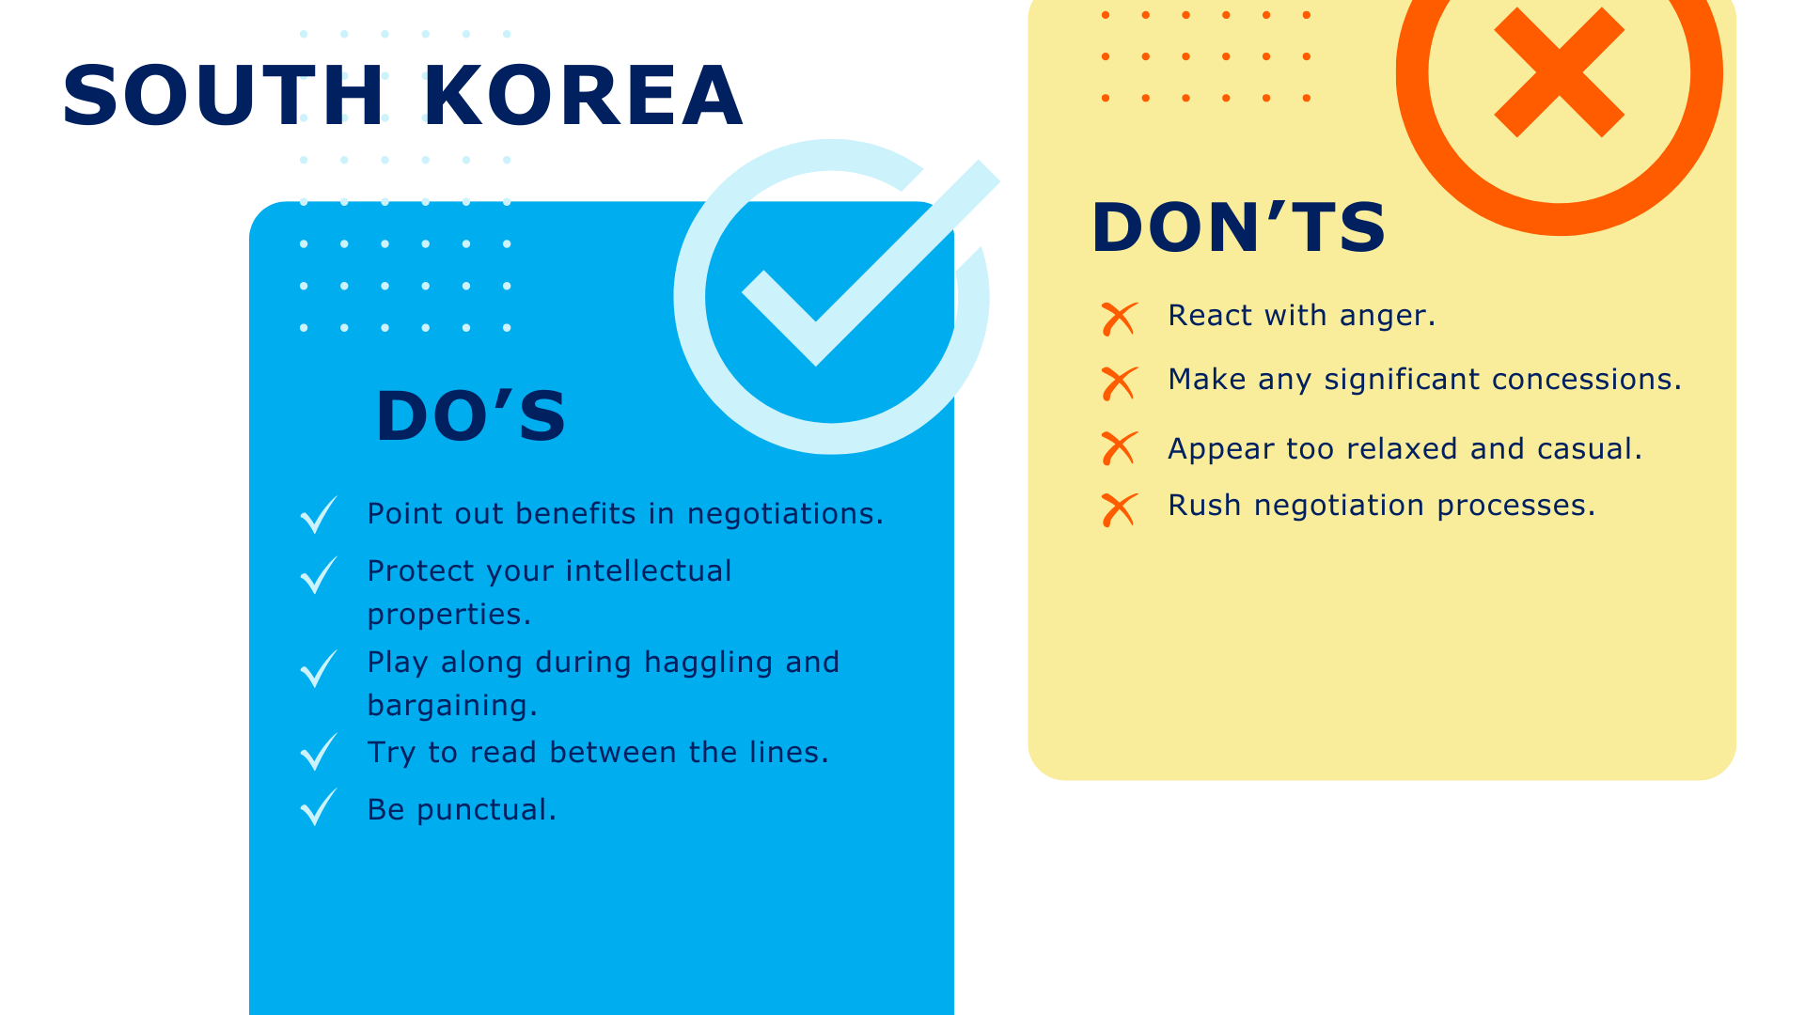
Notes:
Second, South Korea.
According to Daniella Fjellstrom who conducted a case study on factors that influence negotiations, South Koreans like to have a clear vision and mission, strong ambition, and rapid decision-making, as well as clear implementation of plans and commitment.
When negotiating with South Koreans, communication can sometimes be indirect. You need to read between the lines as their “no” and “yes” can mean a lot of things, depending on how they behave. For instance, a “maybe” accompanied by squinting of eyes or tipping the head back can mean “no.”
When having negotiations with them, do:
Point out benefits in negotiations.
Protect intellectual properties.
Participate in their haggling and bargaining.
Read between the lines.
Be punctual.
Do not:
React with anger.
Make significant concessions.
Appear too relaxed and casual
Rush negotiation processes.

Slide 12
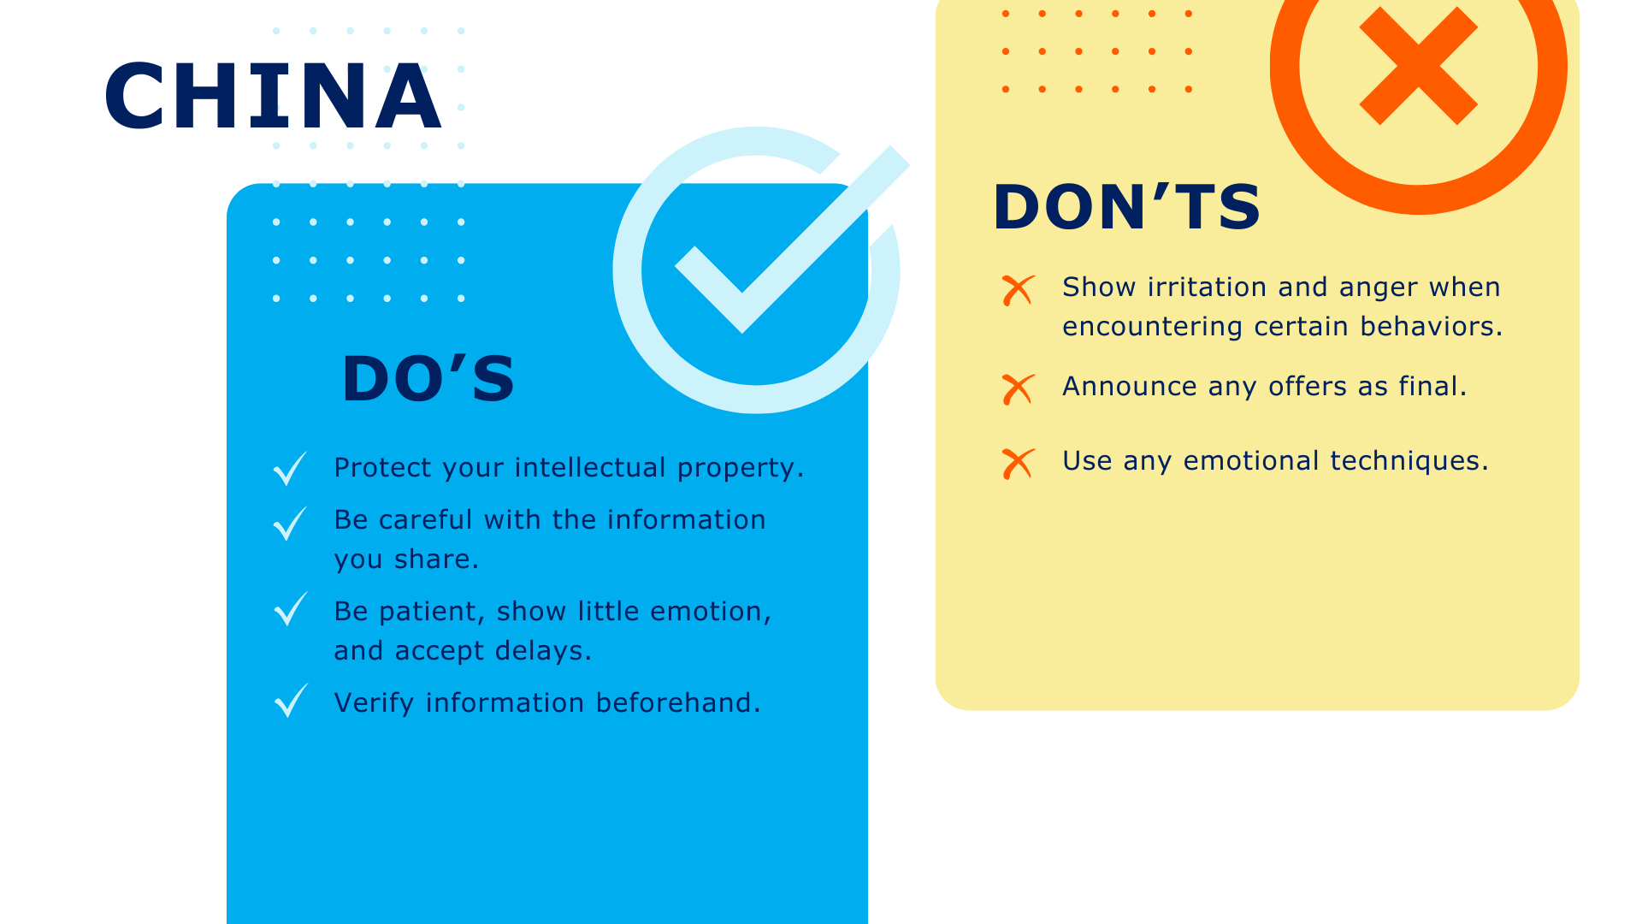
Notes:
Third, China.
Chinese negotiators also like long-term relationships, tend to be competitive, and appear fierce over small gains. Due to these reasons, the process of information sharing can take months or years!
According to Dr. Lieh-Ching Chang from Hsuan Chuang University, a typical Chinese negotiator is quiet during negotiations, and often find loud and talkative people immature. When it comes to bargaining – they set a high price before slowly making concessions.
When having negotiations with them, do:
Protect intellectual property.
Be careful of the information you share.
Be patient, show little emotion, and accept delays.
Verify information beforehand.
Do not:
Show irritation and anger.
Announce any offer as final.
Use emotional techniques.

Slide 13
It’s a wrap!
Thank you!
Notes:
In this template, we have given you a general overview of Asian culture and how this affects their negotiation styles. Remember, Asian culture emphasizes religion, hierarchy, and building long-term and personal relationships in business practices.
However, culture is not the only factor influencing negotiation outcomes and behaviors. Although culture is a big influence, make sure to also research on the individual or group that you are to negotiate with to maximize your advantage.
There’s no doubt that Asia has varied cultures and negotiation styles which is why we have been working on creating templates for different types of cultures. If you want to know more make sure to check out our Cultural Impact on Negotiations course. Remember, it only ever benefits you to be prepared.
Thank you for exploring how Asian culture influences negotiations and outcomes with us.
That’s a wrap! Thank you for joining me today and I hope you learned some tips on how to manage your negotiations when working with counterparts from the Asian culture.

