Slide 1





Culture and Negotiation Styles in Europe
Video Tutorial Link: https://youtu.be/BorDTP1vURI?si=Nvdl4v24XjWPd9hA

Slide 2

Let me introduce myself

Slide 3
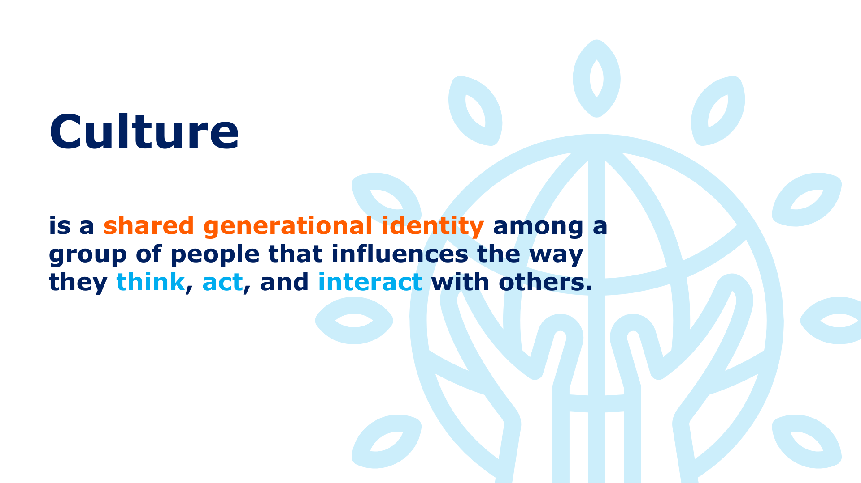


Slide 4
Disclaimer!
In our pursuit to teach you about culture, we acknowledge that although it is a significant factor, we cannot attribute everything solely on cultural differences.

Slide 5
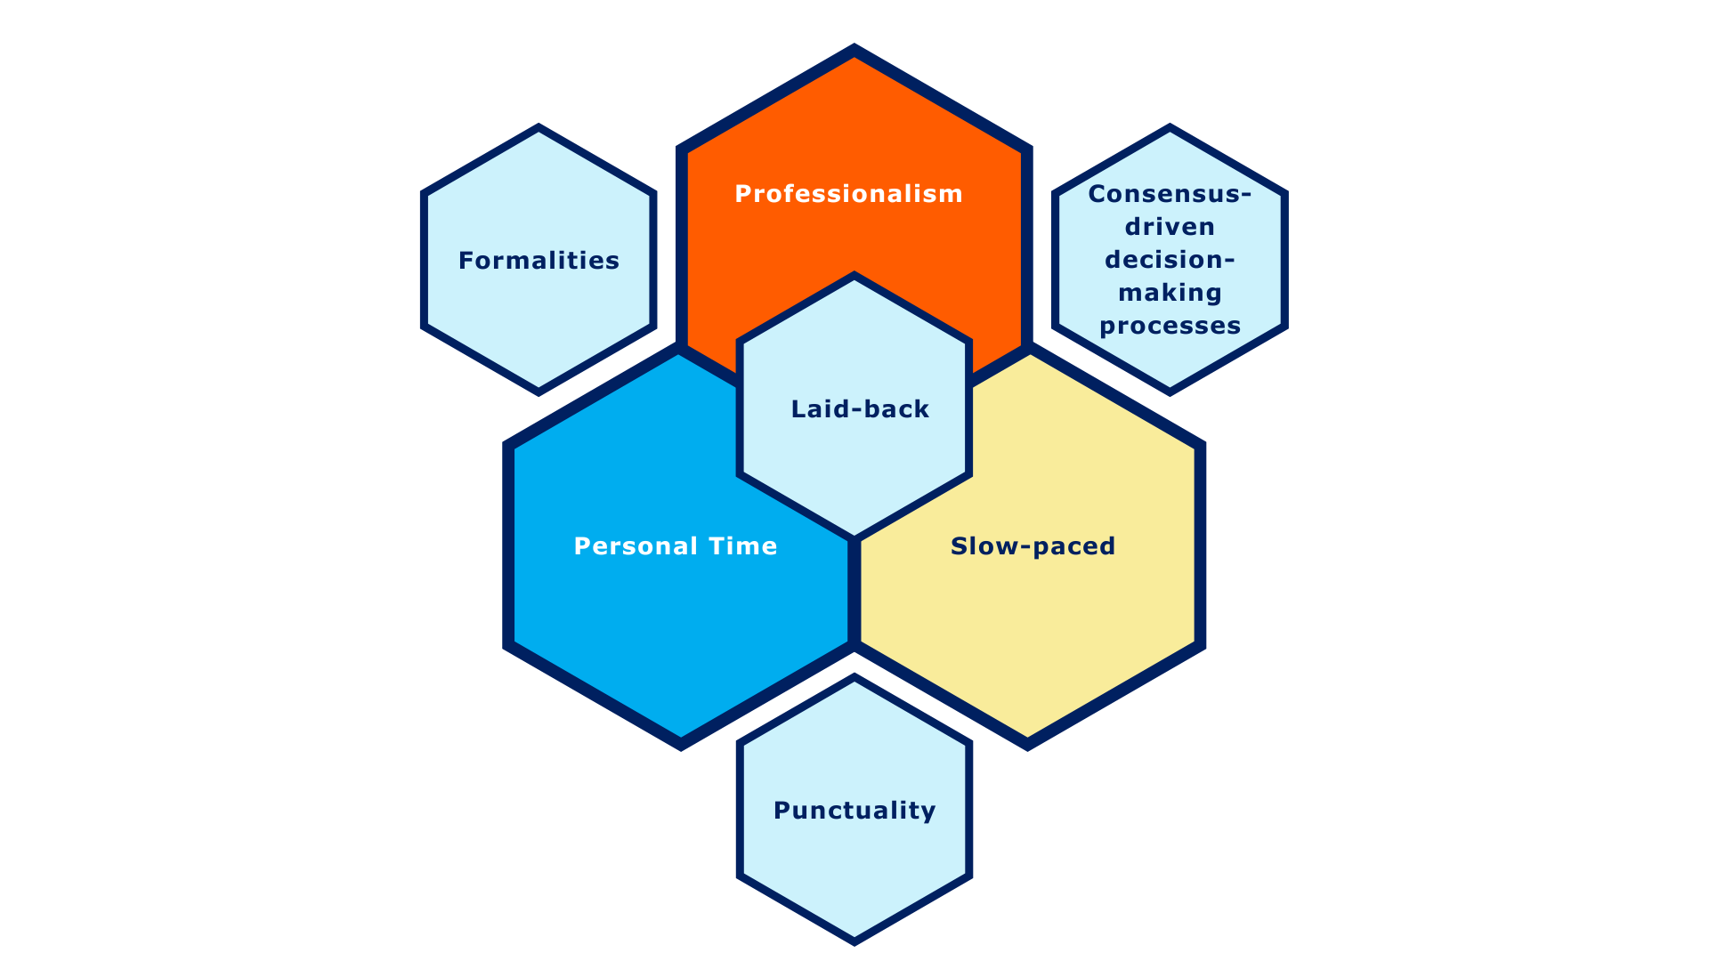
Cultural Patterns in European Negotiation

Slide 6
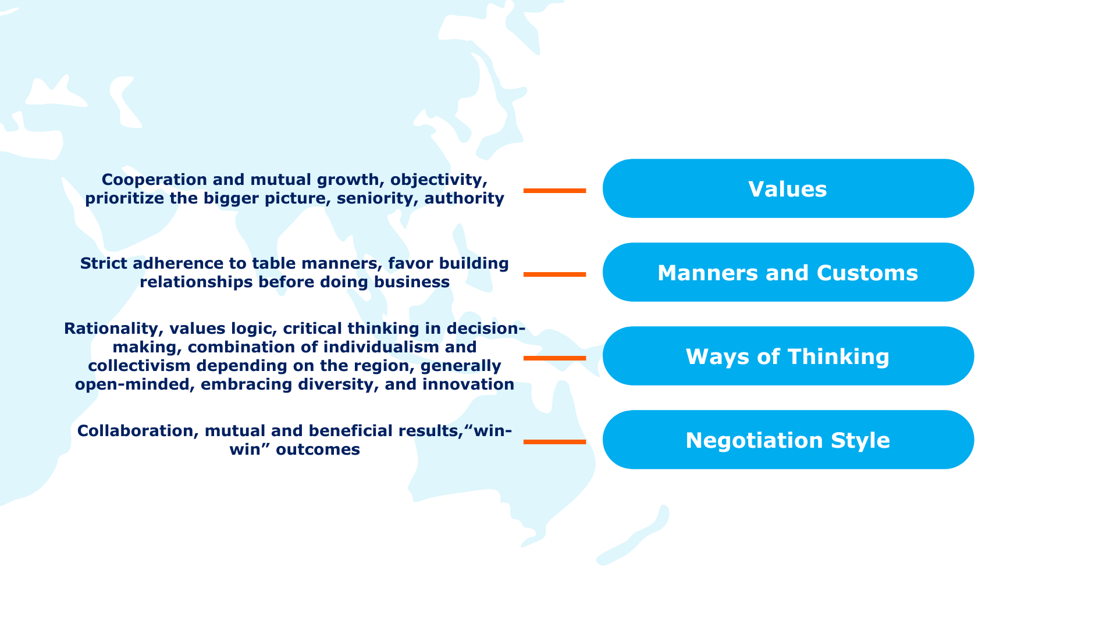
Influence and Priorities in European Business Culture

Slide 7
Exploring Negotiation Styles of European Countries

Slide 8
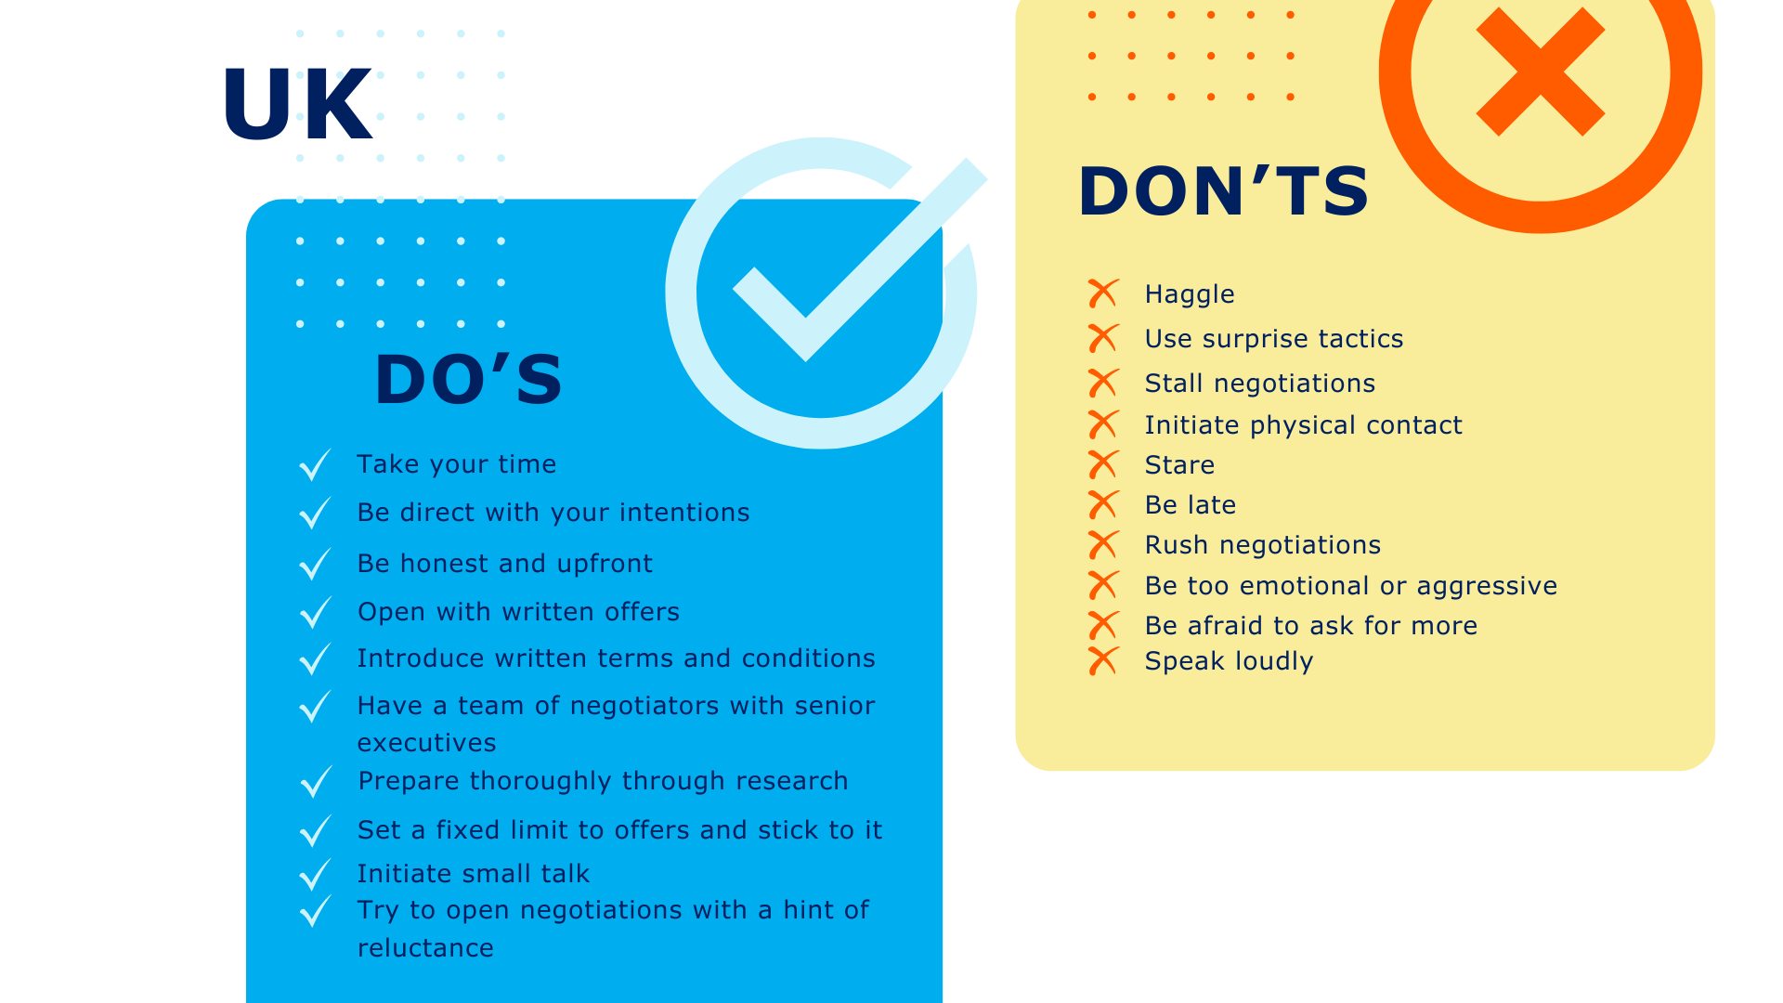

Slide 9
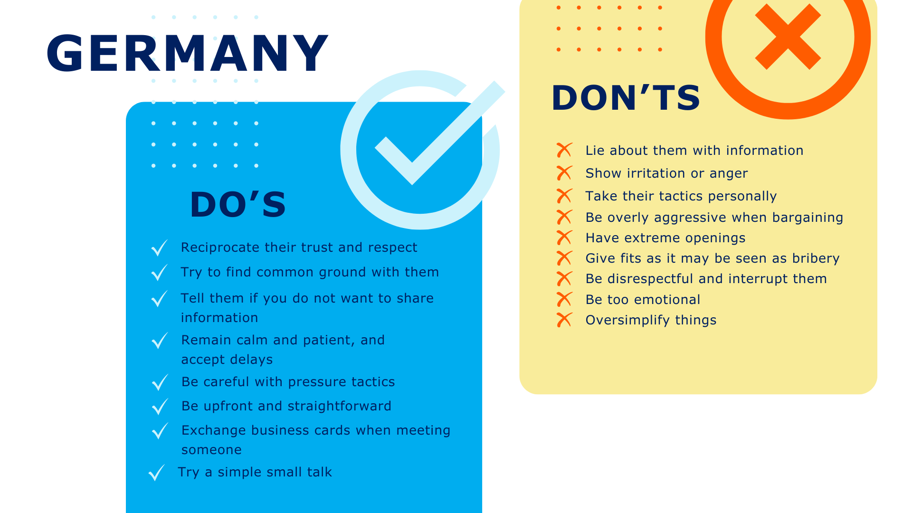

Slide 10
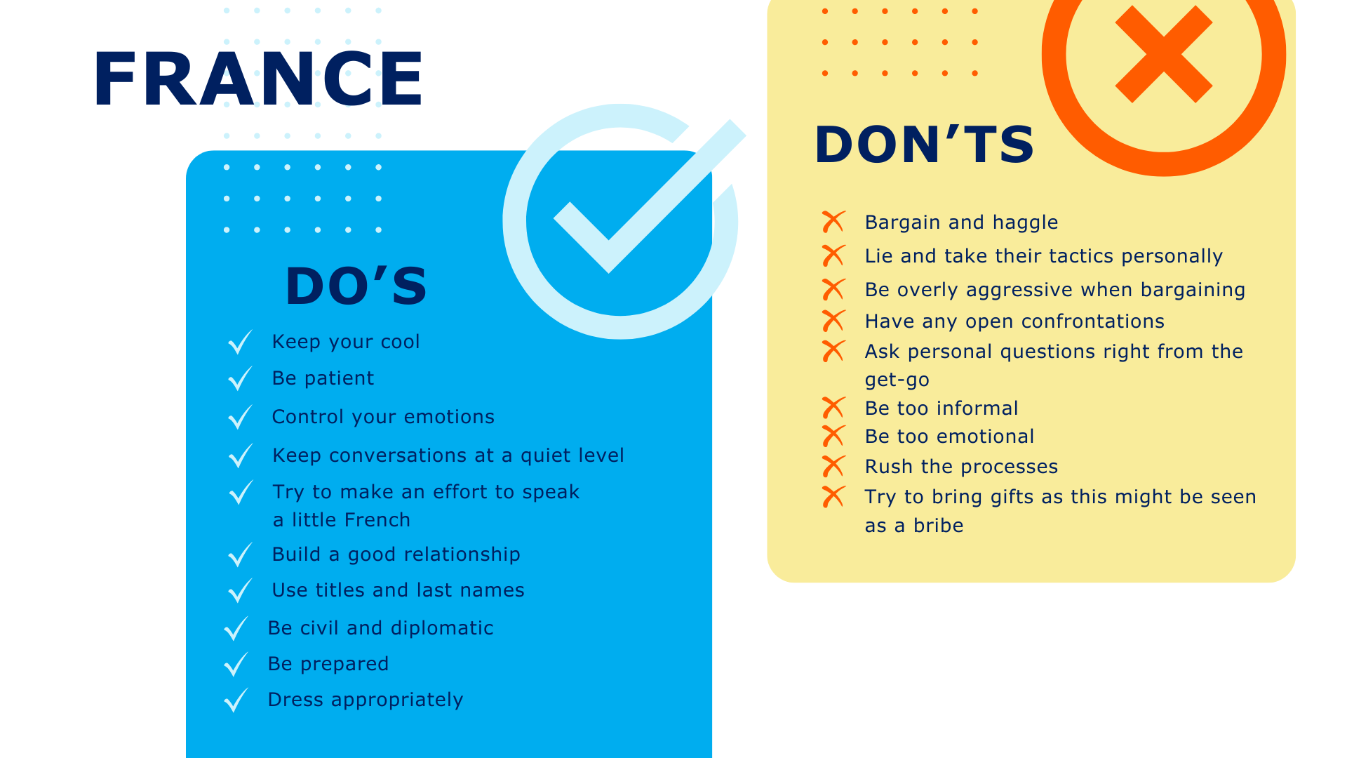

Slide 11
It’s a wrap!
Thank you!

