Slide 1





Culture and Negotiation Styles North America
Video Tutorial Link: https://youtu.be/uih4zv5U_tk?si=_rKu2peCFLYLpnZ5

Slide 2

Let me introduce myself

Slide 3



Slide 4
Disclaimer!
In our pursuit to teach you about culture, we acknowledge that although it is a significant factor, we cannot attribute everything solely on cultural differences.

Slide 5
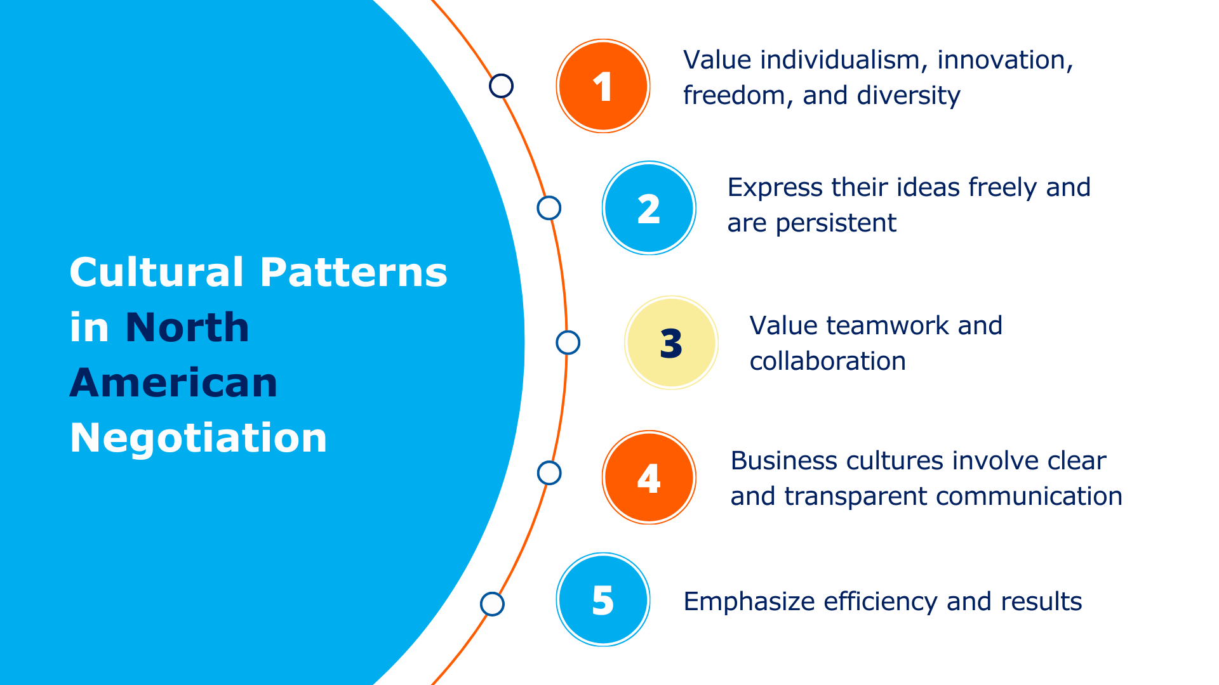

Slide 6
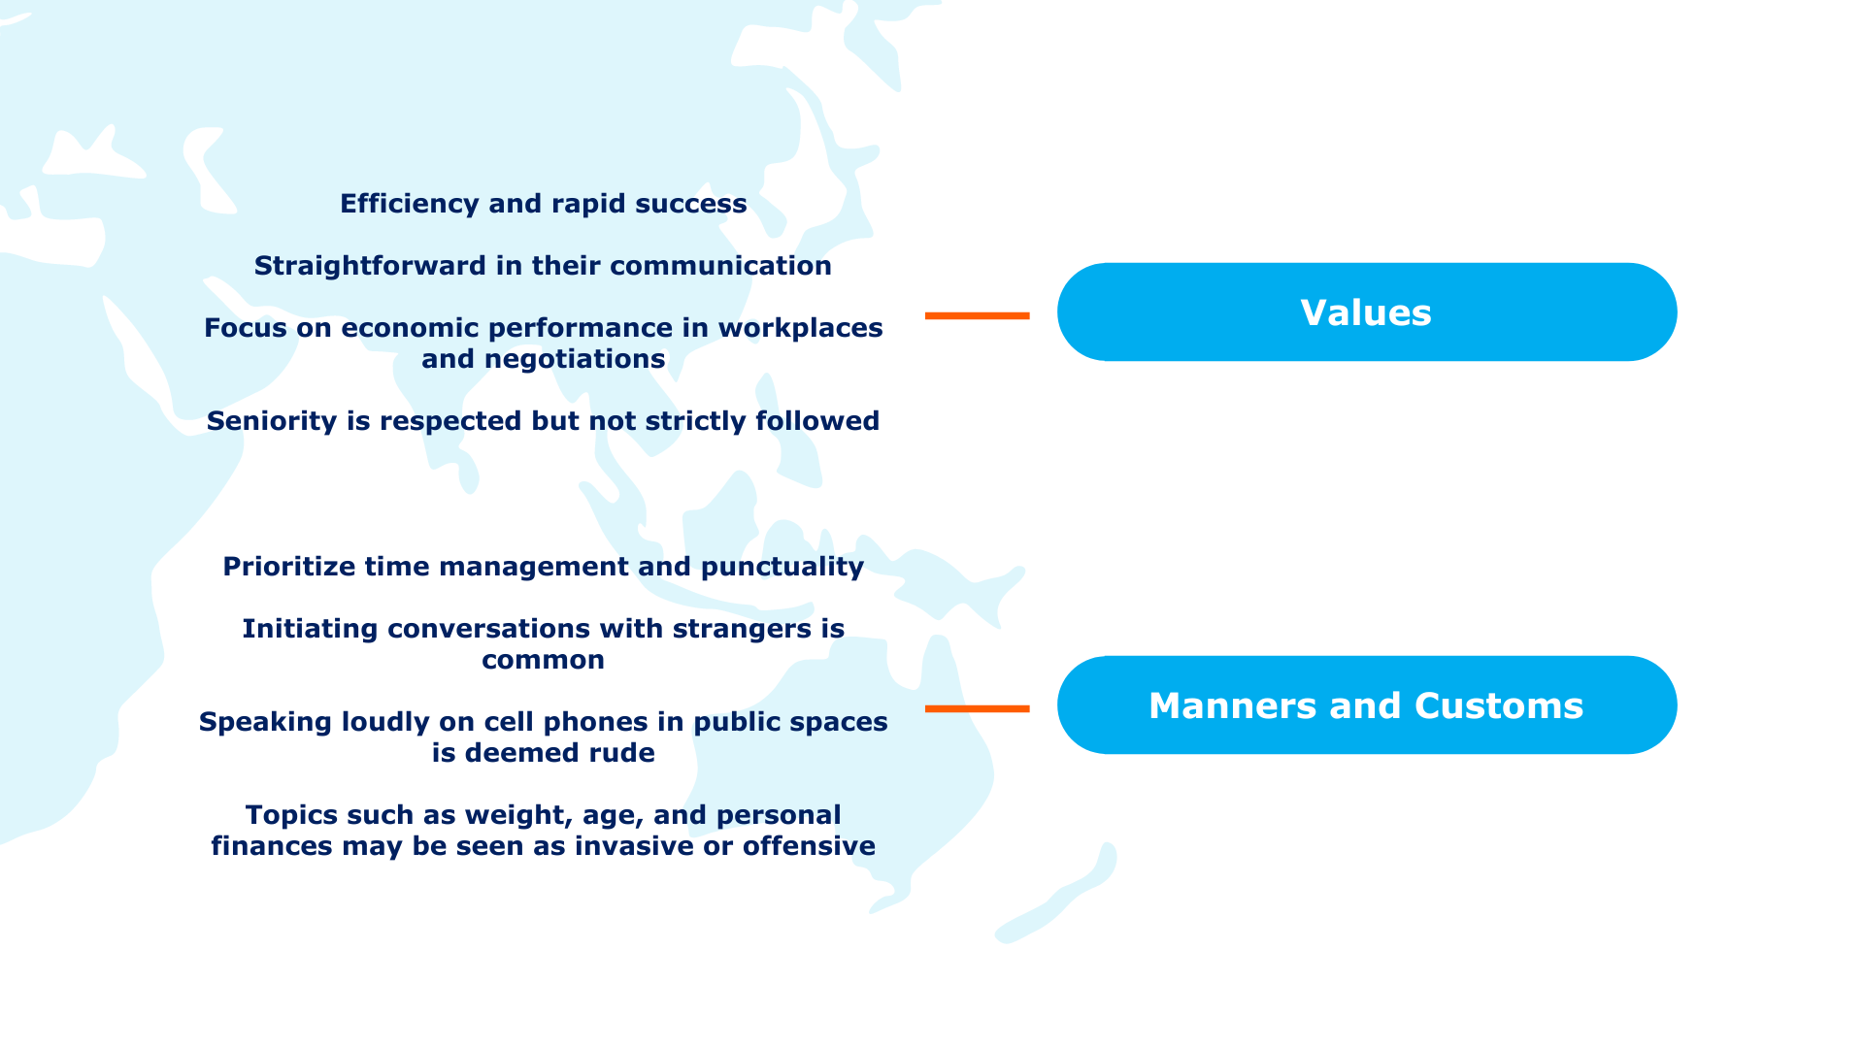

Slide 7
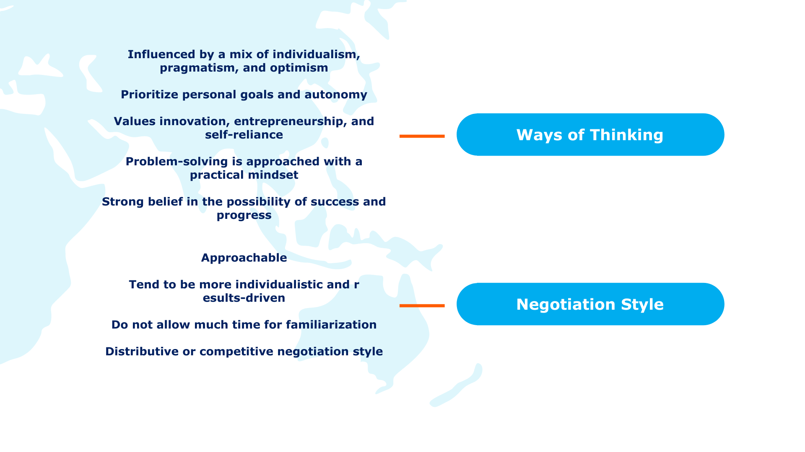

Slide 8
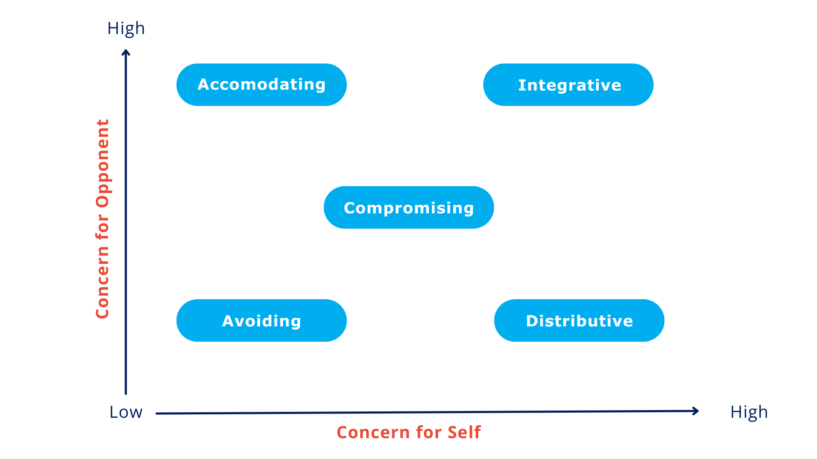

Slide 9
Exploring Negotiation Styles of North American Countries

Slide 10
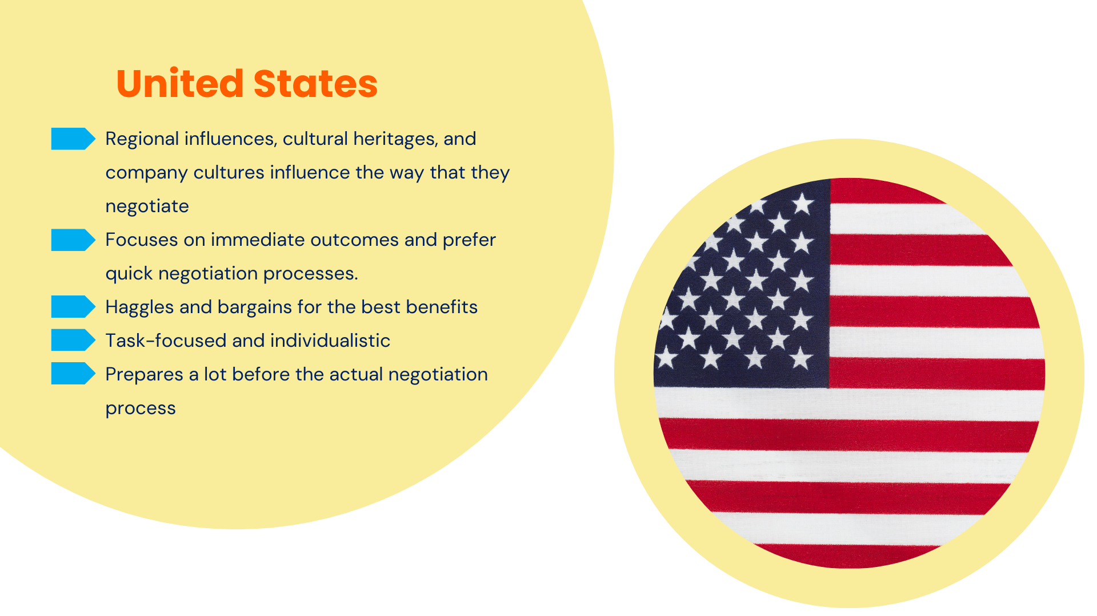

Slide 11
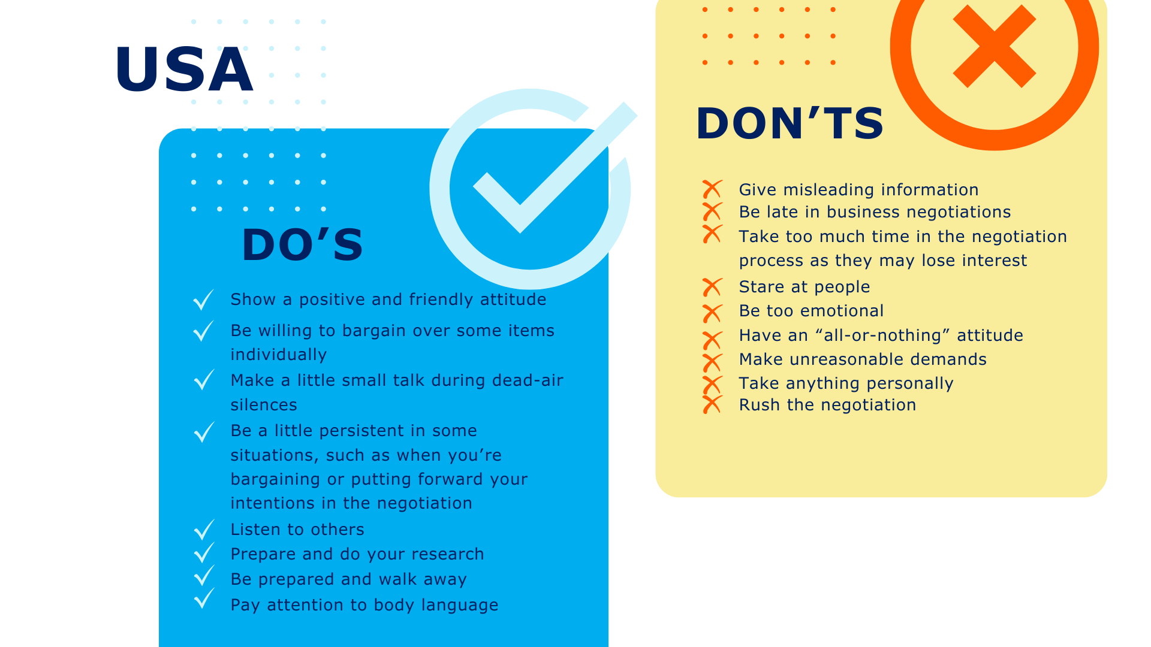

Slide 12
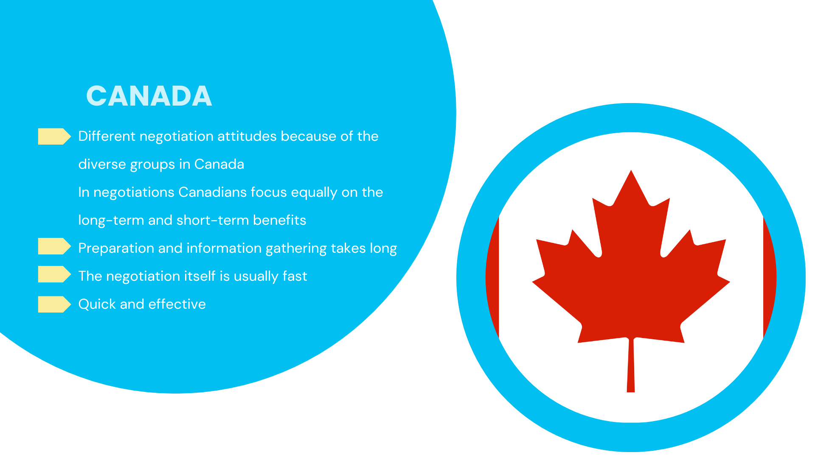

Slide 13
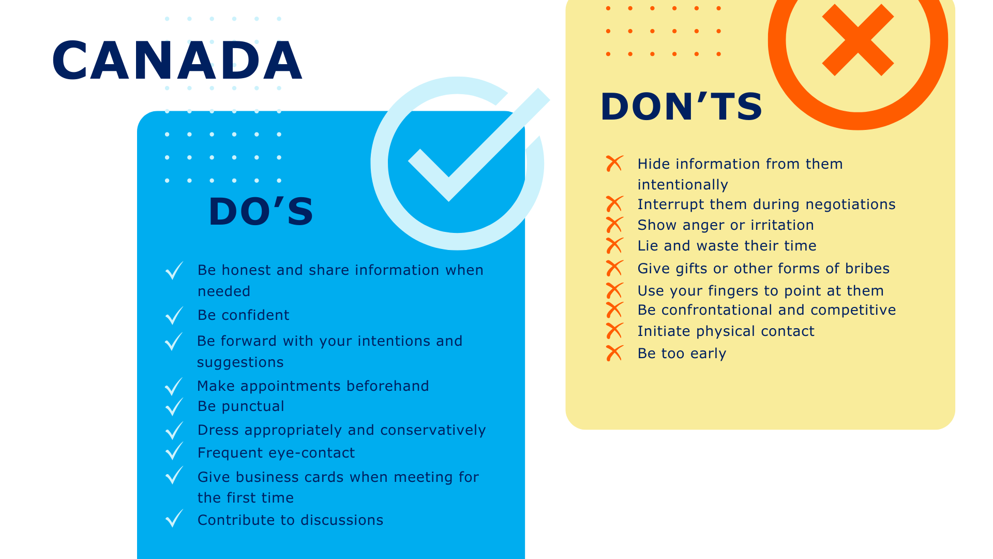

Slide 14
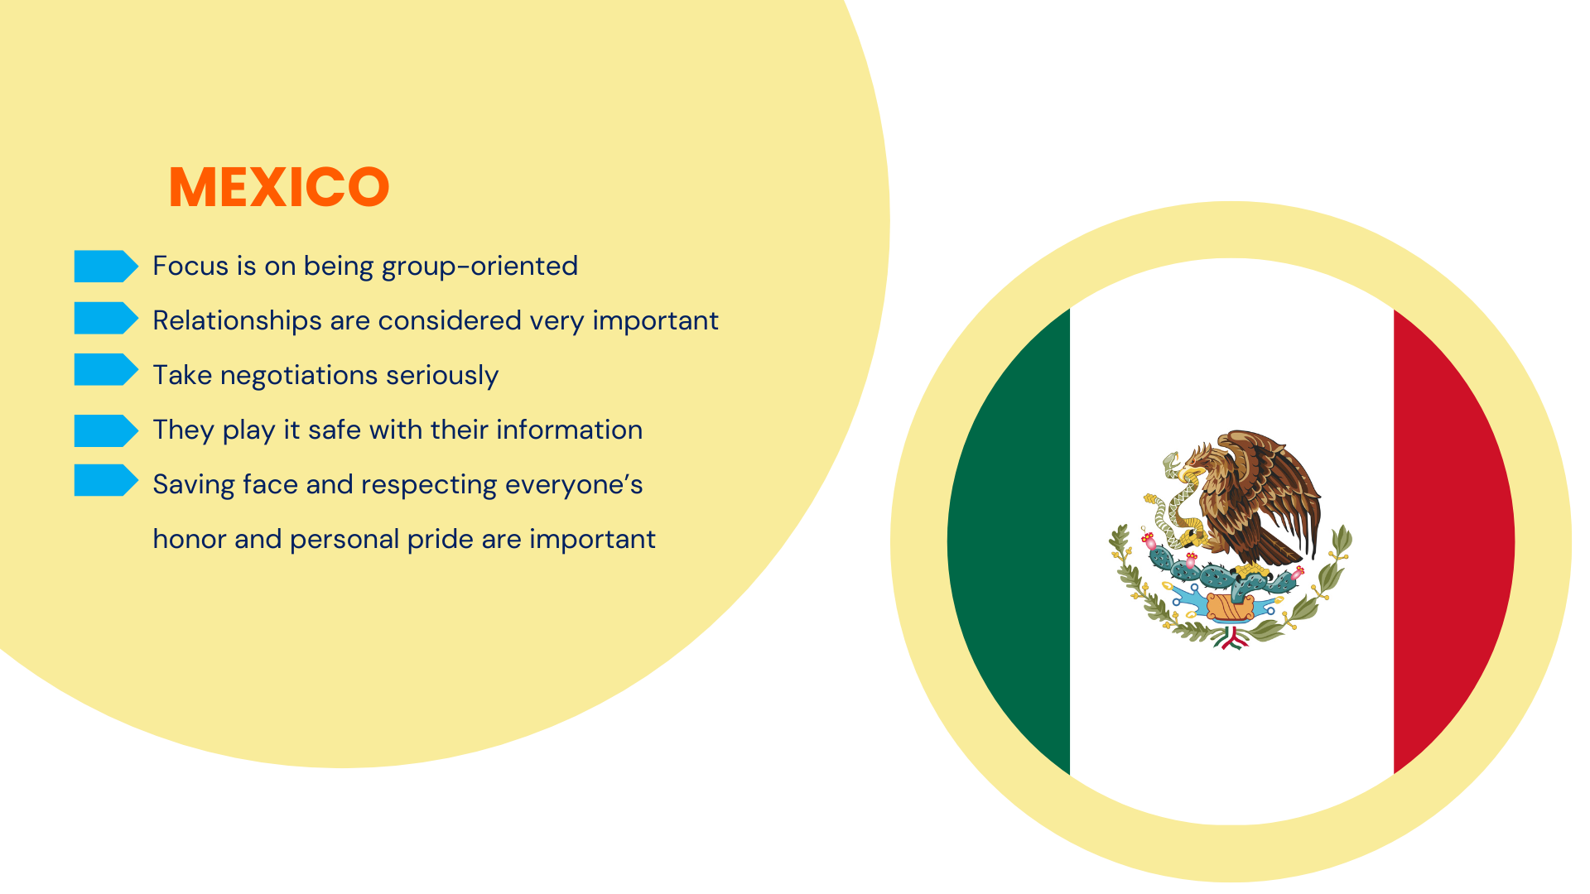

Slide 15
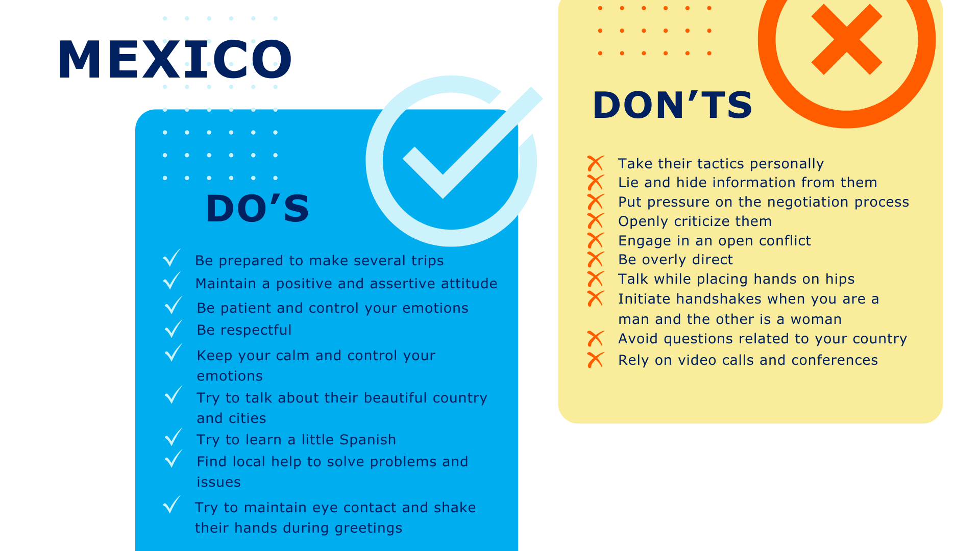

Slide 16
It’s a wrap!
Thank you!

