Slide 1
Procurement Contract
Template
Video Tutorial Link: https://youtu.be/yDFId20HnMk?si=DSjZdKcXA8yNboQ4

Slide 2
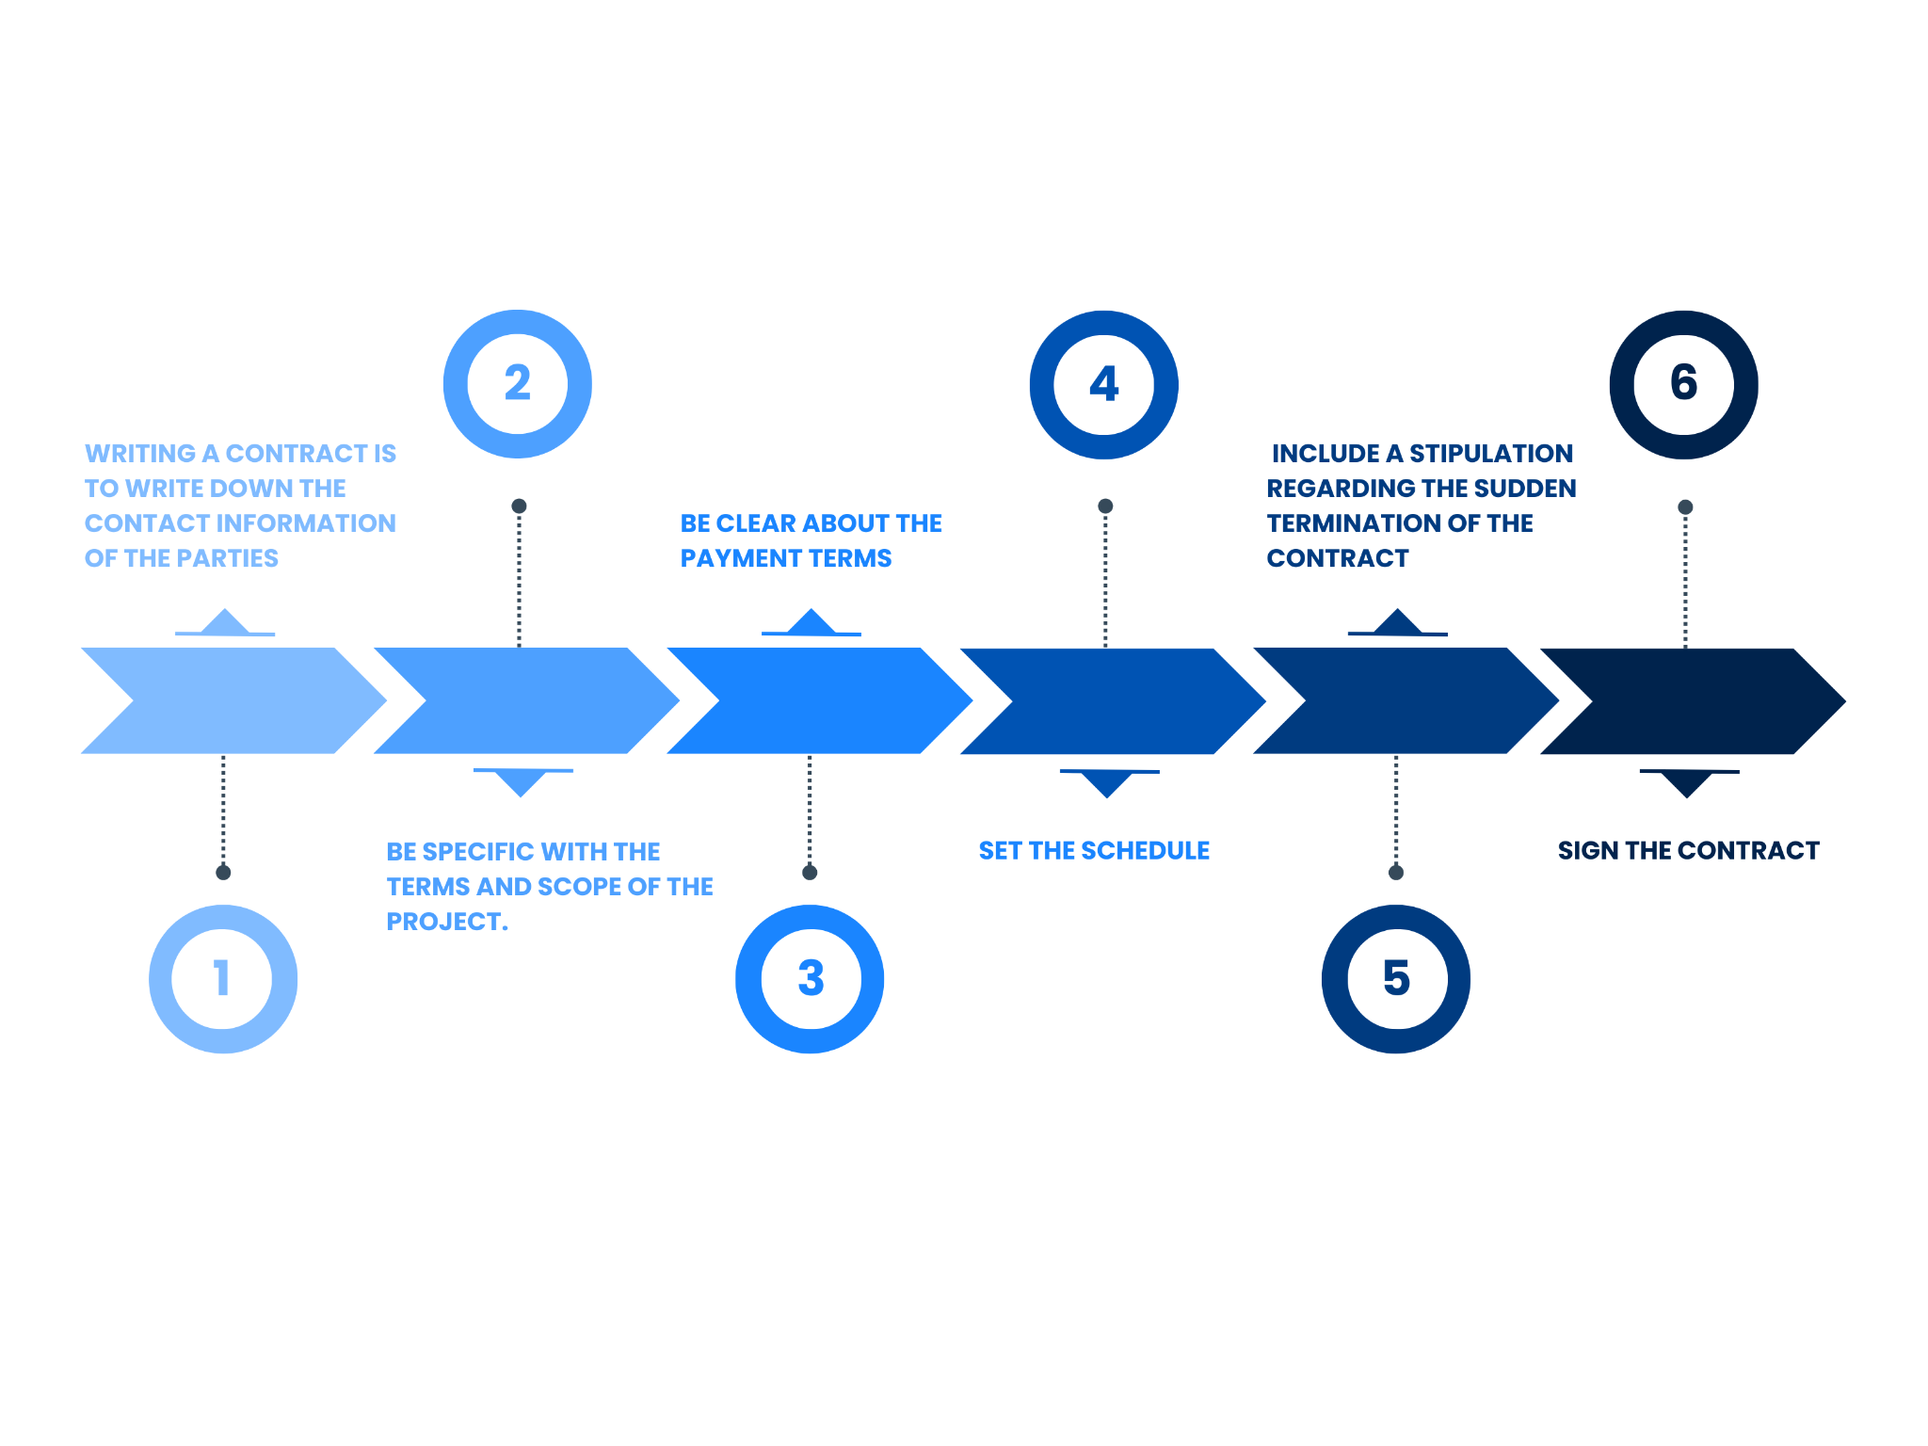


Slide 3
Procurement Contract
Template
[Click here to open
the Template]

Slide 4
It’s a Wrap!
Thank You!

