Slide 1

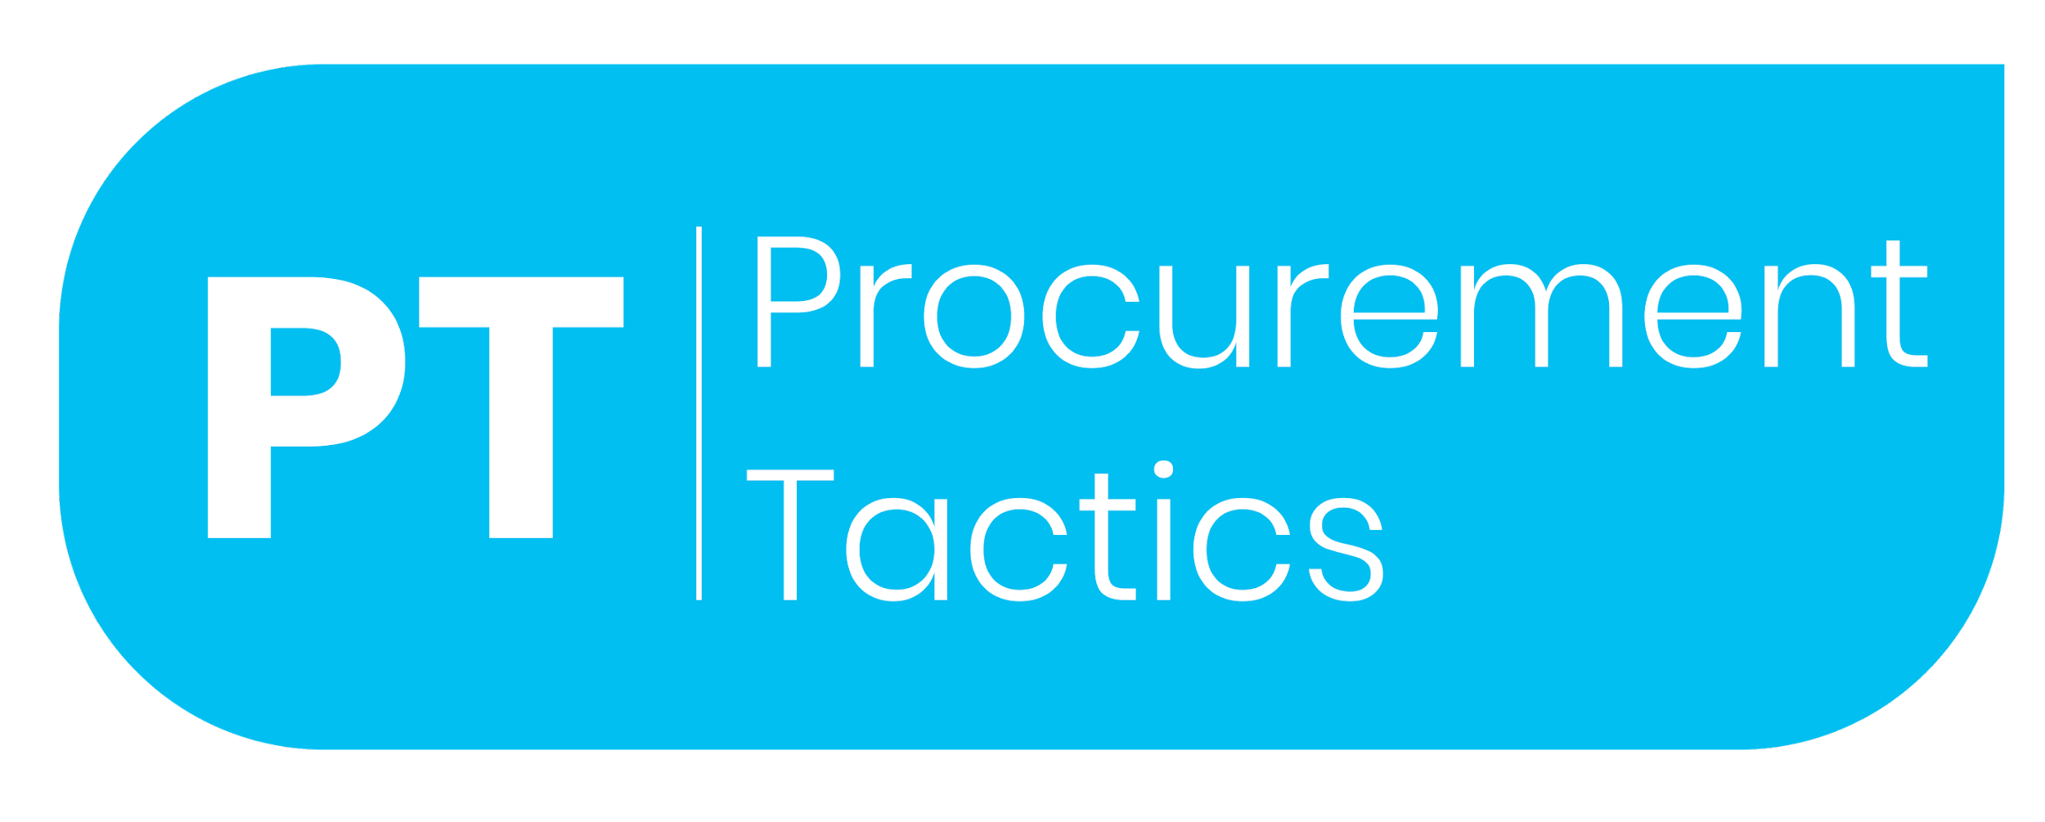
Procurement Strategy Template
Video Tutorial Link: https://youtu.be/Vt9YYocKrUM?si=4atcUX55pUWtcU1y

Slide 2
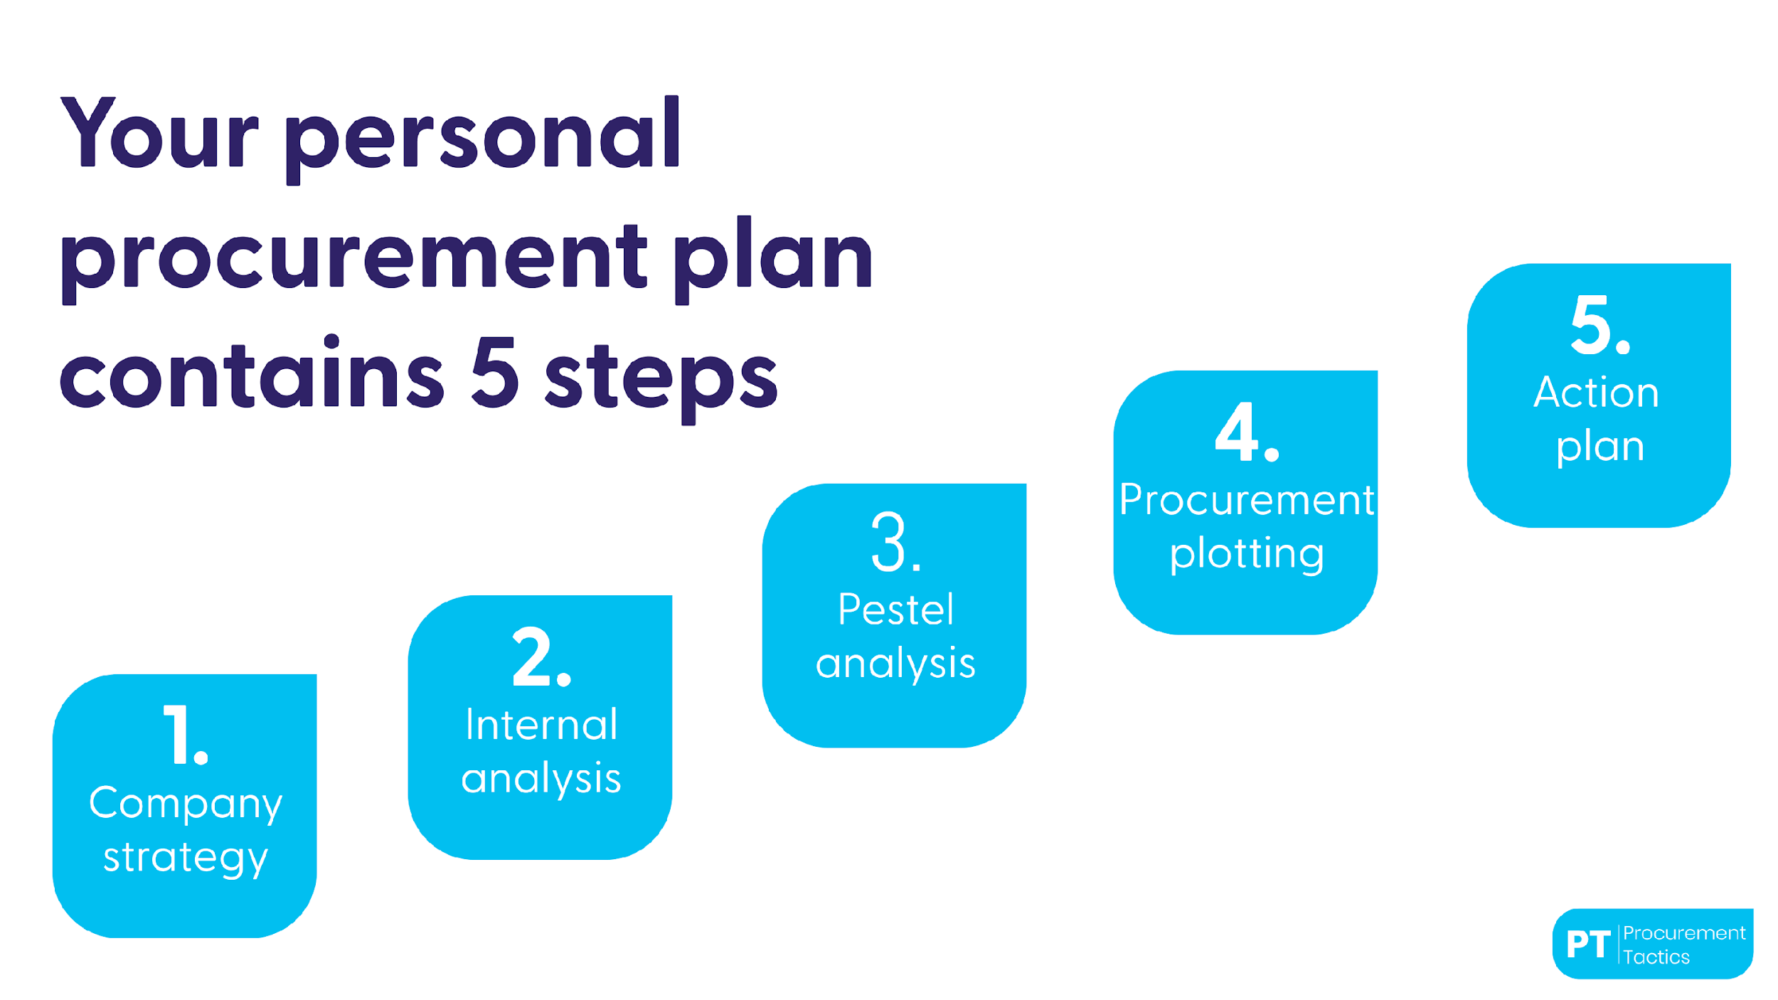

Slide 3
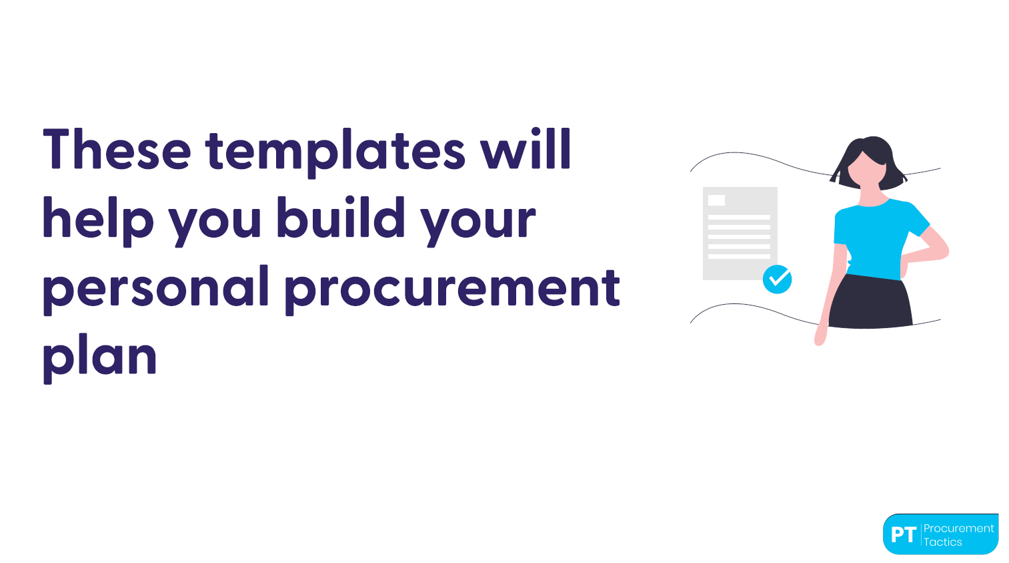

Slide 4
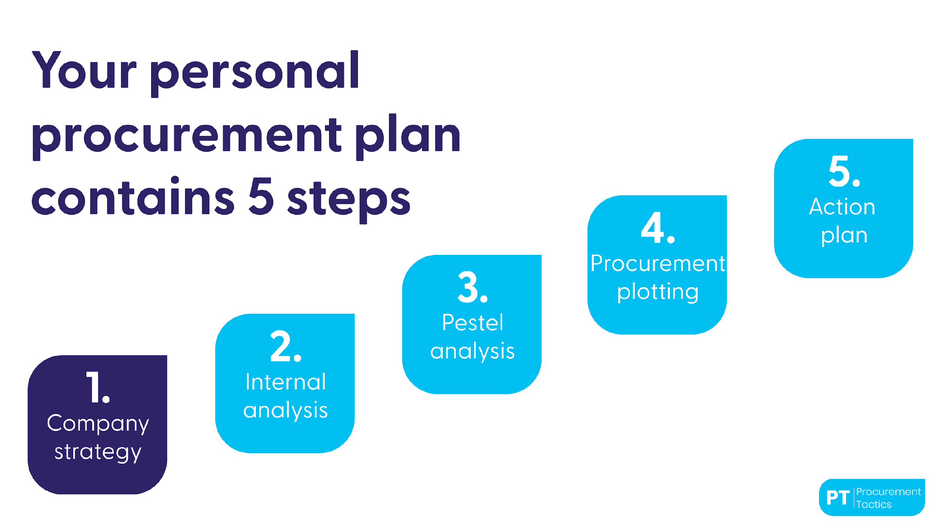

Slide 5
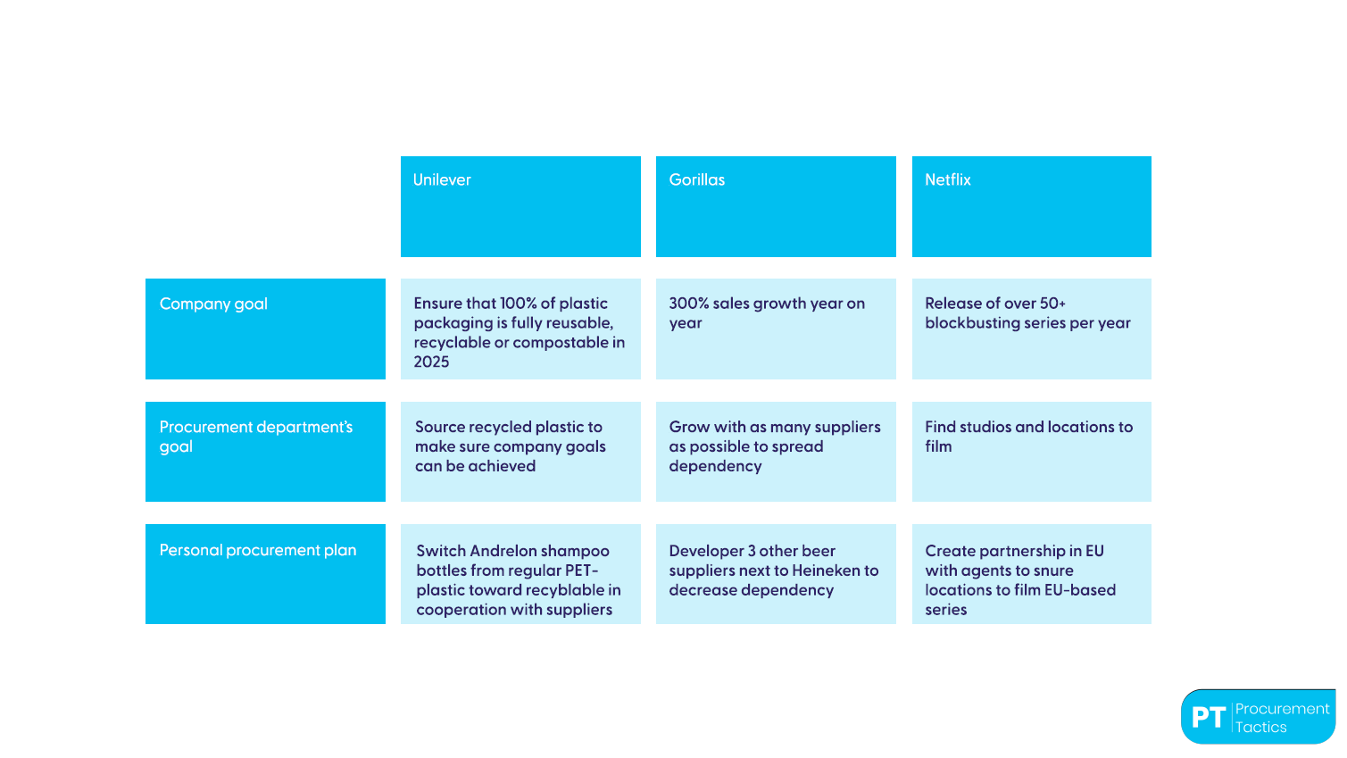
Aligning strategy - example

Slide 6
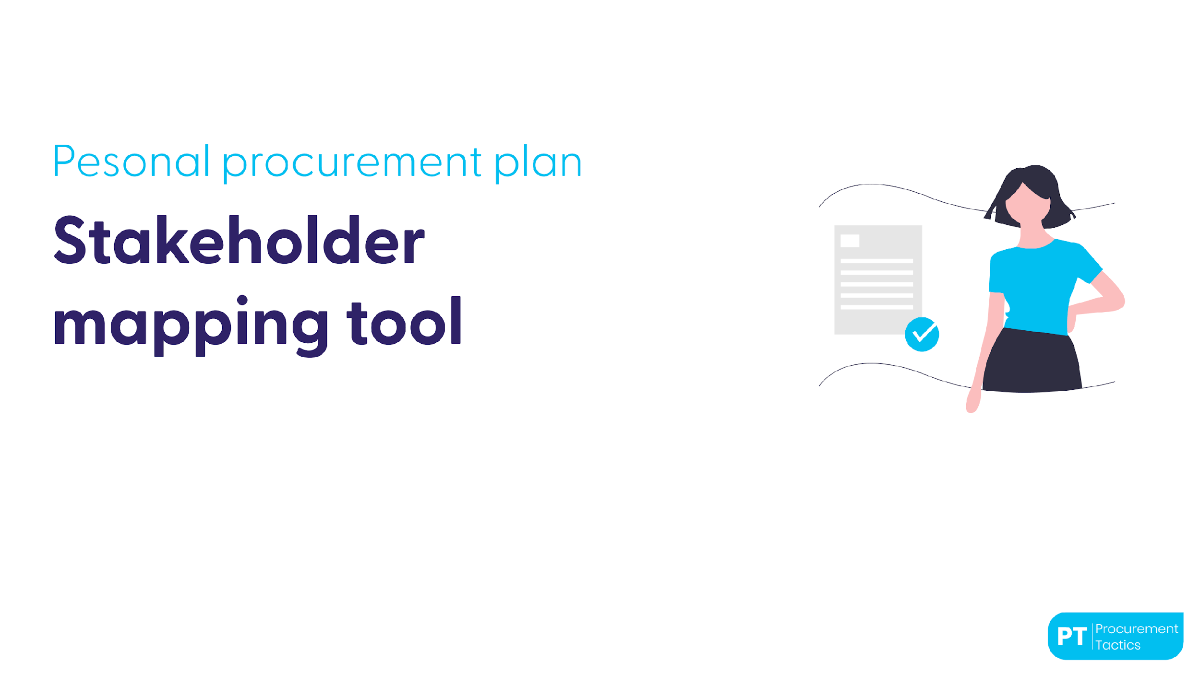

Slide 7
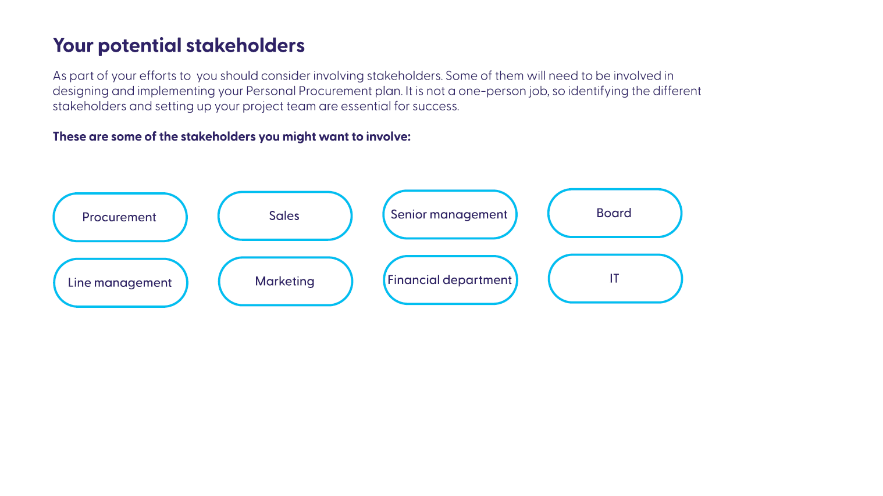

Slide 8
Description
Stakeholders
Role in the process
Stage in the process
Who are the stakeholders that should be involved in designing and implementing your procurement Strategy ?
What is their role in the process?
(Preparation/ Review/ Approval Implementation)
At what stage of the process should they be involved ?
(Prioritization / Design/
Implementation)
Example
Senior management
Review
Senior management : input on company’s strategy
Senior management : approval on focus in action plan

Slide 9
Aligning strategies
Enter your company name
Company goal
Procurement department’s goal
Personal procurement plan

Slide 10
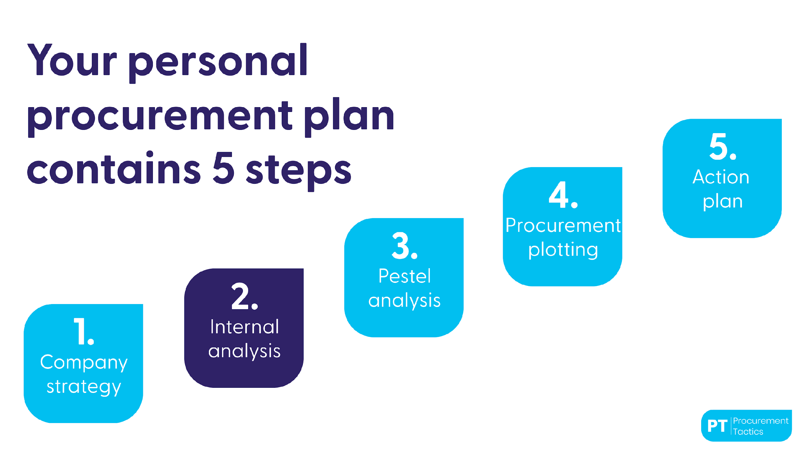

Slide 11
Key figures
(COGS)
Spend under
management
Cost price
breakdown
Number of
suppliers
Payment
terms
Contract
coverage
Supplier
rating
Saving
potential
Note: to determine your groups, ask yourself: what is a logical clustering? For example:
Internal
Analysis
Sourcing group 1
conclusion
Level 1 is products: for example: beer in a can, specialty beer in a bottle, etc Level 2 is product group: Pilsener, lager, saison, tripel, mexican
Level 3 could be Brands, like Heineken, Bud, Corona, Warsteiner Level 4 could be suppliers: Heineken, Ab Inbev, Carlsberg, Duvel
Sourcing group 2
Sourcing group 3
Sourcing group 4
Sourcing group 5

Slide 12
Conclusion
Key figures (COGS)
Spend under management
Value chain analysis
Cost price breakdown
Number of suppliers
Costs savings
Payment terms
Contract coverage
Exchange rate
Supplier rating

Slide 13
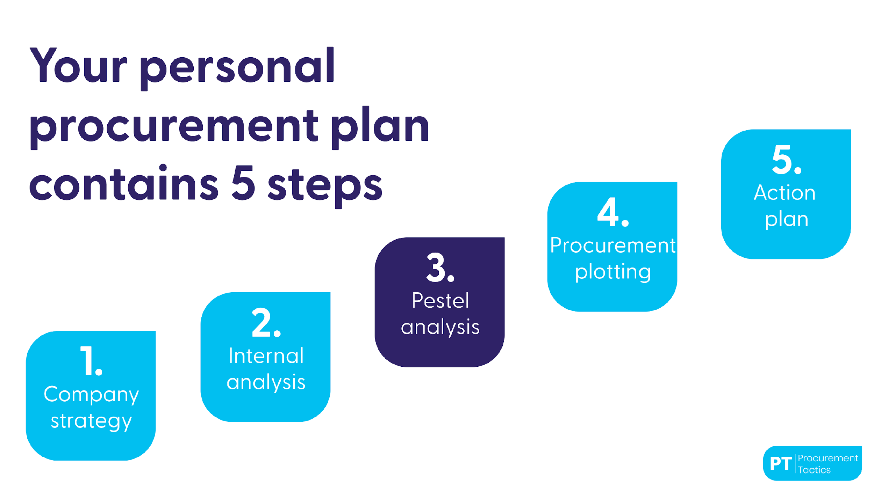

Slide 14
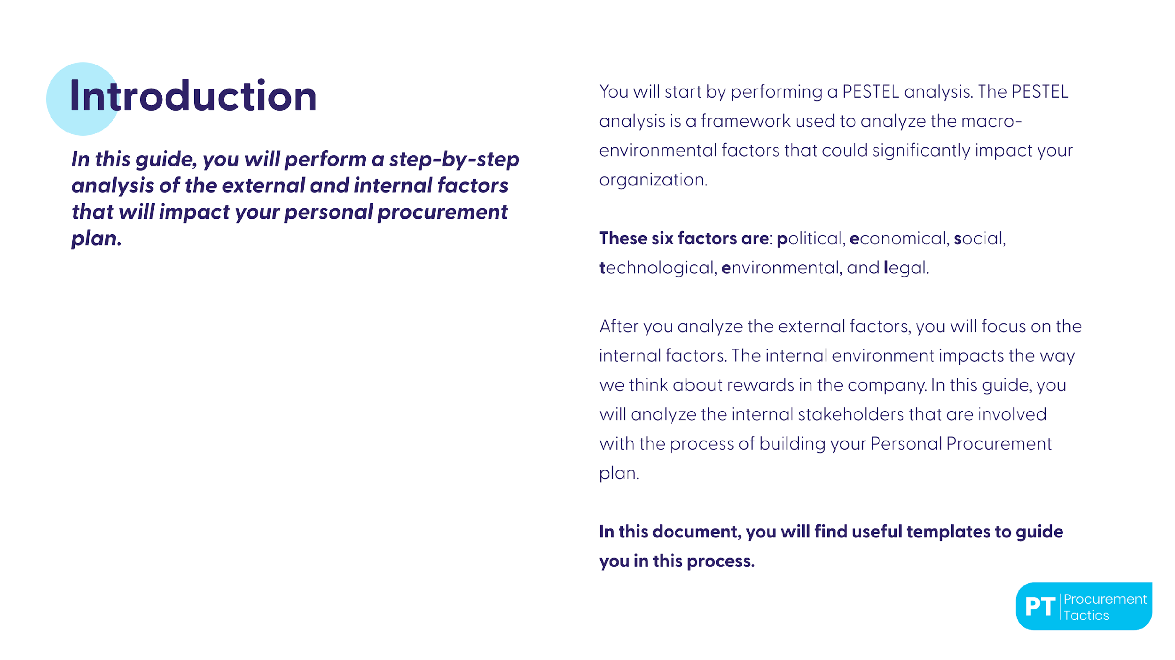

Slide 15
Political factors
These factors are all about how and to what degree a government intervenes in the economy or a certain industry. Basically, all the influences that a government has on your business could be classified here.
This can include government policy, political stability or instability, corruption, foreign trade policy, tax policy, labor law, environmental law, and trade restrictions. You'll want to assess which governmental policies are likely to affect your organization or sector. Is there any political instability to consider? Is there an upcoming change to taxation to take into account?
For example, the VAT was introduced in the Gulf countries three years ago for the first time, and during the transition, many organizations wondered if VAT would increase the inflation in the country and create pressure to increase prices of raw materials, packaging, and services.
Answer these questions below ?
What governmental policies and actions are likely to affect my organization or sector?
What changes are likely in the political priorities of government at regional, national, and European levels?
How are these changes likely to affect the general climate in which my organization operates?
Fill your answers here

Slide 16
Economical factors
Economic factors are determinants of a certain economy's performance. Factors include economic growth, exchange rates, inflation rates, interest rates, disposable income of consumers, and unemployment rates.
These factors may have a direct or indirect long-term impact on a company since it affects the purchasing power of consumers and could possibly change demand/supply models in the economy. In the economic environment, you'll need to look for factors like inflation, exchange rates, and the unemployment rate. One very poignant and current example is in Lebanon, where inflation and devaluation have had a very profound impact on the population and pricing.
This situation has a huge impact on a company's procurement: the capacity to source, sell, and the kind of procurement strategy that they're going to be able to put in place.
Answer these questions below ?
Are there any economic trends or indicators that are favorable towards my organization or sector?
Are there any clouds on the economic horizon that might affect my organization or sector?
How volatile is the national, European, or global economy?
Fill your answers here

Slide 17
Social factors
This dimension of the general environment represents the demographic characteristics, norms, customs, and values of the population within which the organization operates This includes population trends such as the population growth rate, age distribution, income distribution, career attitudes, safety emphasis, health consciousness, lifestyle attitudes, and cultural barriers.
The social environment is all about the way people's attitudes, behavior, trends in particular groups, or demographic changes in key populations might affect your organization or sector. An example of a current trend is the sourcing of local ingredients. COVID-19 changed how we think about food and turned attention to where our food comes from.
Answer these questions below ?
What key influences are affecting peoples attitudes and behavior in ways that might affect my organization or sector?
Are there trends discernible in particular groups that have implications for my organization or sector?
What demographic changes within key populations might have implications for my organization or sector?
Fill your answers here

Slide 18
Technological factors
These factors pertain to innovations in technology that may affect the operations of the industry and the market favorably or unfavorably. This refers to technology incentives, the level of innovation, automation, research and development activity, technological change, and the amount of technological awareness that a market possesses.
Here, you'll need to examine the impact of developments like digitization, automation, artificial intelligence, machine learning, and instant communication. Insights from this element could result in the development of new tools to support supplier overview, better anticipation of which products have a quality risk, and more data-driven decisions around procurement decisions overall.
Answer these questions below ?
What emerging technologies might have implications for my organization or sector?
Which technologies are becoming redundant, the decline of which might pose a threat to my organization or sector?
Will any changing technologies have an impact on political or economic events with implications for my organization or sector?
Fill your answers here

Slide 19
Environmental factors
Environmental factors have come to the forefront only relatively recently. They have become important due to the increasing scarcity of raw materials, pollution targets, and carbon footprint targets set by governments. These factors include ecological and environmental aspects such as weather, climate, environmental offsets, and climate change, which may especially affect industries such as tourism, farming, agriculture, and insurance.
You might think this does not have the largest impact on procurement, but let's look at a 2021 example. Exxon, the oil and gas company, was confronted by an activist who held a minuscule percentage of Exxon shares. The activist claimed Exxon had not worked hard enough to move into a post-oil world and hadn't focused on commitments fighting the impact of climate change, unlike most of its peers in the oil and gas industry. After a very public fight, three new board members that were supported by the activist organization were appointed.
Answer these questions below ?
What are the macro trends influencing your organization?
What are industry specific trends or changes that will impact your organization?
What sustainability trends are influencing your business operations?
Fill your answers here

Slide 20
Legal factors
Although these factors may have some overlap with the political factors, they include more specific laws, such as discrimination laws, antitrust laws, employment laws, consumer protection laws, copyright and patent laws, and health and safety laws.
You will need to look at the legal environment. Obviously, for an HR pro, topics like employment law, health and safety, antitrust regulations, intellectual property, and consumer protection are all going to have an impact on your business activities. For example, a lot of people who lost their jobs in the first wave of COVID-19 still do not want to go back to work in the poor pre-COVID conditions, especially in industries like retail, food and beverage, hospitality, and leisure.
Answer these questions below ?
What regulatory frameworks do you need to be aware of in your industry?
What are major legal risks you need to mitigate against?
What compliance controls do you need to have in place?
Are there any statutory reporting requirements?
Fill your answers here

Slide 21
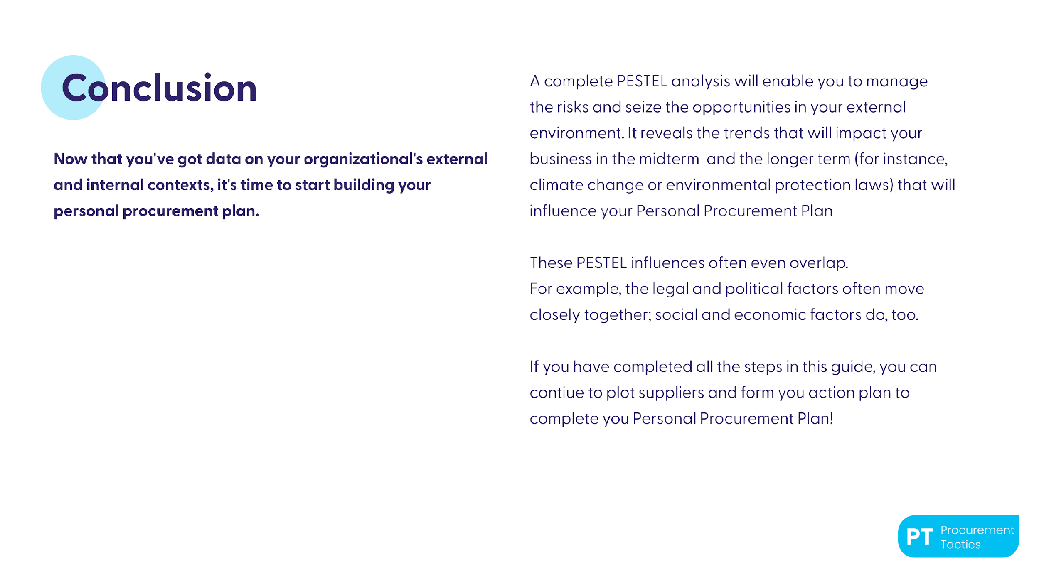

Slide 22
Pestel Analysis
Political
Economical
Social
Technological
Environmental
Legal
Sourcing group 1
conclusion
Sourcing group 2
Sourcing group 3
Sourcing group 4
Sourcing group 5

Slide 23
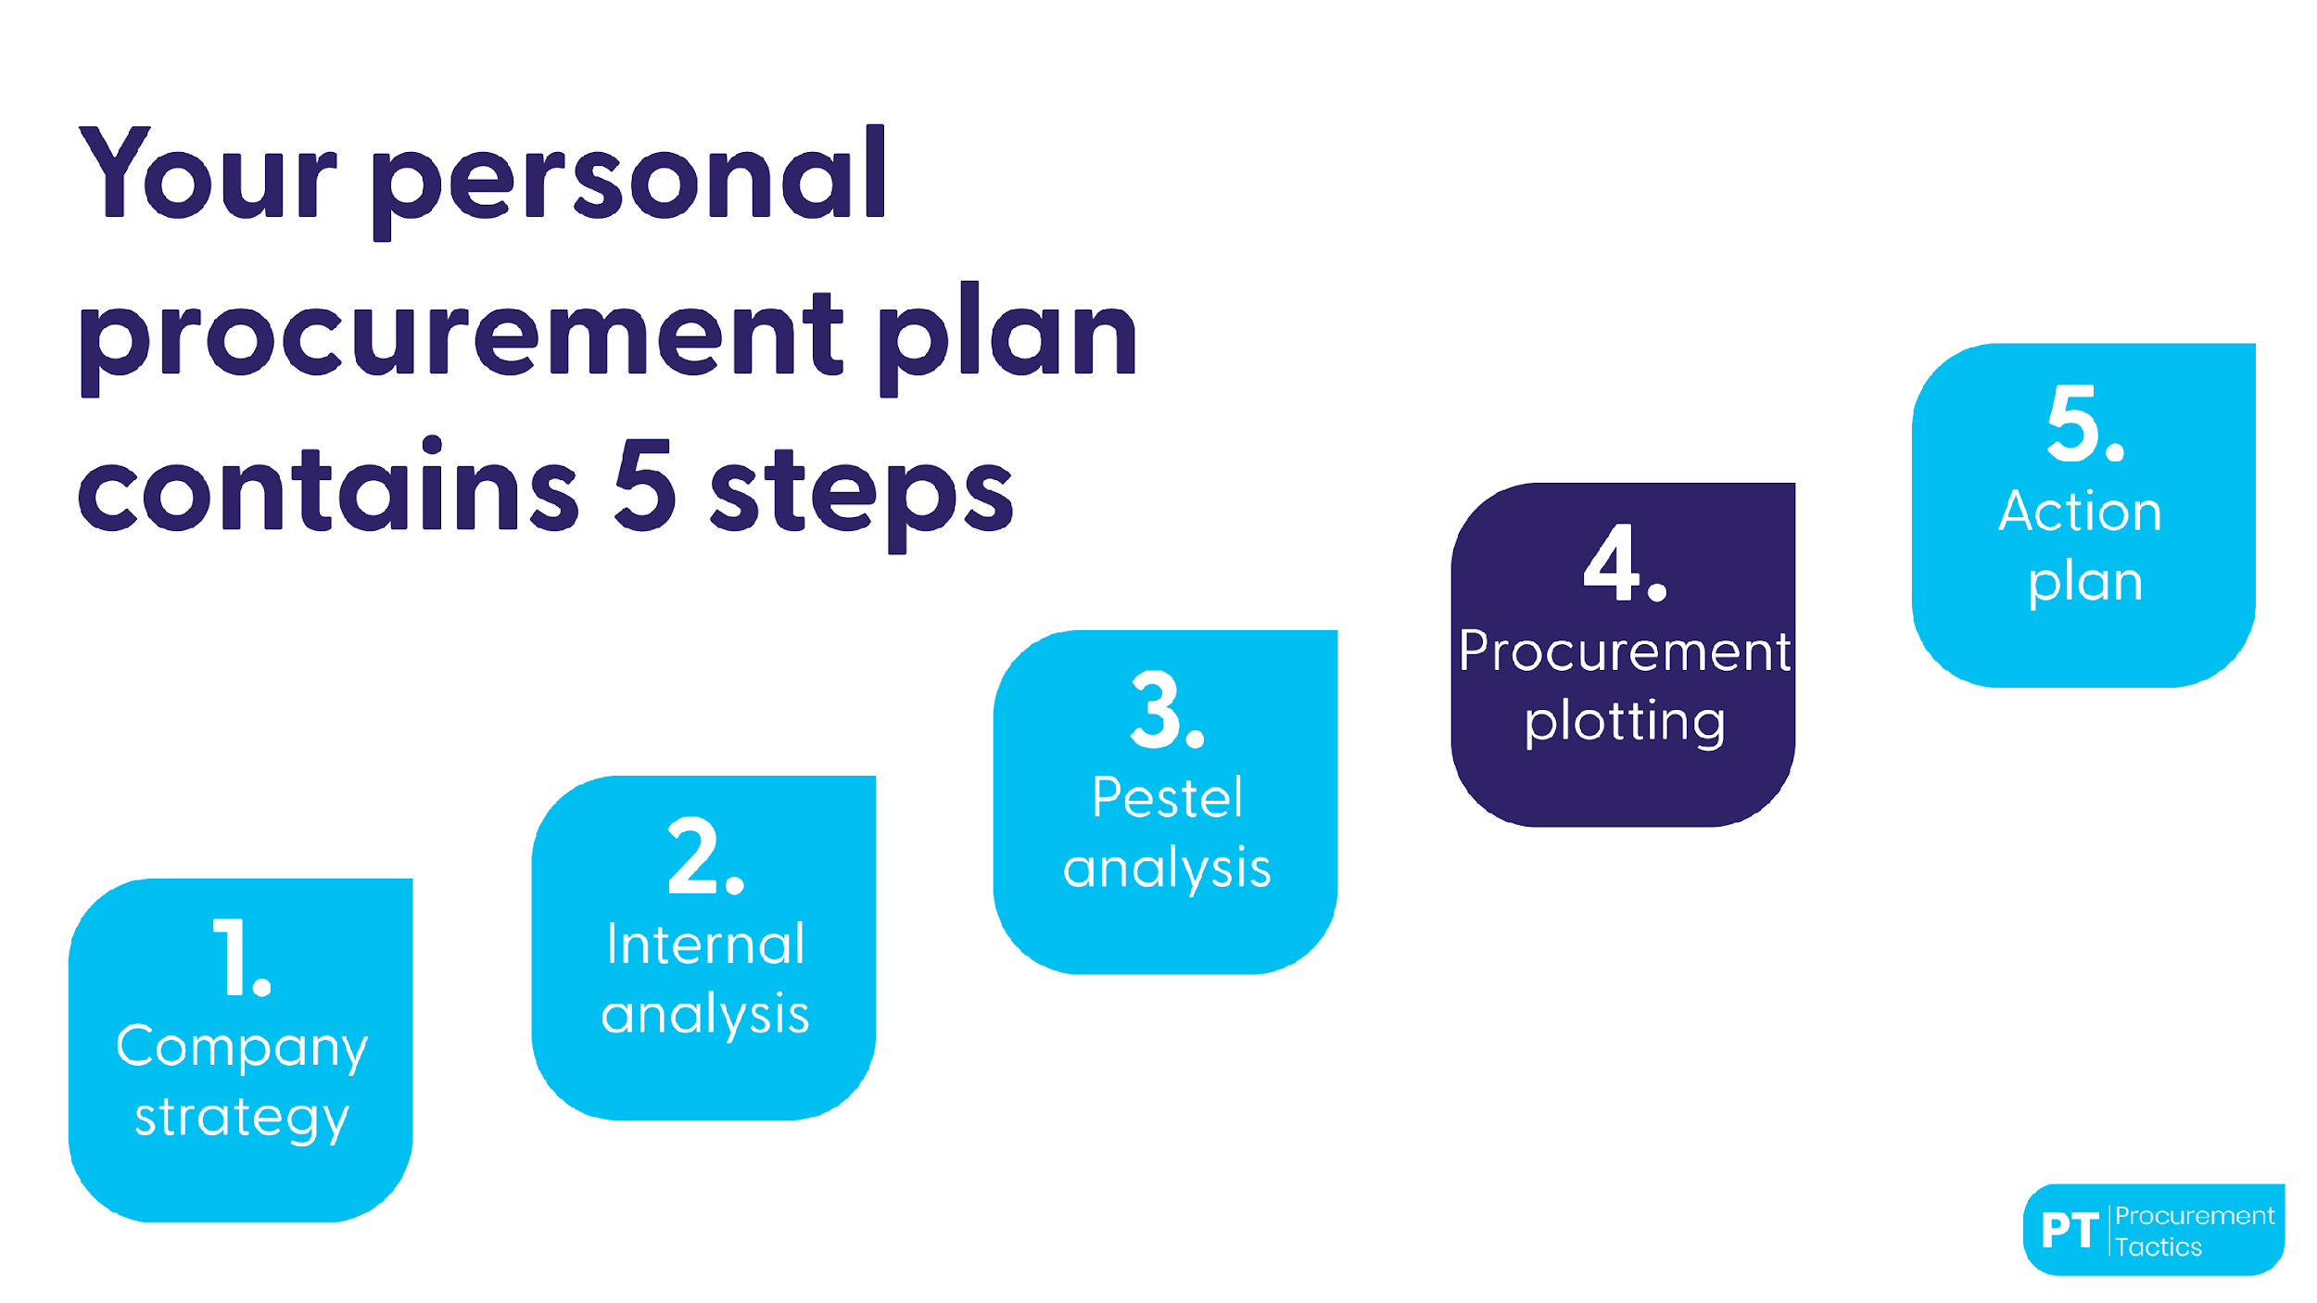

Slide 24
Plotting suppliers: current situation
High
Leverage
Strategic
Profit impact
Non - critical
Bottleneck
Low
Low
Risk / Complexity
High

Slide 25
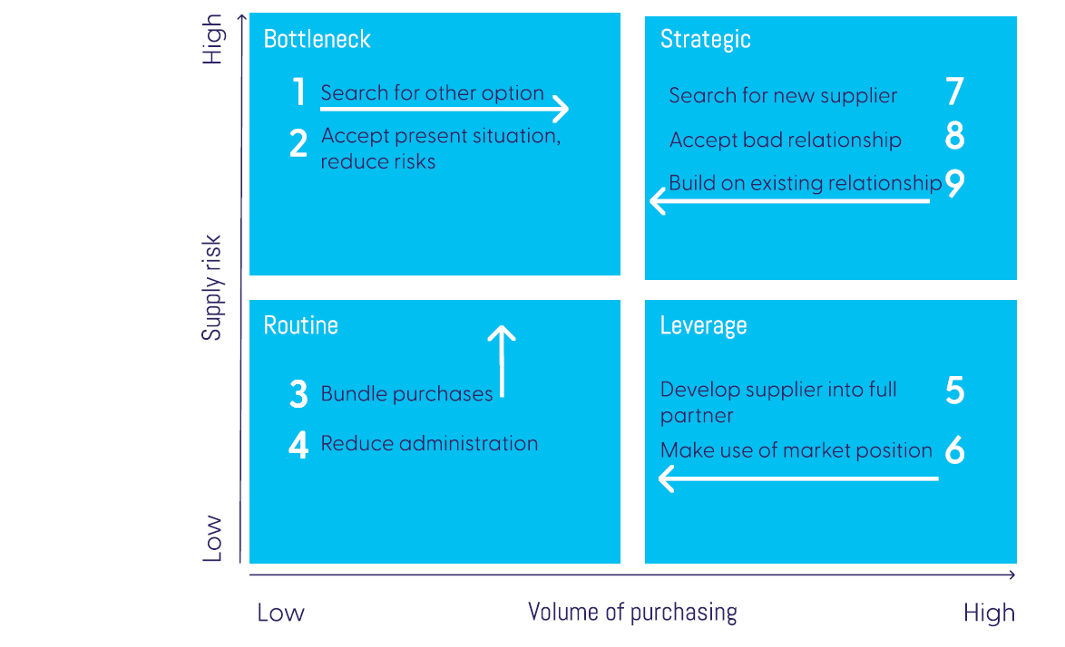
Plotting suppliers: desired outcome

Slide 26
Plotting suppliers: desired outcome
High
Leverage
Strategic
C
D
Profit impact
Non - critical
Bottleneck
B
A
Low
Low
Risk / Complexity
High

Slide 27
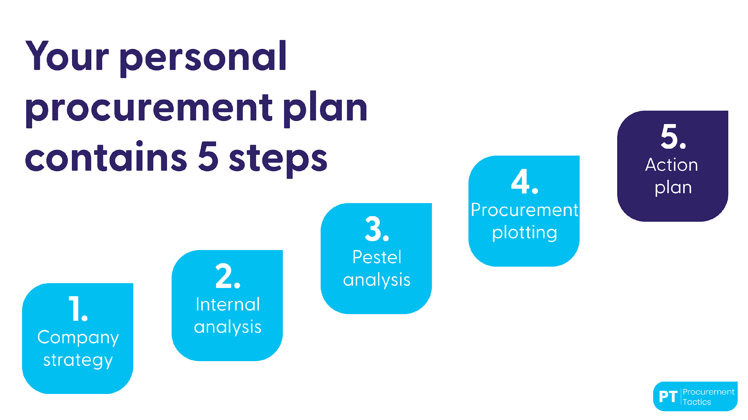

Slide 28


Procurement Strategy -Action plan for buying groups
Note: you could copy this slide if you want to form an action plan for more than 2 groups
Conclusion
Action
Deadline
Saving
Potential
Tactic 1
Tactic 2
Tactic 3
Tactic 4
Tactic 1
Tactic 2
Tactic 3
Tactic 4

