Slide 1

Pre-RFI and Request For Information (RFI) Template
Video Tutorial Link: https://youtu.be/Pi4P466SJ50?si=Jgqtv8QfG8HWt86a

Slide 2
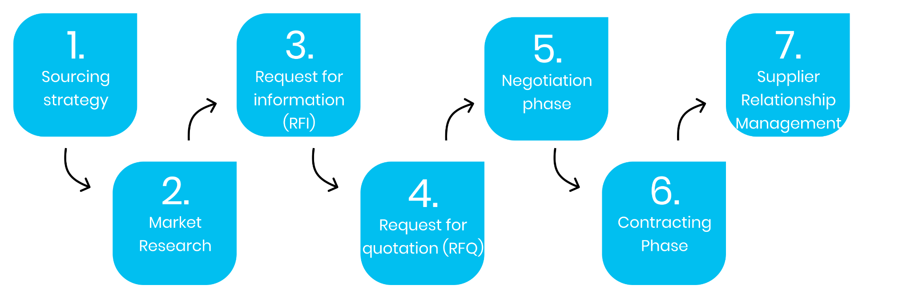
SOURCING PROCESS - INFOGRAPHIC
Specifying Your Needs
Supplier Selection Phase

Slide 3
Pre-RFI and Request For Information (RFI) Template

Slide 4
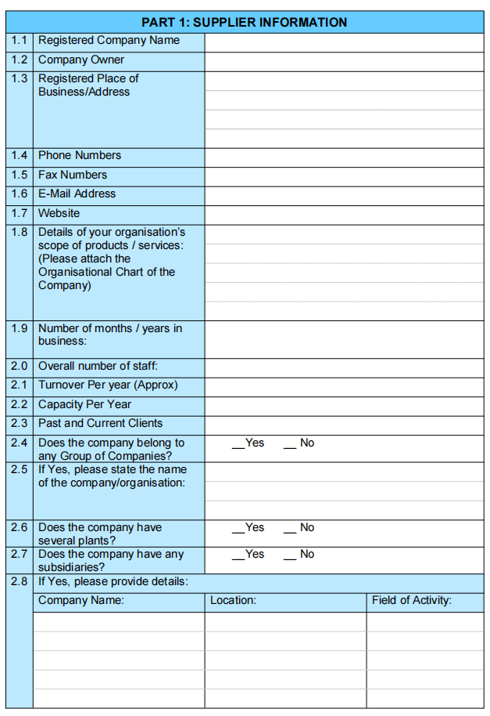
PRE-RFI TEMPLATE 1

Slide 5
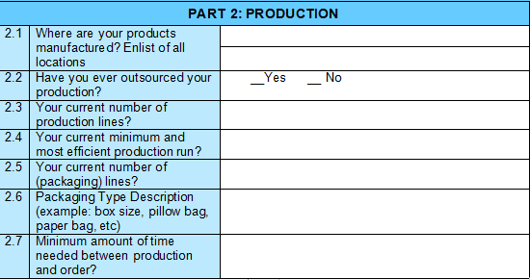
PRE-RFI TEMPLATE 2

Slide 6
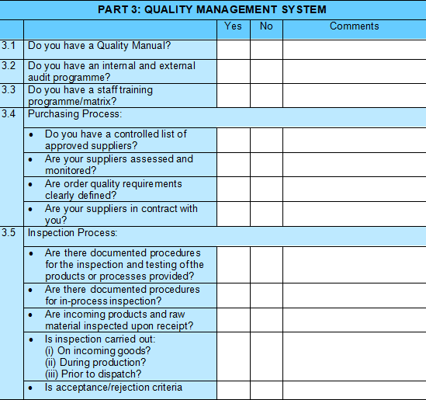
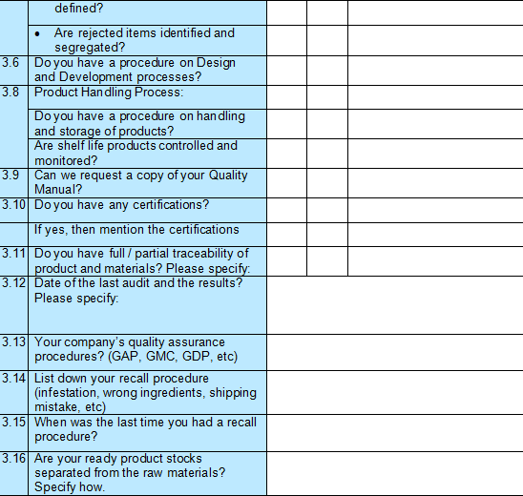
PRE-RFI TEMPLATE 3

Slide 7
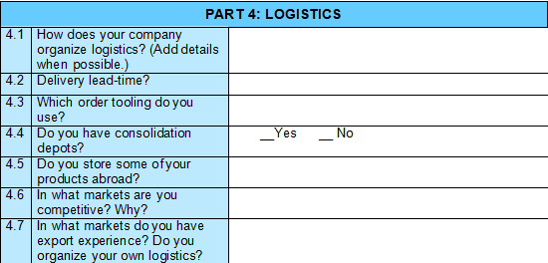
PRE-RFI TEMPLATE 4

Slide 8
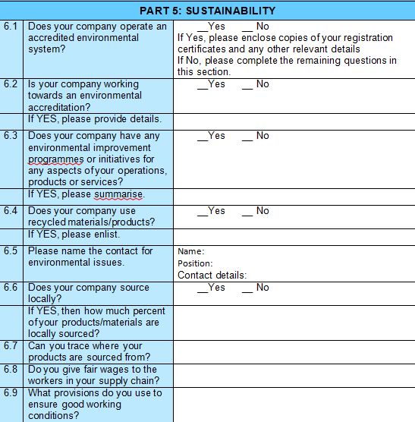
PRE-RFI TEMPLATE 5

Slide 9
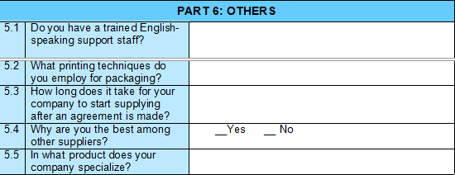
PRE-RFI TEMPLATE 6

Slide 10
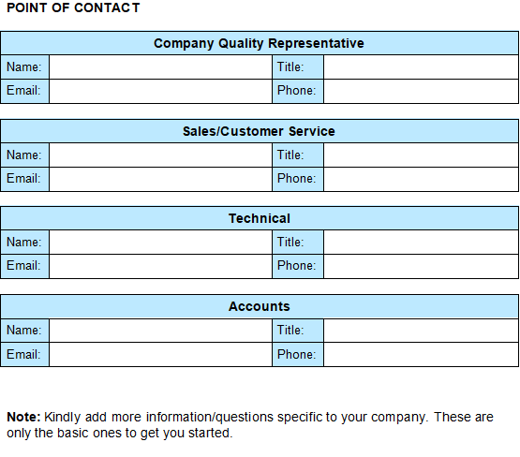
PRE-RFI TEMPLATE 7

Slide 11
REQUEST FOR INFORMATION (RFI) TEMPLATE
REQUEST FOR INFORMATION (RFI)
RFI #:
DATE:
NEED BY:
PROJECT:
PROJECT #:
SUBMITTED TO: [Name/Title Company]
SUBMITTED BY: [Name/Title Company]
RFI DESCRIPTION
ATTACHMENTS:
SUBMITTED BY: [Name/Title Company]
RESPONSE TO RFI (to be filled in by supplier)
RESPONSE BY: [Name/Title Company] | DATE:

