Slide 1
Sourcing Calendar
Template
Video Tutorial Link: https://youtu.be/XzDIC_-PhOY?si=dGmZ7hq4EpxaVuk1

Slide 2
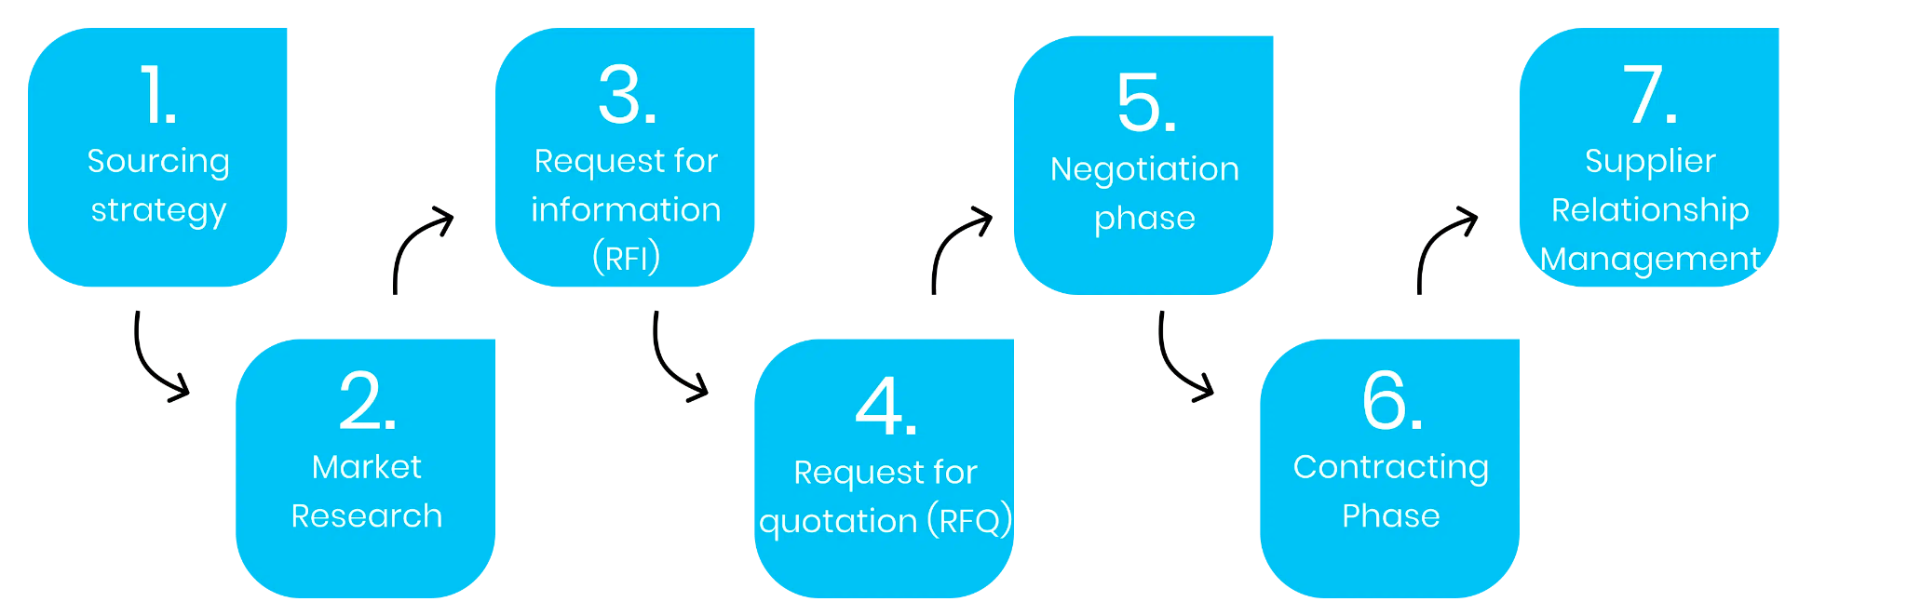

When it comes to the ideal Procurement & Sourcing Process…

Slide 3
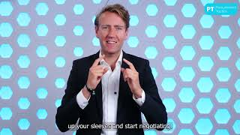
Make sure to watch this video first:

Slide 4
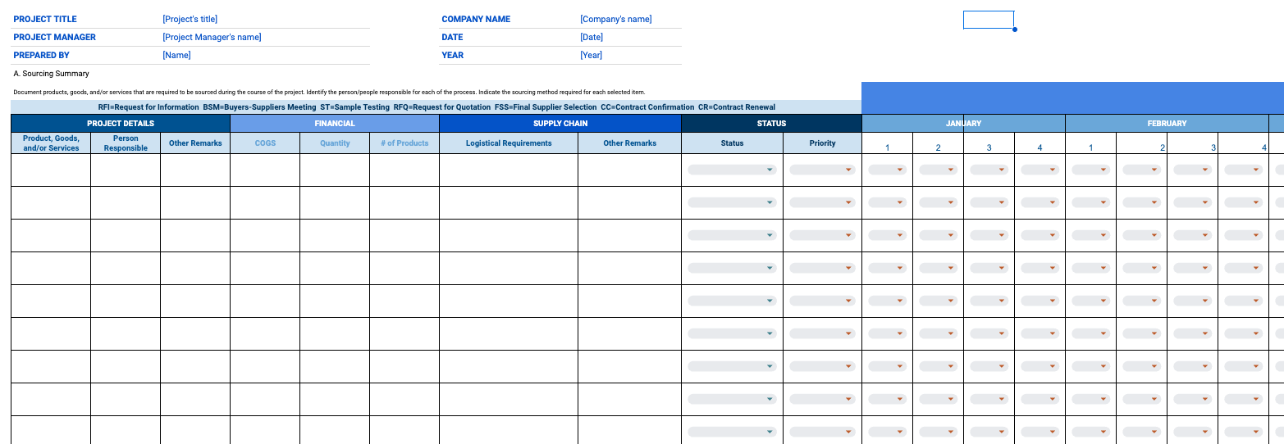
Now, let’s go to the template

