Slide 1


Spend Analysis Template
Video Tutorial Link: https://youtu.be/iapr2wEIDxg?si=1I5Lqkhqdk9iu6d0

Slide 2

Let me introduce myself

Slide 3
Spend analysis

Slide 4
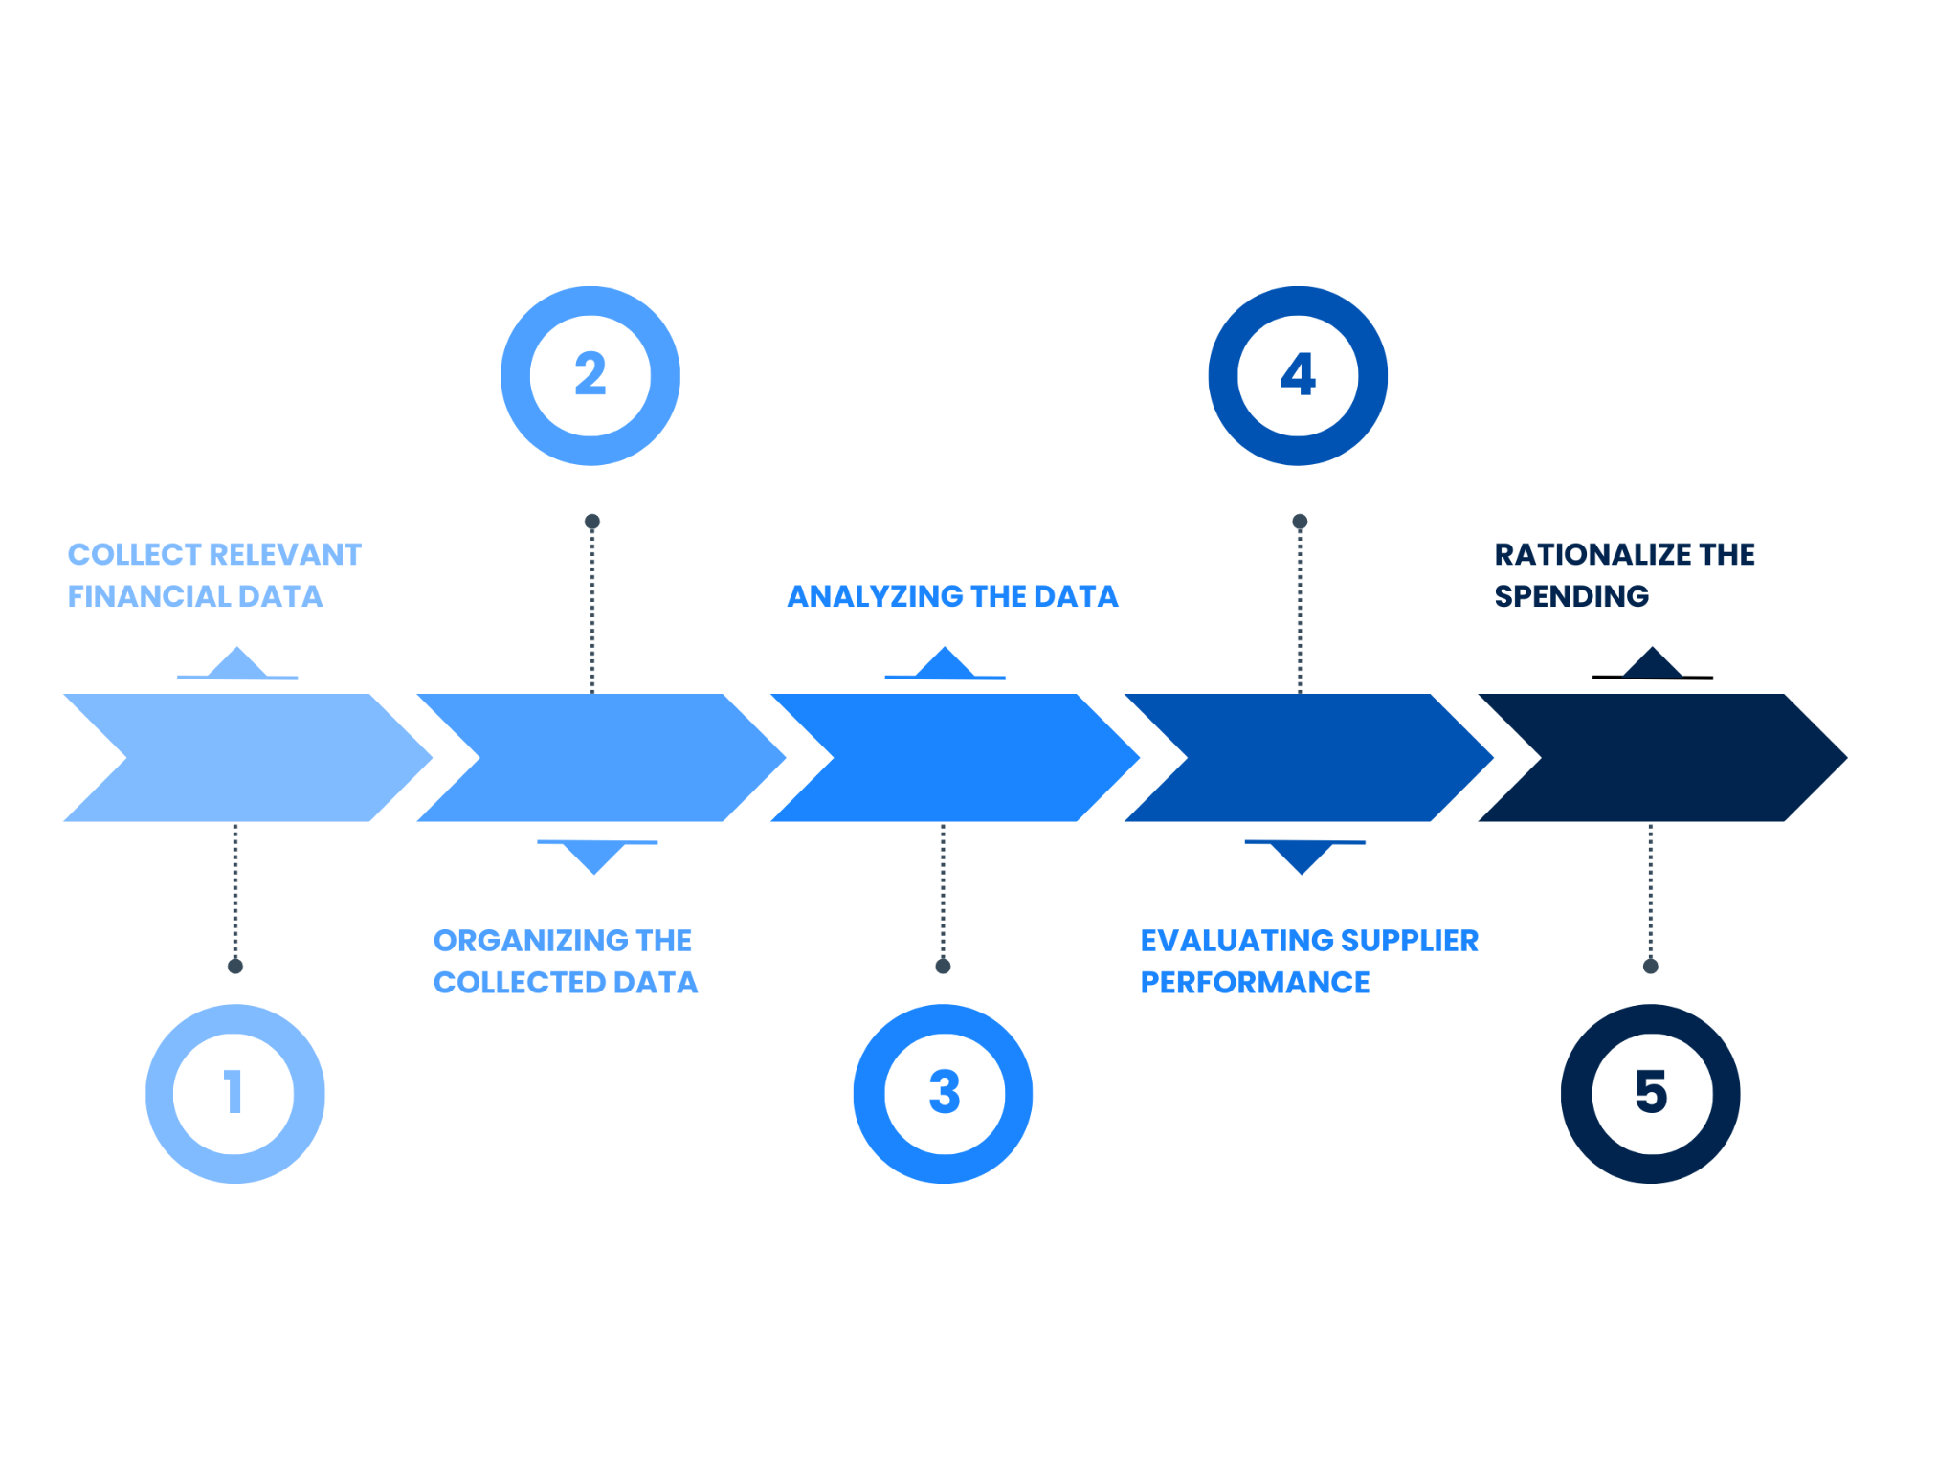

Slide 5
Procurement data management
Cost saving solutions
Gathering financial data
Metrics
Data analytics
Validate data
Metrics and benchmarks
Data clean up
Data classification

Slide 6
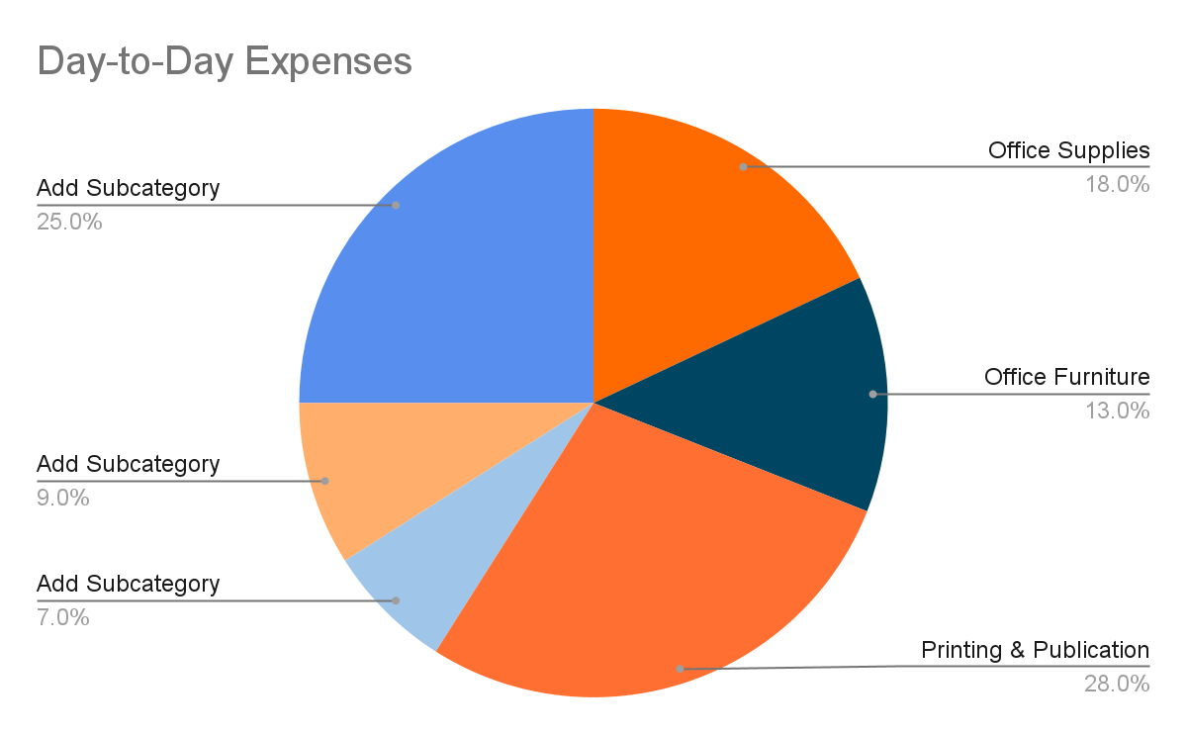
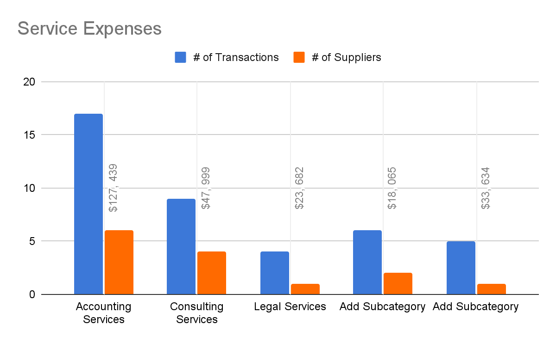
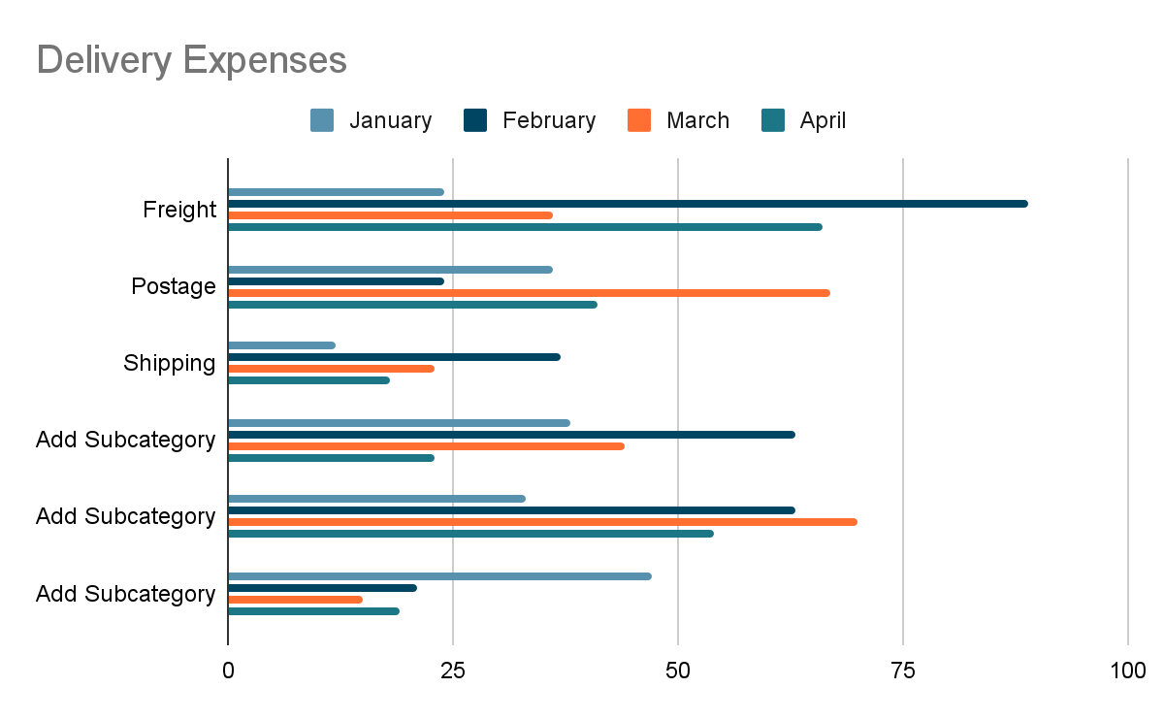
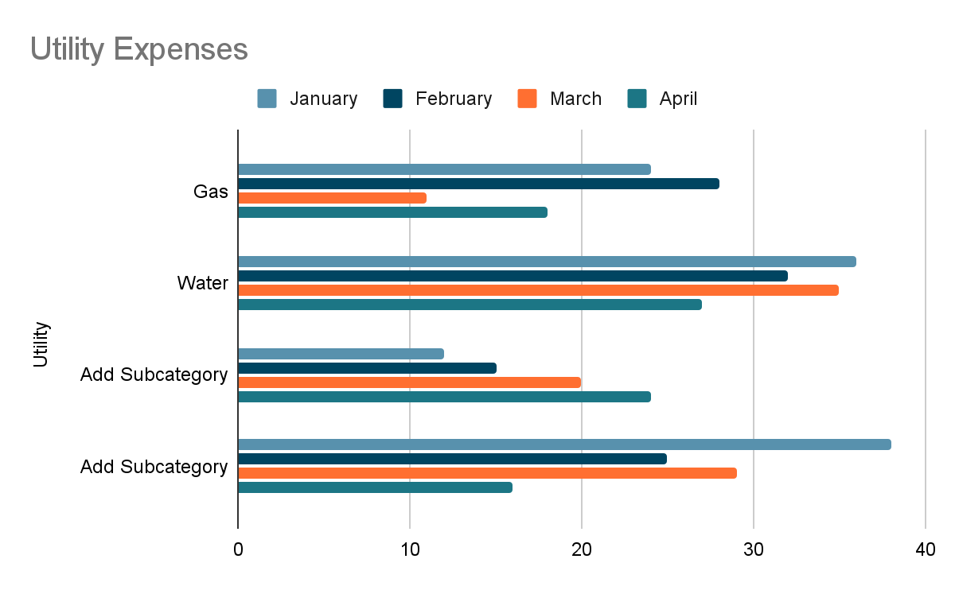
Spend Analysis Template
This slide presents the spend analysis dashboard according to categories.
Total Expenses
$157, 568
Suppliers
47
Transactions
74
Total PO
$436, 357
This graph/chart is linked to Google Sheets. This will be automatically updated based on data changes made.

Slide 7
It’s a Wrap!
Thank You!

