Slide 1
Supplier Deal Comparison
Template
Video Tutorial Link: https://youtu.be/rrlYck-Fero?si=eQFbmOZM5o_og3IE

Slide 2

1:How to determine power balance with current suppliers
Knowledge
Importance of the deal to each party
The more you know about the negotiation issues, objectives, priorities, and the parties involved, the greater your power.
Analyze the interdependency between you and your suppliers easily.
Power Balance and Current Suppliers
Quality of the skills of your negotiation counterpart
Time Constraints
Time constraints become a variable of power within your negotiation when the constraint appears to affect your supplier more than you.
Some companies have people that specialize in negotiation, others don’t.
Competition
The availability or lack of competition may give one negotiation side the upper hand.

Slide 3
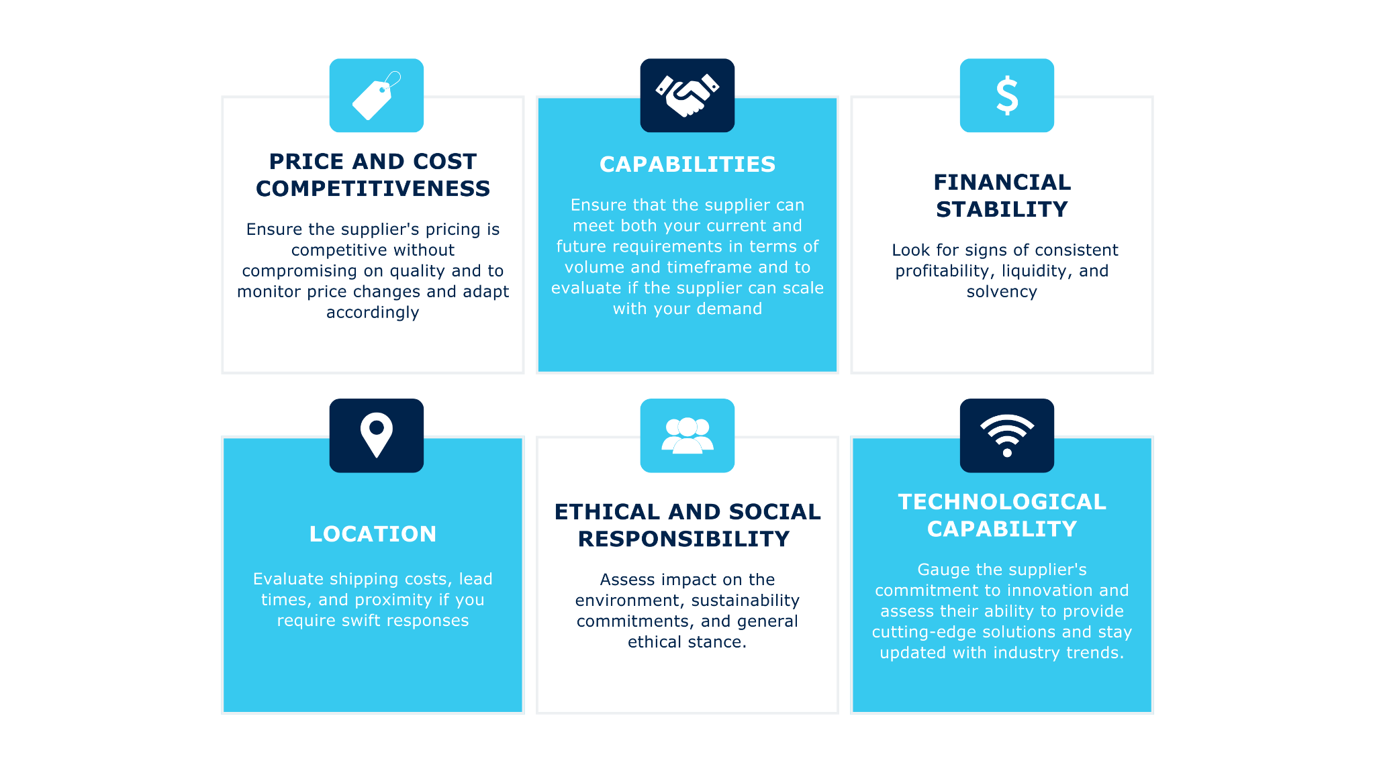
1:visual factors how to compare suppliers

Slide 4
New deal:
Supplier Deal Comparison
Template

Slide 5
1: Comparing proposals for new products/services
 | Supplier 1 | Supplier 2 | Supplier 3 | Winner
Price | Best/Medium/Worst | Best/Medium/Worst | Best/Medium/Worst
Quality | Best/Medium/Worst | Best/Medium/Worst | Best/Medium/Worst
Service | Best/Medium/Worst | Best/Medium/Worst | Best/Medium/Worst
Convenience | Best/Medium/Worst | Best/Medium/Worst | Best/Medium/Worst
Sustainable focus | Best/Medium/Worst | Best/Medium/Worst | Best/Medium/Worst
Risk | Best/Medium/Worst | Best/Medium/Worst | Best/Medium/Worst
Variable x | Best/Medium/Worst | Best/Medium/Worst | Best/Medium/Worst
Variable x | Best/Medium/Worst | Best/Medium/Worst | Best/Medium/Worst

Slide 6
Existing deal:
Supplier Deal Comparison
Template

Slide 7
2: Supplier deal Comparison Template (1/2)
 | Supplier 1 | Supplier 2 | Supplier 3 | Supplier 4 | Supplier 5
Supplier share in your revenue
Total Revenue full year
Growth in % vs last year
Total spend full year
Growth in % vs LY
Volume full year
Growth in % vs LY
Margin in $ full year
Growth in $ vs last year
Payment terms in days
Payment discount %

Slide 8
2: Supplier deal Comparison Template (2/2)
 | Supplier 1 | Supplier 2 | Supplier 3 | Supplier 4 | Supplier 5
Growth bonus included? How?
Purchase volume rebate? How
Sustainability Focus
Account Management
Marketing support
# Quality complaints customers LY
Other variable
Other variable
Other variable

Slide 9
If you rather work on Excel, let’s go to the template there….

Slide 10
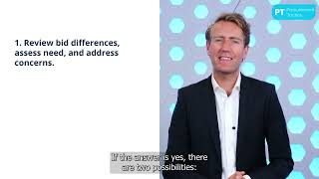
If you want to learn more on (new) supplier comparison, Make sure to watch this video:

