Slide 1

Sustainable Procurement Policy Template
Video Tutorial Link: https://youtu.be/DxVuAi2a9fM?si=LHHNMp6liFTALEAK

Slide 2

Let me introduce myself

Slide 3


Sustainable Procurement Policy

Slide 4
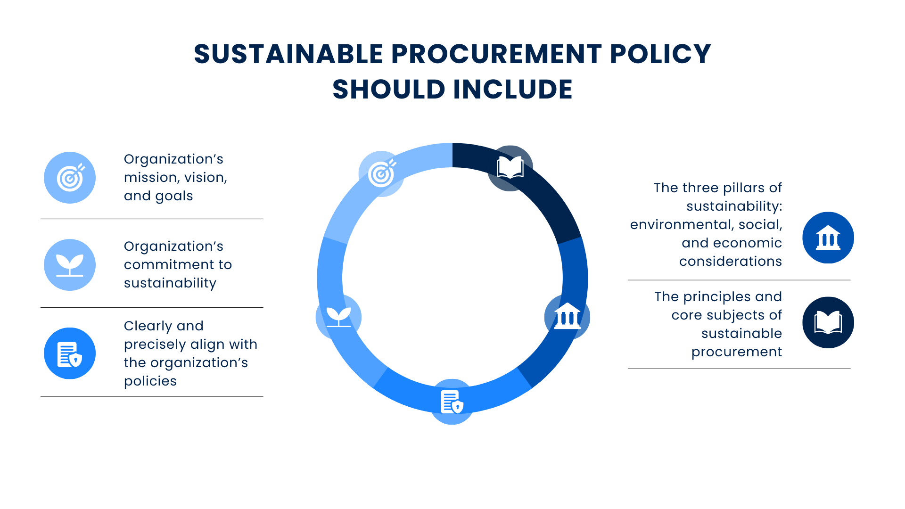
Notes:
Short – how i prp

Slide 5
Sustainable Procurement Policy Template - Setting Goals
Sustainability issue identified | Opportunity to influence markets (high/medium/low) | Scope to improve (high/ medium/low) | Priority | Sustainability goal
e.g. Energy use | Medium | High | High | Reduce energy consumption during use
e.g. Toxic waste | Medium | Medium | High | Decrease content of identified toxic substances within product
Notes:
Short – how i prp

Slide 6
Sustainable Procurement Policy Template - Setting Targets
Sustainability goal | Procurement target (how can the goal be achieved?)
Reduce energy consumption during product use | Specify energy efficiency criteria endorsed by the Government (e.g. Energy Star) Ask supplier to provide proposals to improve energy efficiency Require supplier to factor energy usage and cost into award decision
Decrease content of identified toxic substances within product | Require suppliers to provide evidence of programs aimed at eliminating the use of identified hazardous substances, as well as evidence of progress against these programs
Notes:
Short – how i prp

Slide 7
Sustainable Procurement Policy Template - Setting Goals
Sustainability issue identified | Opportunity to influence markets (high/medium/low) | Scope to improve (high/ medium/low) | Priority | Sustainability goal
Fill in yourself | Fill in yourself | Fill in yourself | Fill in yourself | Fill in yourself
Fill in yourself | Fill in yourself | Fill in yourself | Fill in yourself | Fill in yourself
Fill in yourself | Fill in yourself | Fill in yourself | Fill in yourself | Fill in yourself
Fill in yourself | Fill in yourself | Fill in yourself | Fill in yourself | Fill in yourself
Notes:
Short – how i prp

Slide 8
Sustainable Procurement Policy Template - Setting Targets
Sustainability goal | Procurement target (how can the goal be achieved?)
Fill in yourself | Fill in yourself
Fill in yourself | Fill in yourself
Fill in yourself | Fill in yourself
Fill in yourself | Fill in yourself
Fill in yourself | Fill in yourself
Fill in yourself | Fill in yourself
Fill in yourself | Fill in yourself
Notes:
Short – how i prp

Slide 9
It’s a Wrap!
Thank You!

